Slide 1
Environmental Health:
Preventing Exposure to Hazardous Substances
Presenter’s Name
Presenter’s Title
Title of Event
Date of Event
Agency for Toxic Substances and Disease Registry
Division of Health Assessment and Consultation

Slide 2
What is environmental health?
Environmental health focuses on the relationship between the environment and human health.

Slide 3
What is environmental health?
Environmental health focuses on the relationship between the environment and human health.
The Agency for Toxic Substances and Disease Registry (ATSDR) protects human health from the effects of contaminants and hazardous substances found in the environment.

Slide 4
Why is this important to you?
Having knowledge about environmental health will allow you to
Protect you and your family from hazards in your environment
Better understand the results of ATSDR’s investigations
Know what questions to ask the U.S. EPA, ATSDR, and other public health officials

Slide 5
What is a contaminant
A substance that may be harmful to human health or the environment
Other terms:
Hazardous substances
Pollution
Toxic substances
We will also be discussing exposure to chemicals. Many chemicals can be hazardous substances.

Slide 6
What is exposure?
An exposure occurs when a contaminant enters your body through
Breathing
Touching
Eating or drinking
Remember, before a contaminant can harm you, it has to enter your body.
Notes:
We should also note that if there is radioactive contamination, just being near the contamination could put you at risk of exposure.

Slide 7
Not all exposures cause harmful effects
Your general health plays a big role in how much you can be affected by being exposed to a contaminant
Other factors include
the type of chemical you were exposed to,
the amount of a chemical you were exposed to,
how long the contact lasted,
how often you came into contact with a chemical, and
how the chemical entered your body.

Slide 8
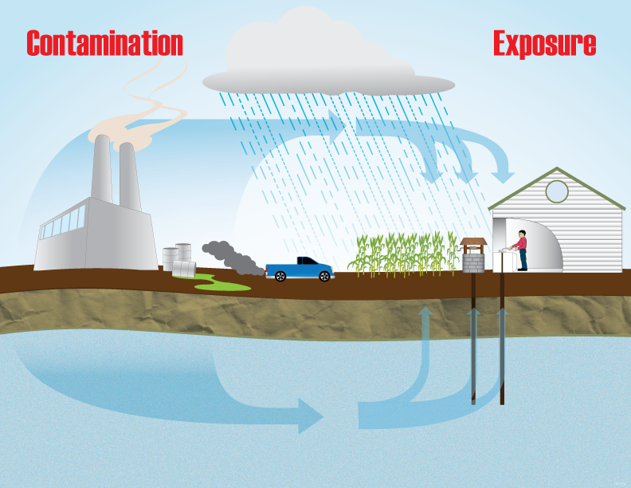
Source of contamination
Contamination travels via air, food, water, or soil
Contamination enters the body by touching, eating, drinking, or breathing it in
Person comes into contact with contamination
Notes:
Many things must take place for a person to be exposed to a contaminant.
When each (be sure to state that they ALL have to be present) of these steps occurs, we sometimes refer to the step as a “completed pathway”

Slide 9
Where is contamination in the Environment?
Air, Water, Soil, and Food

Slide 10
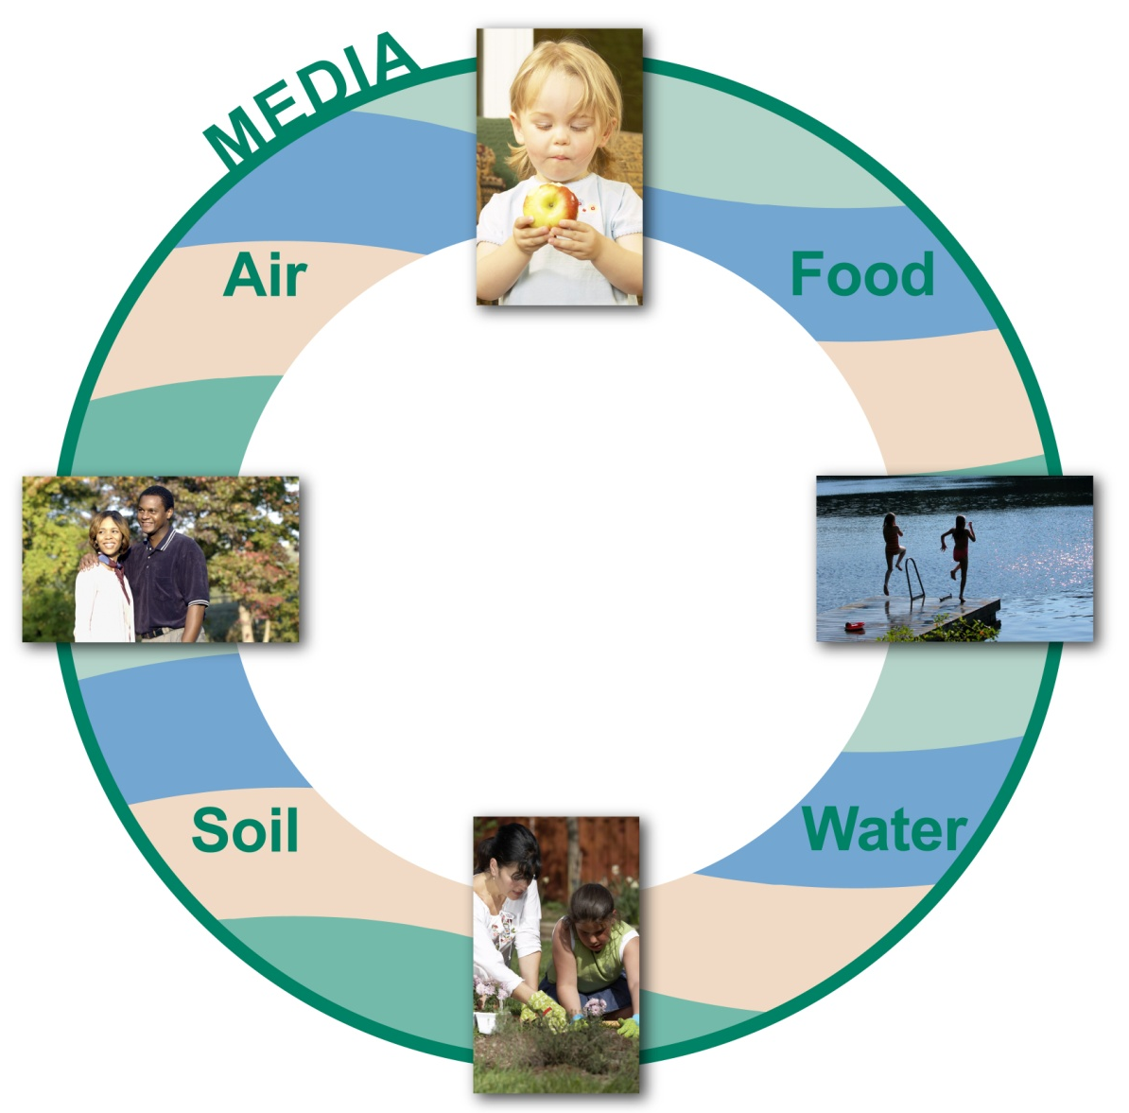
Where is Contamination in the Environment?
Notes:
Contaminants can pollute air, water, soil, or food. We sometimes call these “environmental media”.

Slide 11
Air
Most air pollutants come from
man-made sources
Some air pollutants also come
from natural sources, such as forest
fires and volcanoes.
Air pollution may cause breathing problems
Air pollution can also bother your eyes and skin
Notes:
Air: Most air pollutants come from man-made sources such as factories, power plants, cars, and trucks. Some air pollutants come from natural sources, such as forest fires and volcanoes. Air pollution may bother your airways, causing breathing problems. Air pollution can also bother your eyes and skin.

Slide 12
Water
Harmful substances enter the water when rain or water washes them into rivers, lakes, streams, or the ground
Harmful substances can also be “dumped” into rivers, lakes ,or streams
When contaminants enter sources of groundwater and surface water, they can affect
Drinking water
Part of the food chain
Human and aquatic life
Notes:
Chemicals found in acids, pesticides, industrial wastes, or animal by-products can get into the ground and surface water. Chemicals enter the water when rain or water washes them into rivers, lakes, streams, or the ground. Contaminated water can harm humans, animals, and aquatic plants.

Slide 13
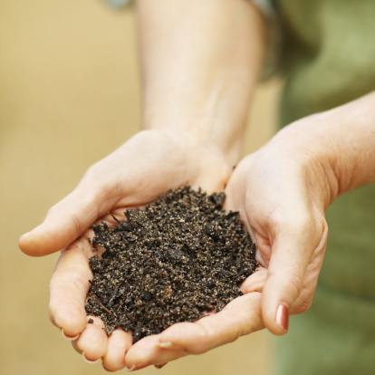
Soil
Chemicals such as pesticides can pollute the soil
Polluted soil can affect the food you grow and eat and the water you drink
Polluted soil can also spread
through the air as dust particles.
Notes:
Chemicals such as pesticides can pollute the soil. Industrial wastes can also be mixed into clean soil—a practice called land-farming—resulting in contaminated soil. Polluted soil can affect the food you grow and eat and the water you drink. Polluted soil can also spread through the air as dust particles. When it rains, these dust particles may settle back into the soil or on the food we eat.

Slide 14
Food
Humans may become exposed to contaminants if
They eat food or drink beverages that have been exposed to chemicals or other contaminants
Plants and animals become exposed in their natural habitat and humans eat them.
Notes:
Humans can become exposed to chemicals if they eat plants or animals that have come into contact with chemicals or chemical pollutants. Plants and animals can become exposed in their natural habitat or sometimes contamination can occur through the preparation, delivery, or manufacturing of food.

Slide 15
Pathways
Touching, Breathing, Eating, Drinking
Notes:
Now we’re going to discuss how contaminated air, water, soil, or food could enter the body---the pathways of exposure.

Slide 16
Exposure Pathways
Touching
Breathing
Eating/Drinking
Notes:
Touching, breathing, eating, and drinking harmful substances, including chemicals, are the ways those substances could enter your body. We call these routes of exposure pathways.

Slide 17
Touching
Contact with skin (dermal)
Chemicals can enter your bloodstream through the pores, small cracks, or cuts in your skin
Chemicals may irritate or burn your skin, exposing it to infection
Contact with eyes
Some chemicals may burn or irritate your eyes
Some chemicals may enter your body through the eye
Notes:
Touching: Touching includes contact with the skin: Chemicals can enter your bloodstream through the pores, small cracks, or cuts in your skin. Other chemicals may irritate or burn your skin, exposing it to infection.
Contact with the eyes: Some chemicals may burn or irritate your eyes. They may enter your body through the eye.

Slide 18
Breathing (Inhalation)
Contaminants that enter the lungs
can either have a direct effect on the cells of the lung
or can be absorbed into the bloodstream
Contaminants that enter the body by breathing include
gases, vapors, aerosols, particles, and fibers (such as asbestos)
Notes:
Breathing (or Inhalation): Chemicals are found as gases, vapors, aerosols, and fibers that you breathe in with air. When chemicals reach the lungs, they can affect the lungs directly or travel to other parts of the body through the blood stream.

Slide 19
Eating and Drinking (Ingestion)
Food or drinks may have chemicals on or in them, and the chemicals can enter your body. These chemicals are absorbed, or taken in, by the digestive system.
Hazardous substances can be ingested if
They are on hands, clothing, or hair.
They are on food or in beverages.
Children eat or drink chemicals or soil (pica)
Children’s hands pick up hazardous dusts
You play or walk in a contaminated area
Notes:
Eating and Drinking (Ingestion): Food or drinks may have chemicals on or in them. When you ingest the food or drinks, the chemicals can enter your body. These chemicals are absorbed, or taken in, by the digestive system.

Slide 20
The Effect of contamination on Sensitive Populations
Children, Pregnant Women, and Older Adults

Slide 21
Do toxic substances affect everyone the same?
Some populations are at a higher risk of the effects of toxic substances than others. These populations include
Young children
Older adults
Pregnant women
Pregnant women
Notes:
Some people cannot tolerate chemical exposure as well as others. We call these groups of people sensitive populations. They can include pregnant and nursing women, children, and older adults. People whose immune systems are weak are also a sensitive population. Such people should speak to their doctors about special precautions to take in dealing with toxic substances in the environment.

Slide 22
Children
Children:
Are closer to the ground
Are more likely to put their hands
in their mouths
May eat dirt
Have a limited diet
Chemicals may be passed in breast milk
Developing tissues of children are vulnerable
Notes:
Children are more sensitive than adults to chemical exposure. This is true because
children are likelier to breathe dust and some vapors because they are closer to the ground.
They are also likelier to put their hands in their mouths. Sometimes, they may eat dirt.
Because infants and toddlers have a limited diet, they may have more exposure to contaminants that are only in certain foods.
Children are also vulnerable to chemicals that may pass during breast-feeding. And
during the teenage years, the body is creating new tissue, particularly in the reproductive system. These tissues are especially sensitive to exposure to chemical substances.

Slide 23
How to protect children from exposure
Wash hands!
Wash toys, bottles, and pacifiers often
Keep poisons locked up
Keep children away from pesticides, cleaning products, and other chemicals
Watch where they play
Notes:
Ways Parents Can Protect Their Children Teach your children to wash their hands often. Hand-washing is one of the most important things you and your children can do.
How to wash your hands:
Wet your hands with warm water.
Apply a generous amount of soap.
Rub your hands together for 20 seconds.
Rinse your hands.
Dry your hands with a paper towel.
Use the paper towel to turn off the faucet and open the door.
Wash toys, bottles, and pacifiers often. Besides their hands, children often put these things into their mouths.
If you need to use pesticides and other potentially harmful chemicals, keep children, toys, and pets away when using them.
Store and use pesticides, cleaning products, and other chemicals where children can’t reach them.
Know where your children play.
Children may play in mud, splash in creeks, crawl on the floor, and roll in dirt that might contain contaminants.
Be aware of areas that may have physical or chemical hazards.

Slide 24
Pregnant and Nursing Women
Levels of immunity among pregnant and nursing women are lower than normal
Anything the mother eats, drinks, or touches may be passed to her unborn child
Contaminants are passed through breast milk
Notes:
Pregnant and nursing women are especially sensitive to chemicals because
during pregnancy, a woman’s immune system has to work harder to protect both the mother and the developing baby.
Exposure of the mother to harmful chemicals can affect the health of the unborn baby. Anything the mother eats, drinks, or absorbs into her body while pregnant may affect her baby’s development and growth.
If breastfeeding, a mother can pass harmful substances to her baby through her breast milk.

Slide 25
How to Protect Pregnant Women from Exposure
Be careful what you eat
Eat fish that’s low in mercury
Shrimp, trout, tilapia, catfish, crab, calamari (squid), & wild Alaska salmon
Wash fruits and vegetables
Wear gloves and a face-mask when gardening
Have someone else do the
painting
Use no-VOC paint
Avoid using pesticides
Notes:
Ways Pregnant Women Can Reduce Their Exposure
Be aware of what you eat
Fish and shellfish are an important part of a healthy diet. Eat up to two servings a week of different kinds of fish and shellfish that are lower in mercury. Fish and shellfish that are lower in mercury include shrimp, trout, tilapia, catfish, crab, calamari (squid), and wild Alaska salmon. When eating locally caught fish, know the local fish advisories for your area and follow those recommendations.
Wash fruits and vegetables before you eat them; they can have pesticides and other contaminants on their surface.
Wear gloves and face mask when gardening
When you wear gloves, you avoid contact with pesticides, herbicides, and fertilizers.
When you are finished gardening, wash your hands with warm water and soap. Washing will help prevent the transfer of any chemicals on your hands to other surfaces in your home or to the food you may eat.
The face mask will help reduce your exposure to contaminants stirred up by the gardening
Be aware of your environment
Avoid areas where the soil, water, or air is known to be contaminated or polluted.
Avoid painting
Have someone else paint the nursery. If you do it yourself, limit the amount of time you spend on the project each day.
Buy no-volatile organic compound (VOC) paint. Even low concentrations of VOCs can be harmful.
Keep the windows open to reduce exposure and avoid inhaling fumes.
Wear protective clothing to avoid getting paint on your skin. Paint contains many chemicals, and they can be absorbed through the skin.
Avoid using pesticides
If you have to apply bug repellant, spray it on your clothing, rather than on your skin.
If you have to use a pesticide in your home,
have someone else apply it;
open the windows and allow the house to ventilate with fresh air;
leave, and wait for a few hours to return to allow the air to clear and the pesticide to weaken.
Remove any food or food preparation items before the pesticide is applied; and
after the pesticide is used, wash the food-prep areas in your kitchen before working on them. Washing removes the chemicals from the surface area you use to prepare food.

Slide 26
Older adults
Older adults
May have weak immune systems
Tend to have more sensitive lungs
May be less aware of environmental emergencies
May have more trouble moving to a safer place
May have poor nutrition
Notes:
Older adults may be sensitive to chemical exposure because
their immune systems are often weaker;
they tend to have more sensitive lungs, making fighting off health effects from breathing contaminants harder.
They may socialize less and therefore be less aware of environmental emergencies.
They may have trouble moving to a safer place if a spill or a chemical release happens. And
they may suffer from poor nutrition, due to lack of appetite or less interest in cooking, and the poor nutrition can affect the immune system.

Slide 27
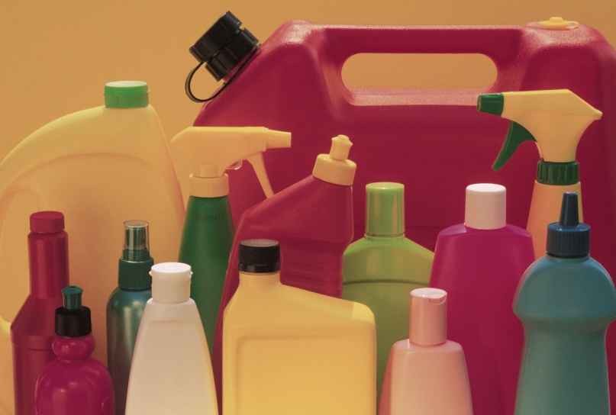
How to protect older adults from exposure
Use clear, large print labels on all chemical products
Do not store chemicals in food containers
Do not store food in chemical containers
Be aware of local concerns
Notes:
Ways Older Adults or Their Caregivers Can Reduce Exposure to Chemicals
Create clear, large-print labels. Put them on all chemical products, such as bleach, cleaning agents, or disinfectants stored in the home.
Do not store any chemical products in containers that were used to store food, and do not store food in containers that once held chemicals.
Remain aware of any environmental concerns in your neighborhood.
If you live near an industry known to have chemical spills or releases, be sure people know how to contact you if/when a spill or release happens. Form a telephone tree.

Slide 28
Preventing Exposures
At Home, At Work, & At Play

Slide 29
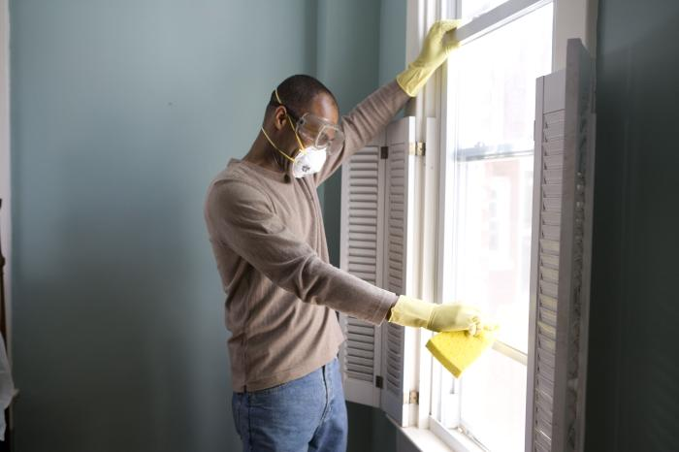
At Home
Home built before 1980?
Asbestos
Insulation
Wiring
Shingles
Mercury
Thermostats
Thermometers
Lead
Paint
Plumbing
Avoid tobacco use and smoke
Notes:
Be Aware of Possible Dangers Around the House
If your house was built before 1980, it may have been built with materials that contain asbestos, mercury, or lead. Asbestos could be found in insulation, wiring, and roof or siding shingles. Mercury is frequently found in old thermostats and old light switches. Lead is sometimes found in old plumbing and paint.
If you are remodeling your home, do so safely. Find out if you have asbestos, mercury, or lead in your home before you start. Many counties require permits for remodeling. The permitting office should offer help on how to safely remodel your home. Your health department may test water or dust for lead. An inspection may also tell you if your house has hazardous materials.
Removing hazardous materials requires special care and often special training and equipment. Learn how to handle, remove, and dispose of these materials safely, or hire professionals. Professionals have the right equipment, personal protective gear, and training to do the job safely.
For asbestos, hire a professional contractor who specializes in asbestos removal.
For mercury thermostats, hire a heating, ventilation, and air conditioning (HVAC) specialist.
Quick tip: Whether at work, home, or play, avoiding cigarette smoke is an easy way to reduce your exposure to harmful chemicals.

Slide 30
Cleaning Products
Open window or turn on fan when you clean
Store safely away from children
Keep in original containers
Do not mix different products
Read labels and follow directions
Alternatives to chemical cleaners
Vinegar (mix with water for an all-purpose cleaner)
Lemon juice (removes stains, serves as glass cleaner, deodorizer)
Baking soda (mix with water for an all-purpose cleaner)
Olive oil (furniture polish)
Notes:
Using Cleaning Products Safely
Many cleaning products give off fumes that you don’t want to breathe in. Some can burn or irritate your skin and eyes. Most are poisonous if swallowed. To protect you and your family from harm,
make sure the room you are cleaning is well ventilated with a fan or an open window.
Store your cleaning products in a safe place where your children cannot reach them.
Keep cleaning products in their original containers.
Do not mix cleaning products with each other
Follow the directions on the containers, and
if a cleaner is hazardous, make sure it is clearly marked.
To reduce your exposure, use natural cleaning products, such as vinegar (removes mildew and grease), lemon juice (stain remover, glass cleaner, and deodorizer), baking soda mixed with water (all-purpose cleaner), and olive oil (furniture polish).

Slide 31
Heating your Home
Wood-burning fireplaces
Have your chimney checked and cleaned
Do NOT burn treated wood
Kerosene Heaters
Ventilate, follow instructions, and keep 16” away from anything flammable
Don’t use gas ovens or burners to heat your home
Never use gas or charcoal-fueled barbecues or grills in the house, carport, or garage
Install carbon monoxide detectors
Notes:
Heating Your Home
If you use space heaters or wood burners in your home, you should be aware of these safety concerns.
Kerosene Heaters
If you use a kerosene heater, ensure that your home has lots of circulating air, especially if your home is modern and well insulated. If your kerosene heater is poorly maintained or not adjusted properly, it can release pollutants into your home. Some of these pollutants are:
carbon dioxide,
carbon monoxide, and
soot.
Protect your family by taking the following steps:
Follow the instructions for your kerosene heater carefully. Use only water-clear 1-K grade kerosene.
Leave a window cracked open and open the doors between rooms.
Place heaters at least 16 inches from the walls, curtains, and furniture. Hot surfaces on the heater pose a fire and burn risk.
Never refuel indoors.
Wood-burning Fireplaces
If you use a wood-burning fireplace,
have your chimney checked for problems and cleaned regularly.
Do not burn treated lumber in your fireplace. This lumber can release toxic smoke when it burns.
Other Heating Concerns
Never use gas ovens or burners to heat your home; never use barbecues or grills in the house, carport, or garage.
Install carbon monoxide detectors inside your home. Carbon monoxide is an odorless, colorless, and toxic gas. Gas from kerosene heaters or worn boilers and furnaces may cause high levels of carbon monoxide inside your home. Exposure to carbon monoxide can lead to health problems or death.

Slide 32
In the Garage
Find a source for throwing out old oil
Use paint thinners, kerosene, and gas with care
Keep products in well marked (preferably original) containers
Store all hazards out of reach of children
Use masks, gloves, goggles, and appropriate clothing
Never idle your car in a
closed garage
Notes:
Working in the Garage
If you work on cars, lawn mowers, snow blowers, or other types of small engines, you should find an auto shop or a waste disposal location that will help you discard old oil.
Use kerosene, gas, and paint thinners with care. Keep these liquids in well marked (preferably original) or DOT-approved containers and follow directions.
Store chemicals out of reach of children.
When working with chemicals, wear protective equipment such as a a mask, gloves, or other appropriate clothing such as goggles and long pants.
Do not idle your car in a closed garage or a garage attached to your house. Keep the garage doors open for a couple of minutes after you park your car. This step will help clear out the fumes (carbon monoxide) before you open the door to your house.

Slide 33
In the Garden and Yard
Take off your shoes at the door to avoid tracking soil into the home
Wash your hands after working
Contaminated soil?
Use raised-bed gardening, dampen soil to reduce dust
Using herbicides, pesticides, and fertilizers
Use natural products if available
Follow directions, calculate correct amount, and don’t apply before/after heavy rain
Always wash fruits and vegetables
Wash pets frequently
Notes:
Working in the Garden and Yard
If you live in an area that has contaminated soil and you want to garden, a raised-bed garden is one way to garden and avoid exposing you and your family to chemicals. In raised-bed gardening, you build boxes on top of the ground. These boxes separate your gardening soil from the contaminated soil. Use bagged soil or soil from a contaminant-free area to ensure your safety.
Gardening can involve the use of herbicides, pesticides, and fertilizers. Below are some ways to help protect your health if you use these chemicals:
Have your soil tested before you fertilize. Soil testing is offered for free from many Cooperative Extension Service offices.
Calculate the correct amount of fertilizer, and do not apply right before or after heavy rainfall.
Dampen the soil with water before you garden. This step will limit the amount of dust you inhale.
Take your shoes off at the door to avoid tracking soil into your home.
Wash your hands after gardening.
Wash fruits, vegetables, and herbs before you eat them.

Slide 34
At Work
Possible work exposures include dust, fibers, chemicals (liquids or fumes), radiation, or biologic agents
Contamination can be carried with you on
Your hair and body
Your car
Your clothes
Wear personal protective equipment
Shower or change clothes before you go home
Wash your work clothes separately
Notes:
At Work
Many jobs might expose employees to hazardous materials, causing various health effects. Examples of workplace exposure can be found in factories, chemical plants, manufacturing, and automotive shops.
If you come into contact with hazardous chemicals and materials at work, here are things you can do to reduce your exposure:
Read and follow instructions provided by your employer.
If you come into contact with dust, fibers, chemical fumes, radiation, or biologic agents on your job, ask for and wear all required personal protective equipment (such as gloves, masks, coveralls, and respirators).
Shower and/or change clothes before leaving work. Otherwise, you can carry contaminants home from work on your clothing.
If your clothing is contaminated, wash your work clothes separately from the rest of your family’s clothing.

Slide 35
Hobbies
Be aware of the chemicals you are using
Read the instructions
Store correctly & away from children
Wear gloves, masks, and other protective clothing
Keep work area ventilated
Wash your hands!
Alternatives:
Investigate less toxic alternatives for wood
strippers, paints, adhesives, etc.
Notes:
At Play
Many hobbies involve using chemicals. For example, woodworking and painting use solvents, thinners, and finishes. Pottery can use a mix of chemicals to create glazes, and some stained glass materials can contain lead.
If your hobby involves the use of chemicals, you can reduce your chances of exposure in several ways:
Read the instructions for how to use the chemical properly.
Keep the work area well ventilated.
Wear gloves, masks, or other protective devices to reduce contact with the chemicals.
Make sure you wash your hands with soap and warm water after using chemicals.
Investigate alternatives. If you like to do woodworking or refinishing, look into using the nontoxic wood strippers found in most hardware stores.

Slide 36
Summary
Contaminants can be found in air, water, soil, and food
Contaminants can enter your body by breathing, touching, eating, or drinking them
Contamination must enter your body before it can make you sick
Not all chemical exposures make you sick
Some populations are more sensitive than others (pregnant and nursing women, children, and older adults)
You can reduce your exposure

Slide 37
Reduce Your Exposure
Be aware of chemicals in everyday products
Be aware of any contamination or pollution around your home or work
Wash your hands
Wash fruits and vegetables before eating them
Read labels that warn you about chemical exposure

Slide 38
Reduce Your Exposure
Don’t burn treated wood
Follow proper disposal guidelines for electronics, batteries, paint, and other chemical-containing products
Avoid cigarette smoke
Eat fish low in mercury
Follow local fish advisories

Slide 39
Questions?
The findings and conclusions in this report are those of the authors and do not necessarily represent the official position of the Centers for Disease Control and Prevention.
Agency for Toxic Substances and Disease Registry
Division of Health Assessment and Consultation

