Slide 1
Environmental Health and Land Reuse Certificate Module 1: Engaging with Your Community
Agency for Toxic Substances and Disease Registry
(Created in 2020)
Instructors: Laurel Berman, Leann Bing, Sue Casteel
Division of Community Health Investigations

Slide 2
Engaging with Your Community: Objectives
Demonstrate the ability to create and activate a development community
Describe at least two principles of community engagement
Describe three community engagement tools that you could use in your work
Explain the role, responsibilities, and scope of practice of a development community team member

Slide 3
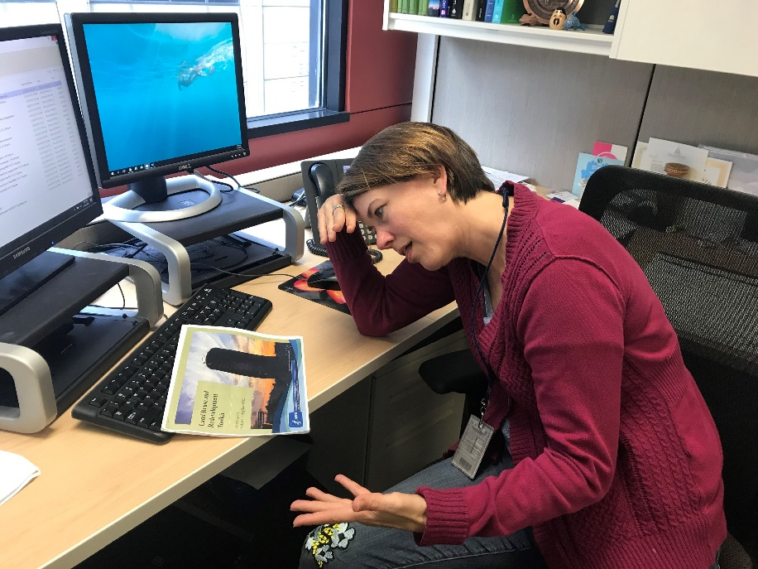
Engaging with Your Community: Details
Pre-test
Post-test: 70% or higher to receive a certificate
Create a 4-digit number to put on your pre-test and post-test
  Memorize the number or keep a written copy.
  Use the same number on both the pre- and post-test
ATSDR Regional Representative taking a test. ATSDR, 2019

Slide 4
Engaging with Your Community: Pre-test
Pre-test Module 1
Put your memorized 4-digit number on the top right corner of your pre-test

Slide 5
The Role of an Environmental or Health Professional in Land Reuse
Your role can be pivotal in engaging the “development community”:
  Citizens
  Community planners
  Stakeholders
  Schools
  Healthcare
  Others
You can build the development community’s understanding of--and capacity to support--safe land reuse and redevelopment.
Notes:
Your role in the development community can set the tone for early community involvement in safe land reuse planning. Your knowledge of hazardous exposures, the environment, and health education may be welcomed in the development community.

Slide 6
The Role of an Environmental or
Health Professional in Land Reuse
Set the tone for early community involvement.
Put the community first.
Your knowledge of hazardous exposures, the environment, and health education may be welcomed.
Image of a Community Meeting (CDC stock image, n.d.)
Notes:
Community members can be an asset in identifying potentially contaminated Land Reuse Sites and inspiring action toward cleanup — or, at a minimum, restricting access to the site. As an Environmental or Health Professional in the development community, you can set the tone for early community involvement in safe land reuse planning. Your knowledge of hazardous exposures and the environment (and if you are a Health Professional, health education) will be welcomed in the development community.
As an Environmental or Health Professional, your role in engaging with the development community (citizens, Community Planners, stakeholders, etc.) can be pivotal in building the community’s understanding of — and capacity to support — safe land reuse and redevelopment.

Slide 7
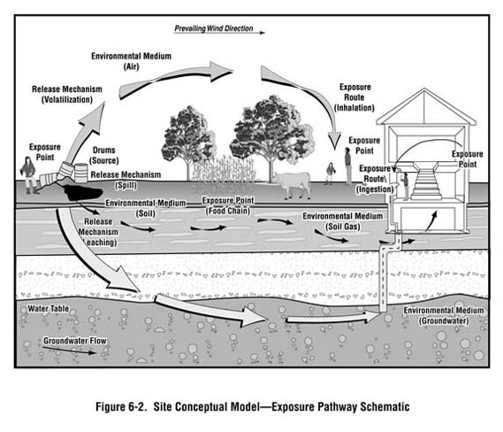
The Role of an Environmental or Health Professional in Land Reuse
Assess and understand all exposure pathways.
Assess the extent of community exposure to the land reuse site(s).
Communicate information in plain language.
Watters, M. Environmental Health and Land Reuse, in Land Reuse and Redevelopment: Creating Healthy Communities (Berman & Whitehead, Eds., 2019)
Notes:
The ways that people can come into contact with a hazardous substance include:
Inhalation
Ingestion
Direct contact (touching)
When you engage with the community and analyze the site(s), it is crucial to assess and understand all exposure pathways. Exposure pathways are the ways people can come into contact with a hazardous substance. The three basic exposure pathways include inhalation, ingestion, or direct contact. As an Environmental or Health Professional, you can assess the extent of community exposure to the Land Reuse Site by measuring the amount of contact all populations have with the hazardous substance(s) on the site.
It’s important to begin the process with a proximity analysis. This analysis can identify individuals who live near the site in question and what, if any, negative effects they feel as a result of their proximity. It’s especially important to understand who is at increased risk from exposure to toxic agents, often referred to as sensitive or special populations, people who might be more sensitive or susceptible to exposure to hazardous substances because of factors such as age, occupation, sex, or behaviors (for example, cigarette smoking). Children, pregnant women, and older people are often considered special populations. Sometimes, low income communities or communities of color are disproportionally impacted by Land Reuse Sites.

Slide 8
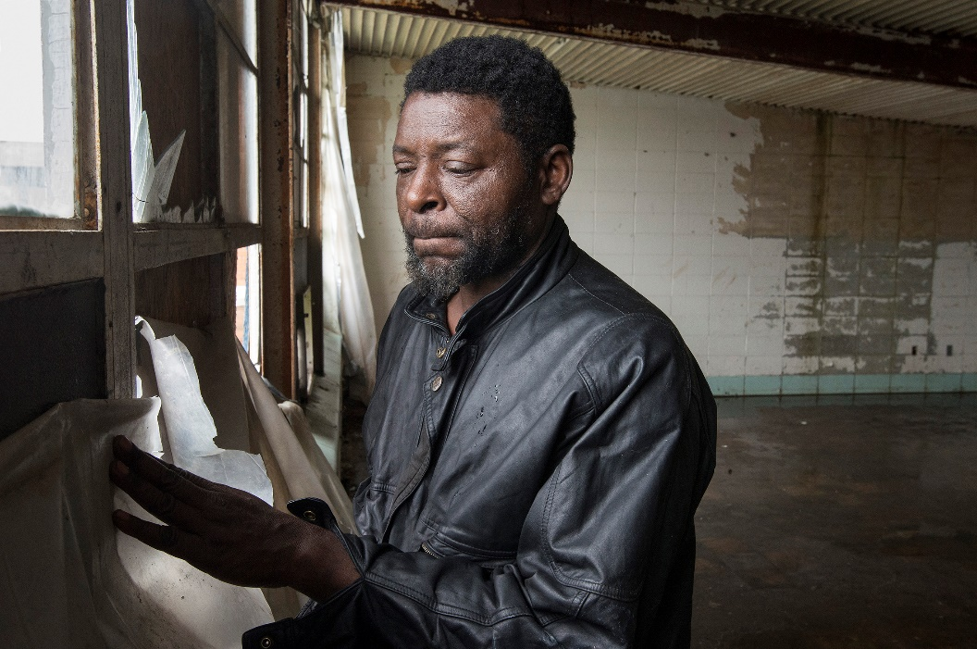
Activating the Community: Who is Affected by Land Reuse Sites?
Your community can be an asset in identifying land reuse sites
You can learn about community characteristics and sensitive populations
Community member and certified lead based paint expert
explaining remediation. Source: Lloyd DeGrane, 2018.
Notes:
The practice of community involvement requires earnest, respectful, and continued attention. To successfully create a collaborative environment, establish clear expectations, communicate effectively and always put your community first. ATSDR has learned the importance of community health considerations and incorporates these needs in their land revitalization activities.
In the photo shown, a community member in a rural Southeast Missouri town grew up in the town, knows the brownfields sites, and even has had job training to become an expert lead base paint remediation specialist.

Slide 9
Knowledge Check #1
Which answer is FALSE?
When activating the development community, the environmental or health professional may
  Help build the community’s understanding of safe land reuse and redevelopment
  Describe all potential exposure pathways in highly technical and detailed language
  Establish clear expectations
  Understand who is affected by the land reuse site(s), particularly special populations
  Communicate effectively
  Share their knowledge of hazardous exposures, the environment, and health education, where appropriate
  Always put the community first
Notes:
KC #1: b) is FALSE. Environmental or health professionals can communicate in plain language to ensure everyone understands the potential exposure pathways. Highly technical and detailed explanations may confuse community members or be hard to interpret.

Slide 10
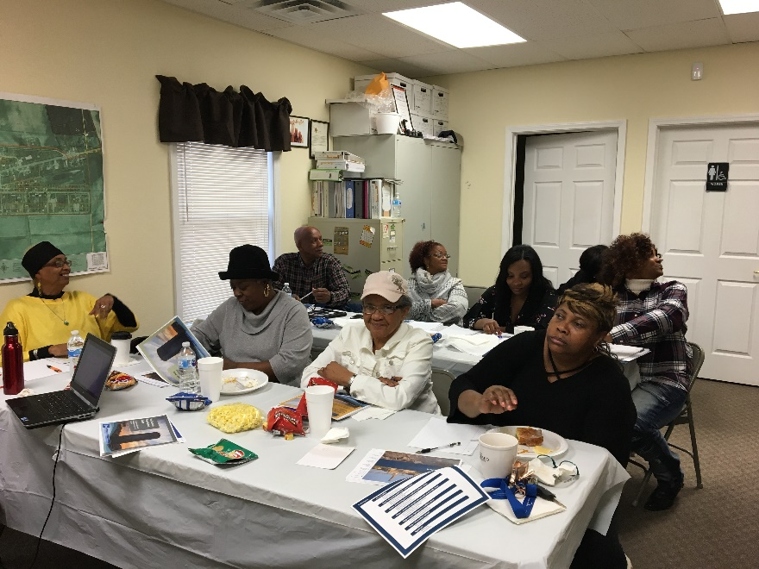
Activating the Community:
Finding the Community Champions
Find and build community champions using these resources:
Non-profits and community groups, e.g., friends of the park
Grants awarded, e.g., brownfields grant – who are the partners and communities of concern?
Community champions in Howardville, Missouri. Source: ATSDR, 2018.
Notes:
You can strengthen your role in community engagement by partnering with Community Champions. Often, the Community Champions are so busy rallying their constituents that they could use some support from an expert. As an Environmental or Health Professional, you may often become a trusted advisor and member of the Development Community; your peers may look to you for reliable and accurate information about contaminants, risks, exposures, and site redevelopment techniques.

Slide 11
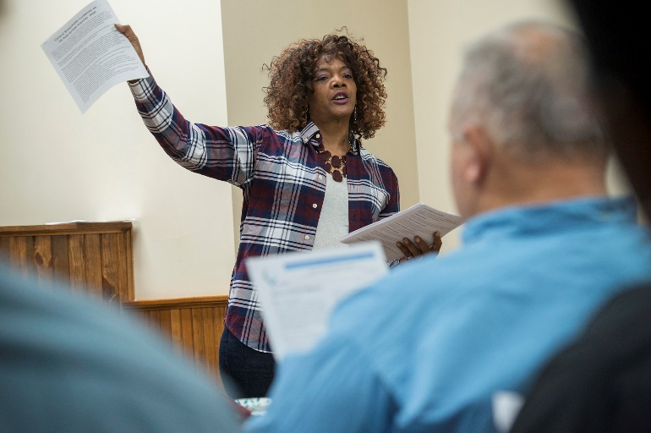
Understanding Roles throughout the
Process of Engagement
A community champion
  Lives in the community and is passionate about the community’s health
  Engages the community, communicates risks, measures success
A community champion leading a meeting in the Missouri “Bootheel” of far Southeast Missouri. ATSDR, 2018.
Notes:
Do you know of or work with any Community Champions now?

Slide 12
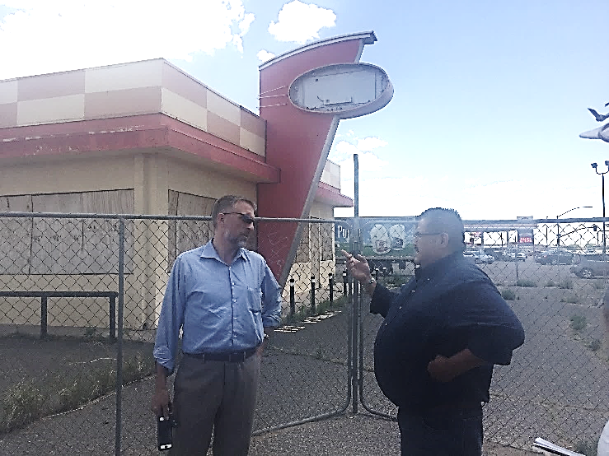
Understanding Roles throughout the
Process of Engagement
Community planner
  Manages logistics of the redevelopment project
  Is involved at each step
Community planners discussing a land reuse site. Source: ATSDR, 2017.
Notes:
Here are two community planners, one from a Navajo Chapter and one who assists a variety of communities (a consultant who is helping plan redevelopment projects).

Slide 13
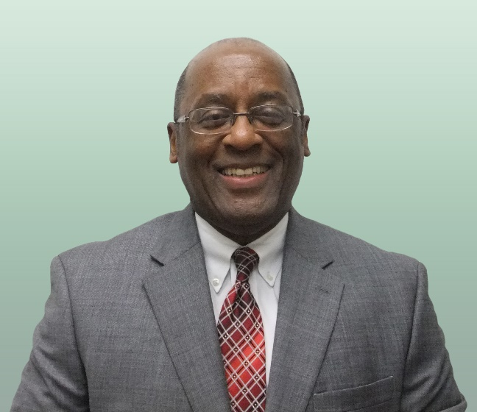
Understanding Roles throughout the
Process of Engagement
Municipal agency representative
  Works for a municipal agency
    Chapter House
    City government
    Other
  Is involved at all steps
A brownfields redevelopment specialist working with the City of Tampa, FL. Source: E Johnson, 2012
Notes:
Do you work with your municipal agency?

Slide 14
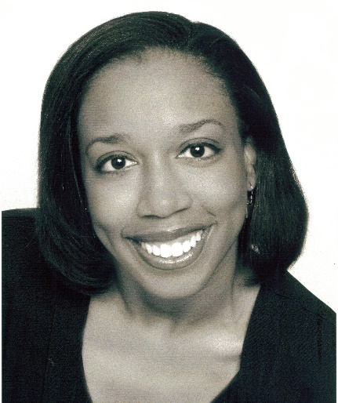
Understanding Roles throughout the
Process of Engagement
Environmental or health professional (you!)
  Provides environmental and health services
  Evaluates and communicates environmental and health risks
An environmental health specialist with a Fulton County health agency. Source: M. Robinson, n.d.

Slide 15
Understanding Roles throughout the Process of Engagement
Developer
  Is in charge of the development steps of the project, from planning through actual site reuse
  Is involved at all steps, primarily in the redesign
Source: ATSDR Land Reuse Toolkit for Environmental and Health Professionals, 2017.
Notes:
In some smaller communities, the developer may be rural U.S. Department of Agriculture, or the community itself.

Slide 16
Revisiting Your Role with Community Champions
Community champions are busy and can use your support!
You can become a trusted advisor who provides reliable information about contaminants, risks, exposures, and site redevelopment techniques

Slide 17
Knowledge Check #2
Which answer is correct?
The community planner is
The person who is qualified to provide environmental and health services to a community
The person in charge of the development aspects of the project
A person living in the community who is passionate about his or her community’s health
The person who plans the logistics of the redevelopment project
Notes:
KC #2 Answer: d) is correct. The Community Planner plans the logistics of the redevelopment project.

Slide 18
Knowledge Check #3
Identify all the primary responsibilities of the environmental or health professional in the redevelopment of a land reuse site.
Provide a network of resources, including community outreach, grant writing, staffing, etc.
Conduct a site assessment
Activate the community to make them aware of the site
Conduct environmental cleanup of site
Conduct a community health analysis
Notes:
KC #3 Answer: b), d), and e) Conduct a site assessment, conduct environmental cleanup, conduct a community health analysis. These are the primary responsibilities of the environmental or health professional.

Slide 19
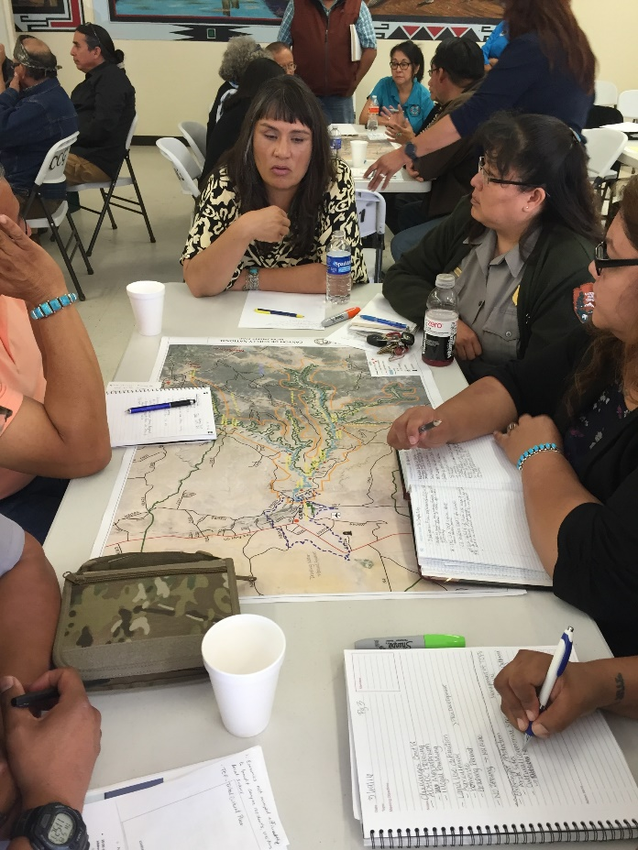
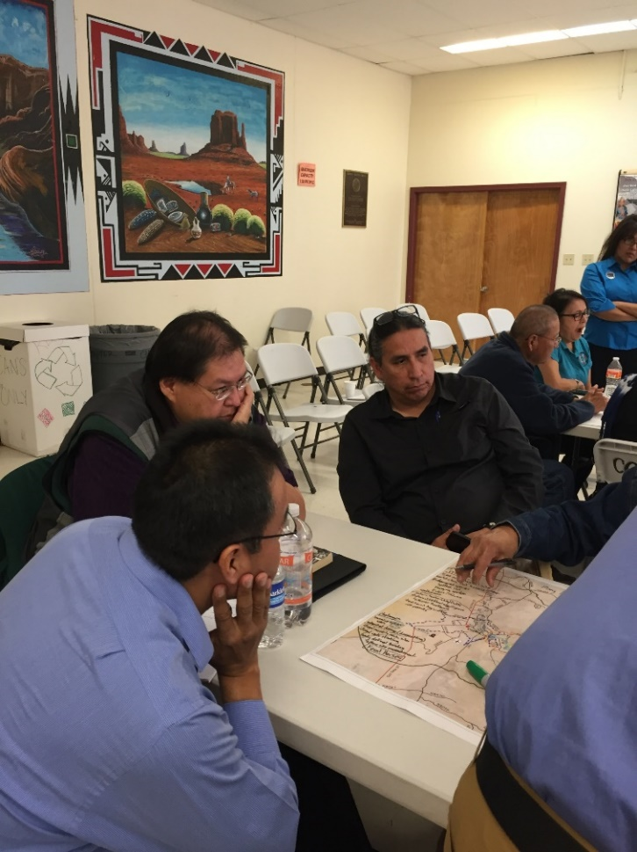
Methods of Engagement
Images of a community land reuse meeting (ATSDR, 2016).
Notes:
Community engagement can take time. This meeting occurred in Navajo Nation with multiple stakeholders. It was held after a one-year engagement process about how agencies can jointly manage land use and redevelopment. Some of the most successful projects occur when ample time is allocated to community engagement. It builds trust, collaboration, and cohesion.

Slide 20
Methods to Engage:
Resources
ATSDR Communication Toolkit: https://www.atsdr.cdc.gov/communications-toolkit/index.html
  Tools to increase your communication skills
    Guidance for presentations (internal to ATSDR but useful guidelines in general)
    Community Meeting Guidelines
    Community Concern Assessment Tool (Module 3)
    Message Mapping Tool (Module 3)
Notes:
These are just a few of the tools in the ATSDR Communication Toolkit. We encourage you to check out the full toolkit on your own time at the link provided in this slide.
We will discuss presentations and meeting guidelines next.

Slide 21
PowerPoint Templates
Use the minimum number of slides possible to keep the audience’s attention.
Use as few words on slides as possible.
Use plain language as much as possible.
Use relevant visuals on slides (e.g., maps and photos of the site).
Avoid jokes or humor which may be misinterpreted to mean you are not taking the situation seriously.
Review the points on your slides against the message mapping template, worksheet, and checklist to evaluate your messaging before delivery.

Slide 22
ATSDR Communication Toolkit:
Community Meeting Guidelines
Develop some understanding of the community.
  Demographics
  History related to environmental issues and health concerns
Invite as many community members as possible.
Set expectations.
  Explain who you are.
  Explain what you are able to provide.
Be prepared to address basic questions about the contamination and how community members can protect themselves, if needed
Notes:
You can also set a timer and go around the room and give everyone a set time to talk. This can keep the playing field level.

Slide 23
ATSDR Communications Toolkit
Community Meeting Guidelines
Understand that community may experience high level of concern even though risk is low. Be prepared to discuss this.
Express empathy, honesty, and humility to build trust.
Ask for feedback (phone, email, etc.) to forge relationships.
Listen.
Use plain language.
Consider using a translator, if necessary.
Notes:
Empathy and listening skills are very important. People know if you are not “genuine”.
Let’s take a look at the Toolkit – Community Meeting Guidelines. There are print-outs on your table. For future reference, you can view these online at this link: https://www.atsdr.cdc.gov/communications-toolkit/documents/10_Community-Meeting-Guidelines_508.pdf

Slide 24
Touch Base Discussion
How can you manage a situation where there is high community concern but low risk of exposure?
Notes:
What may minimize exposures to site contamination at this site? (Hint: the fence.)

Slide 25
Methods to Engage:
Principles of Community Engagement
(ATSDR, 2011)
Be clear about the goals of the project and the populations involved.
Understand the community (culture, economic conditions, social networks, support programs, e.g., healthcare providers or park districts).
Build trust, establish relationships, and connect with local leaders.
Notes:
There are nine principles of community engagement that we as environmental and health professionals use on a daily basis.
PROMPT: Read one principle out loud and explain what it means to you:
Be clear about the goals of the project and the populations involved
Understand the community (culture, economic conditions, social networks, support programs (e.g. healthcare providers or park districts)
Build trust, establish relationships, connect with local leaders

Slide 26
Methods to Engage:
Principles of Community Engagement
(ATSDR, 2011)
Power to create change is within the community (not with external entities).
All outside organizations may not share the community’s interest. Reach out for assistance and partners (local, state, national).
Respect the diversity of the community.
Notes:
PROMPT: Read one principle out loud and explain what it means to you:
Power to create change is within the community (not with external entities)
All outside organizations may not share your interest. Reach of for assistance and partners (local, state, national)
Respect the diversity of the community

Slide 27
Methods to Engage:
Principles of Community Engagement
(ATSDR, 2011)
Mobilize community assets and strengths (can do an asset mapping exercise).
Work together with all partners (level the playing field).
Understand that community collaboration requires long term commitment.
Notes:
PROMPT: Read one principle out loud and explain what it means to you:
7. Mobilize community assets and strengths (can do an asset mapping exercise)
8. All partners can work together (level the playing field)
9. Community collaboration requires long term commitment

Slide 28
Methods to Engage:
Community Needs and Vision
Consider long-term sustainability of the community vision.
Lead sessions about the vision for redevelopment
Identify assets and strengths.
Vote on common themes.
Adapt plans that try to suit everyone.
Notes:
Establishing a unified community vision is essential to a successful redevelopment project. You can support your Development Community by leading brainstorming sessions about the vision for redevelopment, finding ways to vote on common themes, and adapting the plan to suit everyone.
It’s also important to consider long-term sustainability of the community vision. Because long-term sustainability typically involves discussing complex issues, it can be a challenge for any community or municipality to tackle. The following resources provide helpful approaches and questions to facilitate these conversations.

Slide 29
Knowledge Check #4
Select all that apply:
Community engagement can be sustained by
Attaining 100% community buy-in
Identifying and mobilizing community assets and strengths
Allowing the community champion to manage the project
Increasing the development community’s ability to make decisions and act on them
Notes:
KC #4 Answer: b) and d) are correct. Community engagement can be sustained by identifying and mobilizing community assets and strengths and by increasing the Development Community’s ability to make decisions and act.

Slide 30
Knowledge Check #5
ATSDR’s Principles of Community Engagement state that the power to create change lies within the community and not necessarily with external programs and organizers.
True
False
Notes:
KC #5 Answer: a) True: the power to create change lies within the community and not necessarily with external programs and organizers.

Slide 31
Knowledge Check #6
Select all that apply:
Environmental or health professionals can support the development community by
Leading sessions about the vision for redevelopment
Finding ways to vote on common themes
Adapting the plan to suit everyone
Supporting the development community in all of the above ways
Notes:
KC #6 Answer: All of the above. These are all ways environmental or health professionals can support the development community

Slide 32
The Visioning Technique
Help your development community attain a shared community vision by talking about what their ideal environment would look like.
  What would I see?
  What would I hear?
  What would I feel, taste, or smell?
Notes:
The Visioning Technique helps individuals arrive at a shared community vision by getting them to talk about what their ideal environment would look like. Begin by inviting citizens to a collaborative setting, where they’ll visually depict their own image of what they would notice in their community if the changes they sought became true. It can be as simple as covering tables with large posters of plans or even blank sheets of white paper and providing colored markers. Ask specifically for images, because they succinctly carry a lot of information. Ask them to describe what your community might look like in the future, using all of the bodily senses:
What would I see?
What would I hear?
What would I feel, taste, or smell?
According to Ken Meter, a Brownfields & Reuse Opportunity Working Group (BROWN) member from Crossroads Resource Center, the following three questions serve as great thought-starters, but also provide guidance to keep the community and facilitators grounded throughout the process:
How can the development community create an inclusive process?
How can the group set a guiding vision for sustainability for the community?
How will progress toward that vision be measured?

Slide 33
Methods to Engage
Community visioning
  Start with the end in sight: What does the community want or see as the result of action?
  How will we get there?
ATSDR Action Model and Action Model Toolkit
Notes:
The ATSDR Action Model Toolkit helps the wide range of members of the development process find ways to integrate health into the redevelopment. In addition to municipal agencies, Environmental or Health Professionals, and planners and developers, the community can also use the Action Model to identify common goals or visions and ensure they’re incorporated in strategic planning.
Over 40 communities across the U.S. have used the Action Model/Toolkit to help address redevelopment concerns, create a Healthfields redevelopment vision/approach, identify health benefits of the redevelopment, and create indicators to measure improvements in health over time. We have been able to consolidate models across these communities and have created a unique data set of community-derived public health indicators associated with redevelopment.

Slide 34
The ATSDR Action Model and
Action Model Toolkit
The action model process helps members of the development community.
  Integrates health into the redevelopment plan
  Identifies common goals or visions
The model is community-based and can lead to
  Improved health and quality of life
  Reduced risks
  Boost in community pride

Slide 35
Methods to Engage: Action Model
Action Model video clip: Baraboo, Wisconsin Action Model Video
Where can I find members for my development community?
  Chamber of Commerce
  Community centers
  Organizations (like the 4-H Club, Boys and Girls Clubs, and Salvation Army)
  Local hospitals and health clinics
  City Council
Notes:
It is a good idea to keep an open mind and foster an inclusive process. Development community members may even want to join the project after it has been going for a while. That is OK and helps everyone to feel included and that their ideas are valued.

Slide 36
Methods to Engage: Action Model
First, form the development community
Next, address issues
  What are the conditions that the development community wants to improve?
  What would help solve them? How can your development community solve them?
    Do you know anyone else who might be interested in the project?
    Search out and include any other community members who are interested.

Slide 37
Methods to Engage: Action Model
Host your first Development Community Meeting:
  Facilitator’s Guide for an Action Model Workshop [PDF - 70 KB] (printed at table)
  Action Model PowerPoint for Workshop [PPTX - 764 KB]
  Blank Action Model Form [DOCX - 29 KB] (printed at table)
  Sample Action Model in the Community Health Monitoring Report from the Baraboo, Wisconsin Project [PDF - 7.4 MB]
Notes:
AT YOUR TABLE WE HAVE PRINTED EXAMPLES OF THE FACILITATOR’S GUIDE, THE ACTION MODEL POWERPOINT, AND A BLANK ACTION MODEL FORM.

Slide 38
Methods to Engage: Action Model Exercise
Let’s look at your hard copies of the Action Model Toolkit Facilitator’s Guide and Template that you can download from the Action Model Toolkit.
Notes:
Let’s take a look at the blank Action Model Template. Take a few minutes to fill in at least 1 or 2 rows of the Action Model. You can use the facilitator’s guide for assistance, or we will circulate in the room to provide assistance. We will report out after 5 minutes.

Slide 39
A Picture is Worth 1000 Words
Community members take pictures of things they wish to change and provide a short caption with the photo
Pictures can
  Raise awareness
  Evoke emotion
  Create action
  Example: Photovoice (see http://journals.sagepub.com/doi/abs/10.1177/109019819702400309)
Notes:
You can lead community projects to document community conditions through photographs and captions. In the example here, youth in a community in Upstate New York documented the lack of playground equipment and benches/tables/garbage cans and presented the photos to their City Council. The result was a new playground and an overall park upgrade.

Slide 40
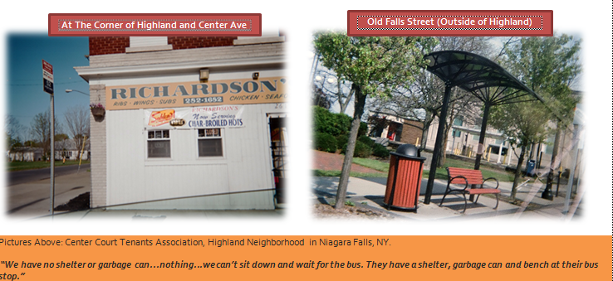
Photovoice Example: Niagara Falls, NY
Photovoice Example: Niagara Falls (New York State Department of Health, undated)
Notes:
In this example, community members compared their bus stop to one in another neighborhood. “We have no shelter or garbage can … nothing … we can’t sit down and wait for the bus. They have a shelter, garbage can, and bench at their bus stop”.

Slide 41
Community Based Participatory Research
CBPR is a partnership approach to research that involves equitable collaboration between academic researchers, people or groups, and partners that share decision-making power and ownership. These groups typically include
  Public health professionals
  Community-based organizations or groups (e.g., churches, schools, advocacy or policy groups, and social organizations)
  Community members

Slide 42
CBPR (cont’d)
CBPR encourages contribution of expertise from each member of the partnership during every step of the process.
  Partners contribute different skills and knowledge.
  CBPR can overcome potential distrust of the research system.
Notes:
CBPR encourages contribution of their expertise from each member of the partnership during every step of the process. This approach brings together partners with different skills and knowledge and enhances the significance and application of research data. Communities with projects can effectively use CBPR to overcome potential distrust of the research system. CBPR is a community-level grass roots approach that ensures partners are equal, with equal expertise.

Slide 43
Additional Community Engagement Tools
Health impact assessment (HIA)
  Implemented before a project is started to determine whether it will have health impacts
    E.g. , rail corridor development
    E.g. , new hospital
    E.g. , proposed redevelopment plan
Protocol for Assessing Community Excellence in Environmental Health (PACE EH)
  A method used largely by health agencies to determine environmental impacts in communities

Slide 44
Knowledge Check #7
Select the best answer:
The visioning technique for building a shared community vision begins by
Interviewing community leaders
Encouraging community members to talk about what their ideal community might look like
Conducting role playing with different members of the community
Telling the community what is best for their land reuse site
Notes:
KC #7 Answer: Bullet 2 – Getting individual to talk about their ideal community is the Visioning Technique for building a shared vision

Slide 45
Knowledge Check #8
The community engagement tool “Photovoice” asks community members to take photos of things they wish to change and provide a short narrative to explain each photo.
True
False
Notes:
KC #8 answer: a) True, Photovoice has community members take pictures of things they wish to change, and include a short narrative.

Slide 46
Knowledge Check #9
Select all that apply.
The ATSDR Action Model Toolkit is intended for use by
Municipal agencies
Environmental or health professionals
Planners and developers
Community members
All the above groups who can use the action model to identify common goals or visions and ensure they are incorporated into the strategic planning for the land reuse site.
Notes:
KC #9 answer: e) All of the above. Everyone can use the Action Model.

Slide 47
Review Your Slides
Post-test is next
70% required to pass
Can take it multiple times
Test is homework for tonight (open book)

Slide 48
Thank you!
Laurel Berman, laberman@cdc.gov
Leann Bing, kbing@cdc.gov
Sue Casteel, scasteel@cdc.gov
Division of Community Health Investigations

