Slide 1
Environmental Health and Land Reuse Certificate Module 2:
Evaluating Environmental and Health Risks
Agency for Toxic Substances and Disease Registry
(Created in 2020)
Instructors: Laurel Berman, Leann Bing, Sue Casteel
Division of Community Health Investigations

Slide 2
Evaluating Environmental and Health Risks:
Objectives
Definitions
  Describe the basics of toxicology.
  Describe the basics of epidemiology.
Best practices
  Describe Phase I and II environmental site assessments.
  Describe the tiered approach to cleanup.
Evaluating the risk
  Describe 4 key steps in risk assessment.
  Describe the ATSDR Public Health Assessment process.
Notes:
Objectives
Definitions helpful in connecting how Environmental Health is related to Land Reuse
Toxicology
Epidemiology
Best practices for environmental site assessments and cleanup
Describe Phase I and Phase II environmental site assessments
Describe the tiered approach to cleanup
Evaluate the risk
Describe the 4 key steps in Risk Assessment
Describe the ATSDR Public Health Assessment Process and how it is different from Risk Assessment

Slide 3

Evaluating Environmental and Health Risks:
Test Details
Pre-test
Post-test: 70% or higher to receive a certificate
Create a 4-digit number to put on your pre-test and post-test
  Memorize the number or keep a written copy
  Use the same number on both the pre- and post-test
An ATSDR Regional Representative taking a test. ATSDR, 2019.
Notes:
Some housekeeping. Everyone write down a 4-digit number that you can remember. You will use this number as your identifier on the pre- and post-test.

Slide 4
Evaluating Environmental and Health Risks:
Pre-test Module 2
Pre-test Module 2
Put your memorized 4-digit number on the top right corner of your pre-test
Image of an environmental professional working in the field: https://www.atsdr.cdc.gov/sites/brownfields/pdfs/Brownfields_Toolkit_Environmental_Professional-508.pdf
Notes:
Distribute pre-test. Collect all pre-tests when finished.

Slide 5
Definitions
Toxicology
Notes:
If a land reuse site is being evaluated for contamination, you may work with environmental engineers/scientists, toxicologists, health assessors, planners, epidemiologists, and other environmental or health professionals. Let’s start with a basic understanding of these fields of practice.

Slide 6
Toxicology
Image of a Brownfield. Lloyd DeGrane, 2014
Notes:
Environmental or health professionals can use a basic understanding of toxicology to enhance their understanding of community concerns about potential exposures to contaminants. This knowledge can further guide understanding of environmental and health assessments related to contaminated or potentially contaminated sites. Toxicology is the study of the harmful effects of substances on humans or animals.

Slide 7
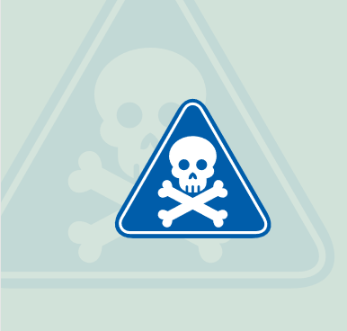
Toxicity
Toxicity depends on
  Dose
  Duration
  Route of exposure
  Substance shape and structure
  Individual human factors
Health status
Sex
Genetics
Notes:
The word “toxicity” describes the degree to which a substance is poisonous or can cause injury. Toxicity depends on a variety of factors:
Dose
Duration
Route of exposure
Shape and Structure of the substance itself (the three-dimensional shape of a molecule)
Individual human factors such as differences in health status, sex, genetics (and sensitivity)

Slide 8
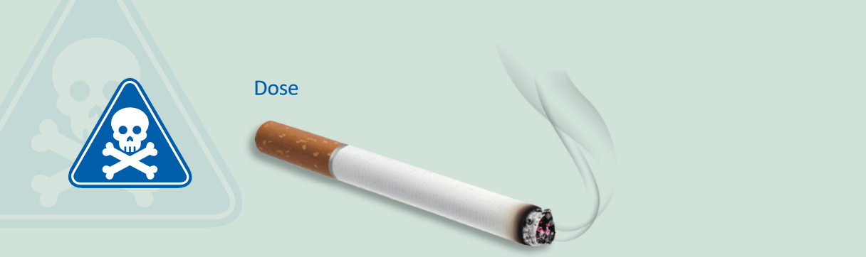
Dose and Duration
Dose– Amount of substance that enters the body; amount of substance per body weight (mg/kg)
  Duration –Amount of time you are exposed to a substance
Notes:
The dose is the amount of a substance that enters the body. It is often measured as a fraction of milligrams (or micrograms) per body weight in kilograms. The time that a person is exposed to a substance is often given as dose per day (e.g. amount/weight per measure of time). In general, the higher the dose or longer the time someone is exposed, the greater the probability that a health effect will occur. For example, one cigarette at one time will have minimal effect on your body. If you smoke one cigarette every hour for 30 years, then you could have a serious health effect such as decreases in lung function..

Slide 9
Dose-response
Dose-response
  Relationship between exposure and health effects
Varies by
  Pollutant
  Individual sensitivity
  Type of health effect
“The dose makes the poison.”
Notes:
Dose-response is a relationship between exposure and health effects that can be established by measuring the effect (response) relative to an increasing dose. Usually the larger the dose (amount/weight), the greater the effect (response). Even substances we use all the time, like salt, can be a poison if the dose is high enough. This is the meaning behind the statement “the dose makes the poison.” This dose-response relationship varies with pollutant, individual sensitivity, and type of health effect.

Slide 10
Safe Level of Exposure
NOAEL:
The “no observed adverse effect level” (NOAEL)
The dose below which harmful (adverse) effects are not seen.
LOAEL:
The “lowest observed adverse effect level” (LOAEL)
The lowest tested dose reported to cause harmful (adverse) effects.
Carcinogens (substances that cause cancer) are assessed differently from non-carcinogens. While carcinogens are considered to have no safe level of exposure, they may have different cancer outcomes and levels of risk.
Notes:
The no observed adverse effect level (NOAEL) is the dose below which the harmful (adverse) effects of a substance are not seen in a population. The lowest observed adverse effect level (LOAEL) is the lowest tested dose of a substance that has been reported to cause adverse health effects. However, substances that can cause cancer (carcinogens), are assessed differently than non-carcinogens. Carcinogens have no safe level of exposure because any exposure could result in cancer. That said, some carcinogenic contaminants can be removed from sites and thus pose minimal risk.

Slide 11
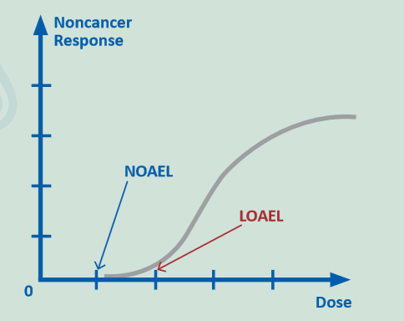
Dose-response Relationship
for Non-cancer Effects
Notes:
This is an example of a dose-response relationship for non-cancer health effects. The NOAEL is… the no observed adverse effect level (NOAEL) - is the dose below which the harmful (adverse) effects of a substance are not seen in a population. The LOAEL is… the lowest observed adverse effect level (LOAEL) - is the lowest tested dose of a substance that has been reported to cause adverse health effects. The grey squiggle line shows the dose-response relationship.

Slide 12
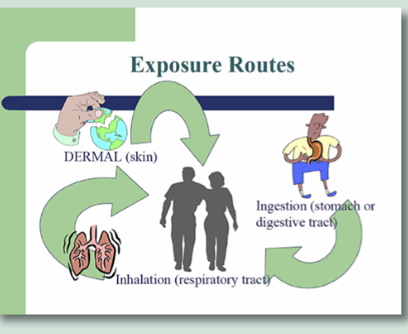
Routes of Exposure
Amount of time exposed: Acute (short) or chronic (long)
Notes:
Environmental exposures are often divided into two categories based on the amount of time exposed:
Acute exposure is short-term (e.g., 24 hours)
Chronic exposure is long-term (e.g., weeks, months, or years)
Routes of Exposure to substances occurs through three major routes:
Ingestion (eating)
Inhalation (breathing)
Dermal (skin) contact
For example, when a person gardens, they have dermal contact with the dirt and substances in the dirt. If the substances stick to their skin, they will be exposed for the entire time they are gardening until they wash their hands and remove anything they have touched. They also may inadvertently inhale or ingest substances on their hands or under their fingernails. They should be careful to not eat until they have washed their hands. A person can lower their chance of dermal exposure by wearing gloves.

Slide 13
Other Toxicology Resources
ATSDR Environmental Health Self Learning Module – Toxicology
(https://www.atsdr.cdc.gov/sites/brownfields/pdfs/toxicology-508.pdf)
ToxLearn: A Gateway to Toxicology (https://toxlearn.nlm.nih.gov/Module1.htm)
Tox Tutor (https://toxtutor.nlm.nih.gov/)
Notes:
ATSDR Environmental Health Module – Toxicology (www.atsdr.cdc.gov/sites/brownfields/pdfs/toxicology-508.pdf)
ToxLearn: A Gateway to Toxicology (https://toxlearn.nlm.nih.gov/Module1.htm)
Tox Tutor (https://toxtutor.nlm.nih.gov/)

Slide 14
Knowledge Check #1
Select the best answer:
Understanding the harmful effects of substances on humans or animals is important to land reuse and redevelopment because
The level of exposure to certain substances could determine whether a site is safe for reuse or not.
Toxicology information should be withheld from the public.
The chances of humans or animals being exposed to toxic substances on land reuse sites are so small.
The media does not care about reporting this information.
Notes:
KC #1 Answer: a) The level of exposure to certain substances could determine whether a site is safe for reuse or not.

Slide 15
Definitions
Epidemiology
Notes:
Look at epidemiology and how it is related to land reuse,

Slide 16
Epidemiology
Epidemiology tries to determine
  Causes of illness in a population
  Causes of wellness in a population
Notes:
Epidemiology is the study of the distribution and determinants of disease or health status in a population. Also, it is the study of the occurrence and causes of health effects in humans.
Stated simply, epidemiology tries to determine two things:
a) Causes of illness in a population
b) Causes of wellness in a population

Slide 17
Environmental Epidemiology
Environmental epidemiology
  Determines detailed disease information related to specific toxicant exposure
  Evaluates environmental and health risks associated with contaminated sites
  Determines if a local disease cluster is related to toxicant exposure
Notes:
Environmental epidemiology is concerned with environmental conditions or hazards that may pose a health risk to populations. For example, epidemiologists may investigate a cancer cluster in a particular community, or question whether people with a particular disease have higher levels of exposure than people without the disease.
Environmental Epidemiology:
Determines detailed disease information related to specific toxicant exposure.
Evaluates of environmental and health risks associated with contaminated sites.
Determine if a local disease cluster is related to toxicant exposure.
Local health departments may receive calls from concerned residents when brownfields or land reuse sites lay idle or when redevelopment begins. People are often concerned about exposures to suspected contamination at these sites. In particular, people worry about increased cancers and lead poisoning. A basic understanding of epidemiology and available resources may be useful to address community concerns and alleviate fears.

Slide 18
Incidence vs Prevalence
Incidence rate
  Number of people newly diagnosed
  Particular disease
  Specific time period
Prevalence rate
  Number of people who have the particular disease
  Defined point in time
Notes:
Incidence and prevalence are important in understanding disease.
The incidence rate quantifies how many people have been newly diagnosed during a specific time period. Incidence reflects the number of new cases in a certain period of time (e.g., the number of new HIV cases in 2015).
The prevalence rate quantifies the number of people who have a particular disease at a defined point in time (Gordis, 2009). Prevalence rate is the number of people who have the disease at a specified time (e.g., the number of people currently living with HIV/AIDS out of the total population).

Slide 19
Knowledge Check #2
Choose all that apply:
Epidemiology can provide useful information to an environmental or health professional who is responsible for communicating with concerned citizens:
Detailed disease information related to specific toxicant exposure.
Evaluation of environmental and health risks associated with contaminated sites.
Studies related to local disease clusters.
Information on their neighbors’ health status.
Notes:
KC #2 Answer: Bullets a), b), and c)
(Choose all that apply)
Detailed disease information related to specific toxicants exposure.
Evaluation of environmental and health risks associated with contaminated sites.
Studies related to local disease clusters.
Information on their neighbor’s health status.

Slide 20
Other Epidemiology Resources
ATSDR Environmental Health Self Learning Module – Epidemiology (https://www.atsdr.cdc.gov/sites/brownfields/pdfs/epidemiology-508.pdf)
CDC’s Principles of Epidemiology in Public Health Practice, 3rd Ed., An Introduction to Applied Epidemiology and Biostatistics (https://www.cdc.gov/csels/dsepd/ss1978/)
Solve the Outbreak
(https://www.cdc.gov/mobile/applications/sto/web-app.html)

Slide 21
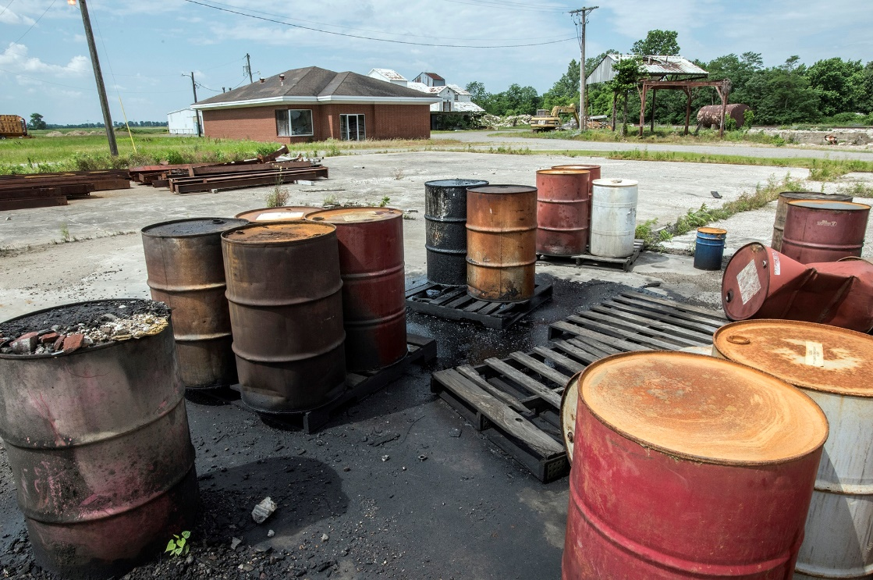
Definitions
Risk Assessment
Image of improperly stored drums. Lloyd Degrane, 2019.
Notes:
Assessing risks of exposure to contamination is a big part of how we determine how dangerous a land reuse site may be.

Slide 22
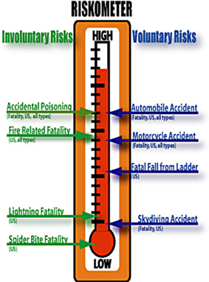
Risk Assessment
Hazard Identification
Dose-response Assessment
Risk Characterization
Exposure Assessment
Source: http://www2.epa.gov/risk/conducting-human-health-risk-assessment#tab-2
Notes:
Risk is defined as the possibility that something will cause harm. Risk assessment (baseline) is an analysis of the potential adverse health effects (current or future) caused by hazardous substance releases from a site in the absence of any actions to control or mitigate these releases (i.e., under an assumption of no action).
The basic elements of risk assessment are:
Hazard identification
Dose-response assessment
Exposure assessment
Risk characterization

Slide 23
Risk Assessment
What health problems are caused by the pollutant?
Hazard Identification
Notes:
Hazard Identification
What is the hazard?
What health problems are caused by the pollutant?
Are any adverse health outcomes associated with the contaminant

Slide 24
Risk Assessment
Dose-response Assessment
What are the health problems at different exposures?
Notes:
Dose-response Assessment
What are the health problems at different exposures? Remember: increasing dose may be more harmful

Slide 25
Risk Assessment
How much of the pollutant are people exposed to during a specific event?
How many people are exposed?
Exposure Assessment
Notes:
Exposure Assessment
How much of the pollutant are people exposed to during a specific time period?

Slide 26
Risk Assessment
What is the extra risk of health problems in the exposed population?
Risk Characterization
Notes:
Risk characterization: What is the extra risk of health problems in the exposed population? It involves reviewing outputs from dose-response assessment and exposure assessments. What are the health problems from exposure? What is the impact? Quantifying the overall risks from individual and multiple chemicals. Consider the toxicity of each chemical and as a group. What are the cancerous and noncancerous health risks?
(Source: Risk Assessment Module (RA Mod), https://www.atsdr.cdc.gov/sites/brownfields/pdfs/risk_assessment-508.pdf
Slides 6, 7)

Slide 27
Risk Assessment
Risk Characterization
Cancer Health Effects
Non-Cancer Health Effects
Notes:
The health risks associated with cancer causing chemicals are evaluated differently than the health risks of non-cancer-causing chemicals. For cancer causing chemicals, the EPA assumes there is no dose of exposure that is considered safe, or without risk. Even a very low exposure to the chemical can increase the risk of cancer. The straight dose-response line assumes that for each unit increase in exposure (dose), there in an increase in cancer risk.
For non-cancer-causing chemicals, or the non-cancer effects of chemicals, there is a “no observable adverse effect level” (NOAEL) at which a person can be exposed to the chemical and experience no effects. At very low doses, the body can repair damage caused by the chemical. However, the dose at which there is an effect varies depending on the chemical, the individual, and the type of health effect.

Slide 28
Other Risk Assessment Resources
ATSDR Environmental Health Self Learning Module – Risk Assessment (https://www.atsdr.cdc.gov/sites/brownfields/pdfs/risk_assessment-508.pdf)
EPA’s Risk Assessment Website (https://www.epa.gov/risk)
EPA’s Integrated Risk Information System (IRIS) (https://www.epa.gov/iris)
Risk Assessment Information System (RAIS) (https://rais.ornl.gov/)
Notes:
ATSDR Environmental Health Self Learning Module – Risk Assessment
EPA’s Risk Assessment Website
On EPA’s risk assessment website you can learn the basics about environmental risk assessments for the public. Additionally, this website also provides links to current EPA tools, as well as EPA guidance and guidelines.
Integrated Risk Information System (IRIS)
EPA’s IRIS is a human health assessment program which explores the potential health effects of exposures to environmental contaminants, to support regulatory activities. Currently, the IRIS database contains information on over 550 chemicals.
Risk Assessment Information System (RAIS)
The RAIS is a website that provides risk tools and information to conduct human health and ecological risk assessments. Included on this website are also several trainings including “What is Risk Assessment?,” and the RAIS Main Tutorial. Additionally, there is a Powerpoint presentation available under “Training Coursework Powerpoint Presentation” which details how the RAIS website can be used effectively to conduct a risk assessment.

Slide 29
Best Practices
Environmental Site Assessment
Notes:
Before the redevelopment of land reuse sites, an environmental site assessment (ESA) is conducted to understand the potential for contamination. An environmental or health professional may already have experience with conducting an ESA. In addition, an environmental or health professional may need to determine the health risks associated with exposure to potential contamination to protect the health of people who live near to or who access the site. This could include identifying a release or threatened release of hazardous materials into structures on the property, into air, or into soil and groundwater or surface water on or near the property.

Slide 30
Environmental Site Assessments (ESA)
Phase I ESA
  Identifies potential environmental concerns
  Exercises “due diligence”
  Conducts “all appropriate inquiry”
Phase II ESA
  Identifies actual contaminants
  Conducts sampling
  Includes laboratory testing
Notes:
The two primary phases of the ESA process are designed to increase the level of understanding of the site condition.
ESA Phase I is sometimes referred to as “due diligence” or “all appropriate inquiry.” It identifies potential environmental concerns.
ESA Phase II identifies actual contaminants through laboratory testing of soil, water, and air samples.
The Environmental Protection Agency (EPA) has established standards for conducting “all appropriate inquiry” – the requirements for assessing the environmental conditions of a property prior to its acquisition. An EPA fact sheet entitled, “All Appropriate Inquiry” is included in the Additional Resources section of this module. For properties purchased after May 31, 1997, the law requires the use of procedures developed by the ASTM, as they meet the “all appropriate inquiry” requirement for site characterizations and assessments.

Slide 31
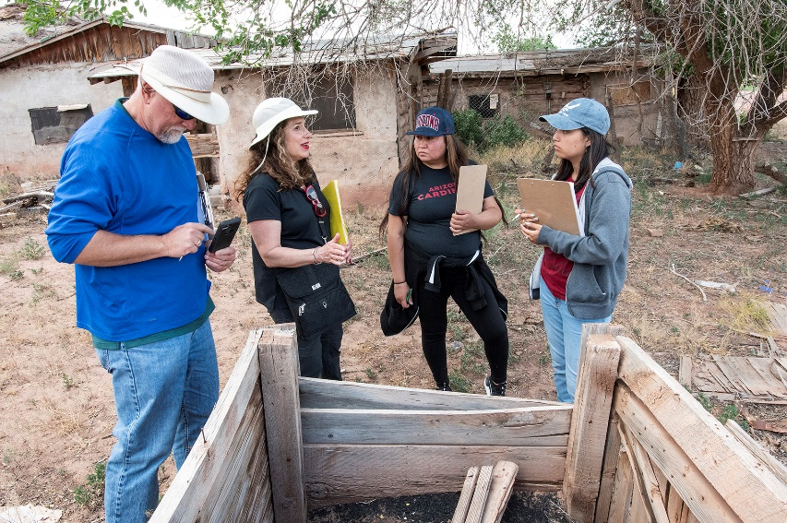
Phase 1 Environmental Site Assessment (ESA)
Phase I ESA
  Records searches
    Sanborn fire insurance maps
    USGS topographical map
    Street directories
  Interviews
    Owners
    Tenants
    Regulators
    Health departments
  Site visit
Environmental Professionals engaged in a Phase 1 ESA. Lloyd DeGrane, 2019.
Notes:
The EPA guidelines and standards for acquiring and assessing brownfields properties also provide property owners with a liability defense against the Comprehensive Environmental Response, Compensation, and Liability Act (CERCLA), commonly known as “Superfund.”
The EPA requires that only licensed environmental professionals conduct Phase I and Phase II ESAs following ASTM International Standards ASTM E1527-13 and ASTM 1903-11, respectively. Because ASTM E1527-13 does not address asbestos, lead paint, or controlled substances, assessment of these additional contaminants needs to be identified in the initial scope of work.
During the due diligence process, the property is evaluated to identify potential environmental contamination. The property is also assessed for potential liability for any contamination present at the property. As part of due diligence, a Phase I ESA identifies potential environmental concerns. It establishes historical and current uses of the site, as well as activities at the site and surrounding area.
The Phase I ESA typically includes the following:
Records searches
Interviews with property owners
Site visit
1. Historical and Environmental Records and Documentation Review:
Geology & hydrogeology review, such as photographs, building permits, Sanborn Fire Insurance Maps, and USGS topographical maps
2. Historical Research:
Historical aerial photographs
Street directories
Building permits
Planning Department records
USGS topographical maps
Sanborn Fire Insurance maps
Department of Oil and Gas maps
Title information
3. Regulatory Records Review:
Review federal, state, local, and tribal records regarding the subject property and/or neighboring sites
4. Site Visit:
View present conditions and assess potential environmentally hazardous site history
Inspect site along with experienced and knowledgeable inspector
Document presence of hazardous materials or petroleum products15
5. Interviews:
Past owners
Current tenants and owners
State and local regulators
Site managers
Neighbors
6. Reporting:
Review any reports you are provided
Complete professional report, which offers conclusions and recommendations regarding the property based on judgment and findings of the environmental professional.
If required, a Phase II ESA may be conducted to sample or test for specific hazards that may have been identified in the Phase I ESA. The Phase II ESA evaluates recognized environmental concerns identified during the Phase I ESA and evaluates whether there has been a release of a hazardous substance at the site.
The American Society for Testing and Materials (ASTM) International is a worldwide standards organization, which has strict guidelines for both ESA I and II. Phase II of the ESA can be very technical, but there are plenty of environmental and health resources available. Besides the aforementioned ATSDR and EPA, there are state, tribal, and even local environmental and health agencies that can also provide support.

Slide 32


Site Visit: Recognized Environmental Conditions (RECs)
During the site visit, note RECs
  E.g., oily spill
  Possible PCB-containing material
  Possible lead-based paint or asbestos
  Odor
  Drums
  Other waste
Brownfields sites that may have recognized environmental conditions. Lloyd DeGrane, 2019.

Slide 33
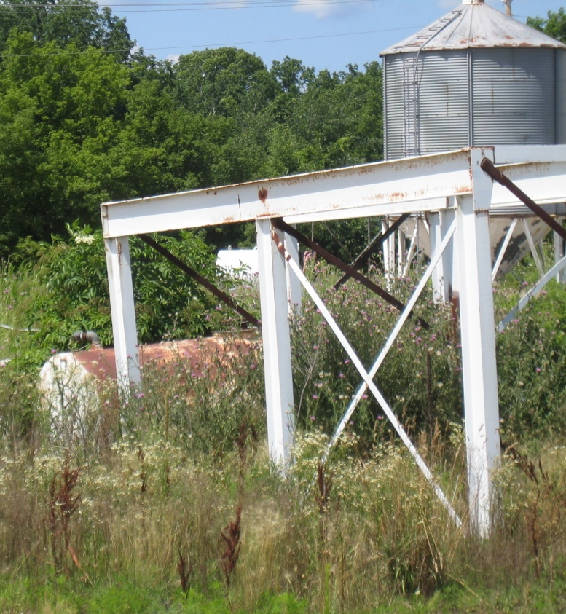
Phase II Environmental Site Assessment (ESA)
Phase II ESA
  Sample/test for specific hazards identified in Phase I ESA
  Evaluate environmental concerns
  Determine whether a hazardous substance was released
Phase II ESA components
  Develop statement of objectives
  Create a conceptual model (hypothesis of how contamination came and migrated)
  Write a report (sampling plan, monitoring well tests, etc.)
Notes:
If the first phase of an ESA indicates possible contamination from hazardous materials, a second phase may be necessary. Phase II is not required to satisfy the AAI. However, Phase I provides an introductory framework for evaluating a site’s potential environmental contaminants, while Phase II provides a more complete understanding of the contamination that may be present on the site.
Phase II ESA
Sample/test for specific hazards identified in Phase I ESA
Evaluate environmental concerns
Evaluates if there was a hazardous substance release
If a Phase II is necessary, the following requirements must be met before taking action:
Statement of Objectives
In order to minimize confusion of the scope of an ESA II, the goals of the assessment must be agreed upon by both the owner of a subject property and the certified environmental or health professional.
Conceptual Model
The conceptual model is a key component of a site assessment performed using the scientific method. It requires the certified environmental or health professional to hypothesize how “target analytes (a substance whose chemical constituents are being identified and measured) would have been released and migrated to the soil or groundwater.” This process guarantees that the evaluation activities are appropriately performed. It also provides assurance that, if a substance is not detected, then it can be concluded that it is most likely not present.
Written Report
Since the new Phase II standards are restructured to more closely reflect the scientific method, ASTM now requires a written report to detail the findings of the assessment in relation to the Statement of Objectives
The ultimate goal of a Phase II ESA is to determine if environmental cleanup of the property will be necessary.
If cleanup is not necessary or already completed, many states will issue a “No Further Remediation Letter” to remediation applicants who have demonstrated, through proper investigation (e.g., Phase I and Phase II ESAs) and any necessary remedial action, that all environmental conditions at their site no longer present a significant risk to human health and the environment.

Slide 34
Knowledge Check #3
Phase I ESA includes sampling soil and water on the site and testing the samples for contaminants.
True
False
Notes:
KC #3 Answer: b) False. Sampling is not conducted during a Phase 1 ESA.

Slide 35
Knowledge Check #4
Select all that apply:
Phase I ESA typically includes the following (choose all that apply):
Subsurface soil testing
Records searches
Site visit
Contamination evaluation
Underground storage tank (UST) sampling
Interviews
Notes:
KC #4 Answer: b), c), and f) are correct.

Slide 36
Knowledge Check #5
Select the best answer:
In a Phase II ESA, the conceptual model is
The same as a sampling plan
The goals for the assessment
The hypothesis for how target analytes may have arrived at and migrated through a site
The explanation of findings from the assessment
Notes:
KC #5 Answer: c) The Conceptual Model is the hypothesis…

Slide 37
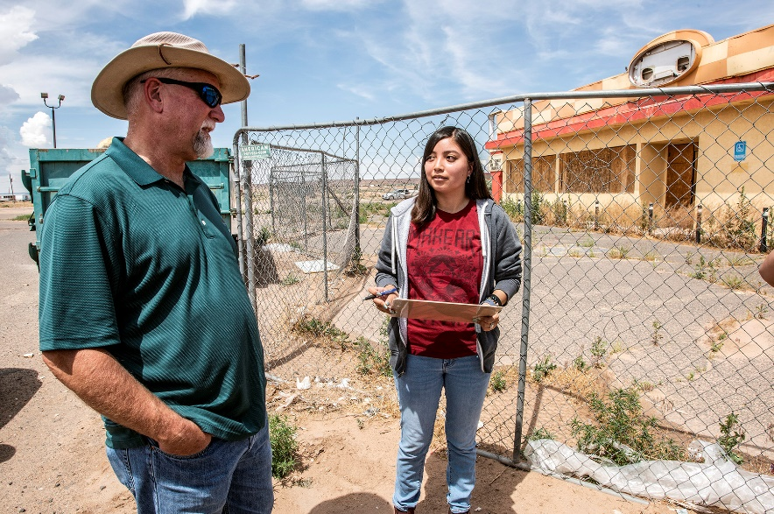
Phase 1 and Phase 2 ESA Activities
Recognized environmental conditions –Guest instructor or video, if available
Environmental Professional discussing potential site contaminants. Lloyd DeGrane, 2014.
Notes:
We will include some photographs of recognized environmental conditions (RECs). There will be some RECs placed throughout the room. Please make notes of these and be prepared to report out.

Slide 38

Phase 1 and Phase 2 ESA
There are piles of paper squares at your tables
Sort the paper squares into Phase 1 ESA or Phase 2 ESA
We will come and check to see how you are doing
Be prepared to explain your answers
Students learning the importance of environmental site assessment. Lloyd DeGrane, 2014.
Notes:
We will play an interactive game. Squares of paper represent either Phase 1 ESA or Phase 2 ESA activities. Participants will sort the squares into the appropriate category of Phase 1 or Phase 2 ESA.

Slide 39
Best Practices
Tiered Approach to Cleanup
Notes:
With support from the Comprehensive Environmental Response, Compensation, and Liability Act (CERCLA), also known as Superfund, CERCLA 128 (a) funding (i.e., funding to states, tribes, and territories from US EPA), state brownfields programs oversee assessment and cleanup activities at the majority of funded brownfields properties across the country. The Michigan Department of Environmental Quality provides a useful example of the tiered approach to clean up in Risk Based Corrective Action (RCBA).
Risk Based Corrective Action helps you to:
Categorize sites according to risk
Allocate resources for maximum protection of human health and the environment
Provide appropriate level of oversight
Move all sites forward quickly
You can use RBCA to:
Identify exposure pathways and receptors at a site
Determine the level and urgency of response required at a site
Determine the level of oversight appropriate for a site
Incorporate risk analysis into all phases of the corrective action process
Select appropriate and cost-effective corrective action measures

Slide 40
A Tiered Approach to Cleanup
Tier I: Environmental impacts
Tier 2: Site-specific data
Tier 3: Site–specific risk assessment
Goal:
Similar levels of protection
Cost effective
Notes:
Tier 1 consists of a qualitative risk-assessment based on general site assessment information. At this stage, data identifies obvious environmental impacts:
Sensitive receptors (e.g., schools, homes, water bodies)
Significant exposure pathways (e.g., drinking water wells, vapor transport, other)
Tier 2 uses more site-specific data to determine the appropriate risk-based actions, including:
Characterization and monitoring
Projections of expected levels of contamination after treatment
Potential plume migration
Reasonable maximum exposure scenarios
Tier 3 focuses completely on the site-specific conditions, such as fate and transport phenomena as well as descriptions of the range of possible exposures and risks. Site-specific risk assessment models may also be developed. Due to the costs involved, this analysis is suited to only large sites.
The goal of all tiers in the tiered approach to cleanup is to achieve similar levels of protection. The difference is that, in moving to higher tiers, more efficient and cost-effective corrective action results because the conservative assumptions of earlier tiers are replaced with more realistic site-specific assumptions.

Slide 41
Knowledge Check #6
The goal of all tiers in the tiered approach to cleanup is to achieve similar levels of protection. However, when moving to higher tiers, the assumptions of earlier tiers are replaced with more realistic site-specific assumptions resulting in more efficient and cost-effective actions
  True
  False
Notes:
KC Answer: a) True

Slide 42
Evaluate the Risk
Risk Assessment

Slide 43

Evaluate the Risk
ATSDR Public Health Assessment
Notes:
If a land reuse site has been evaluated for contamination, either through an ESA II or by a state or federal regulatory agency, the community members may have concerns about exposure to contamination. Through the ATSDR Partnership to Promote Local Efforts to Reduce Environmental Exposure (APPLETREE), ATSDR can fund state and tribal governments or organizations to conduct these activities at land reuse sites.
As part of the public health assessment process, ATSDR and APPLETREE partners investigate and respond to harmful exposures in communities and educate the public on exposure protection. In 2017, for example, ATSDR funded 25 state health agencies. Since 1988, ATSDR and their partners have completed over 2,700 health assessments at land reuse sites across the country, of which 274 were brownfields. ATSDR discovered health hazards at 42% of these brownfield sites.

Slide 44
Public Health Assessment
https://www.atsdr.cdc.gov/videos/health_assessment_process.htm
Notes:
During the health assessment process, either ATSDR or an APPLETREE partner may review environmental data to determine potential adverse health effects on people who may live near or access a land reuse site. Watch the following video (https://www.atsdr.cdc.gov/videos/health_assessment_process.htm) to understand how the health assessment process might work in a community.

Slide 45
ATSDR and APPLETREE Partners
Identify exposure pathways at specific sites
Evaluate environmental and health data to identify potential health risks
Recommend ways to prevent exposures
Educate affected communities and local health professionals about site contamination and potential health effects
Notes:
ATSDR assesses and responds to site-specific issues involving exposure to hazardous substances in the environment. Through the cooperative agreement program, ATSDR’s Partnership to Promote Local Efforts to Reduce Environmental Exposure (APPLETREE), ATSDR gives states resources and guidance to do this work as well.
ATSDR and our APPLETREE partners:
Identify exposure pathways at specific sites
Evaluate environmental and health data to identify potential health risks
Recommend ways to prevent exposures
Educate affected communities and local health professionals about site contamination and potential health effects

Slide 46
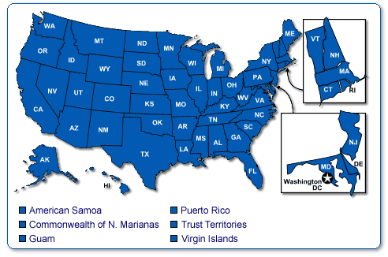
ATSDR Public Health Assessment (PHA)
ATSDR PHA evaluates
  Hazardous waste sites
  Hazardous substances
  Health outcomes
  Community concerns
https://www.atsdr.cdc.gov/hac/pha/index.asp
Notes:
ATSDR incorporates elements of risk assessment into its public health assessment (PHA) process. Since 1986, ATSDR has been required by law to conduct a PHA at each of the sites on the EPA National Priorities List. The aim of these evaluations is to find out if people are being exposed to hazardous substances and, if so, whether that exposure is harmful and should be stopped or reduced. ATSDR Public Health Assessments/Consultations are available online on our website (link on slide).
ATSDR PHA evaluates:
Hazardous waste site
Hazardous substances
Health outcomes
Community concerns

Slide 47
ATSDR Petition Program
Petition ATSDR to investigate
  Whether there are chemicals in your community
  If those chemicals could get into your body
  If they could affect your health
https://www.atsdr.cdc.gov/hac/petitionatsdrdchi.html
Notes:
Residents, agencies, and others can petition ATSDR for a Public Health Assessment/Consultation to investigate
whether there are chemicals in your community,
if those chemicals could get into your body, and
if they could affect your health.
ATSDR can’t
change how a facility operates,
clean up chemicals in your community,
make medical diagnoses,
tell you why there is a lot of illness in your community,
make health conclusions without environmental data,
change zoning codes, or
make another organization treat you with fairness and respect.

Slide 48
ATSDR Health Assessor Training
ATSDR health assessor training topics:
  Mission and Community
  Exposure Pathways and Toxicological Evaluation
  Evaluation of Health Data and Development of Conclusions and Recommendations
https://www.atsdr.cdc.gov/training/public-health-assessment-overview/html/
Notes:
Environmental and health professionals in state or local health agencies may participate in the ATSDR’s Public Health Assessment (PHA) program. ATSDR has created training for health assessors that may be useful for environmental or health professionals in routine site assessment.
The Health Assessors Training is divided into three modules:
Mission and Community
Exposure Pathways and Toxicological Evaluation
Evaluating Health Effects Data and Determining Conclusions and Recommendations
Each section provides detailed step by step guidance through the topic area.
Learning about the Community and Their (Your) Mission
Determining exposure pathways and evaluating toxicology
Evaluating health effects data and Developing Conclusions and Recommendations.

Slide 49
Risk Assessment vs. Public Health Assessment
Risk Assessment | Public Health Assessment
Extent of contamination. | Identify possible harmful exposures.
Numeric estimate of risk without cleanup. | Estimate numeric risk.
Current and potential future exposures. | Conduct past, current, and potential future exposure assessment.
All contaminated media regardless of exposure. | Develop toxicological assessment specific to community.
Standard protective exposure assumptions. | Review community health concerns.
 | Review health outcome data.
 | Provide recommendations to reduce or prevent exposures.
Notes:
The quantitative risk assessment is used by regulators as part of site remedial investigations to determine the extent to which site remedial action (e.g., cleanup) is needed. The risk assessment provides a numeric estimate of theoretical risk or hazard, assuming no cleanup takes place. It focuses on current and potential future exposures and considers all contaminated media regardless if exposures are occurring or are likely to occur. By design, it generally uses standard (default) protective exposure assumptions when evaluating site risk.
Risk Assessment:
Extent of contamination
Numeric estimate of risk without cleanup
Current and potential future exposures
All contaminated media regardless of exposure
Standard protective exposure assumptions
The public health assessment is used by ATSDR to identify possible harmful exposures and to recommend actions needed to protect public health. ATSDR considers the same environmental data as EPA, but focuses more closely on site-specific exposure conditions, specific community health concerns, and any available health outcome data to provide a more qualitative, less theoretical evaluation of possible public health hazards. It considers past exposures in addition to current and potential future exposures.
Public Health Assessment:
Identify possible harmful exposures
Numeric estimate of risk
Past, current, and potential future exposure assessment
Toxicologic assessment specific to community
Review community health concerns
Review of health outcome data
Recommendations to reduce or prevent exposures
The general steps in the two processes are similar (e.g., data gathering, exposure assessment, toxicologic evaluation), but the public health assessment provides additional public health perspective by integrating site-specific exposure conditions with health effects data and specific community health concerns. ATSDR’s public health assessment also evaluates health outcome data, when available, to identify whether rates of disease or death are elevated in a site community, especially if the community expresses concern about a particular outcome (e.g., cancer).
Remedial plans based on a quantitative risk assessment represent a prudent public health approach—that of prevention. By design, however, quantitative risk assessments used for regulatory purposes do not provide perspective on what the risk estimates mean in the context of the site community. The public health assessment does. The process is more exposure driven. The process identifies and explains whether exposures are truly likely to be harmful under site-specific conditions and recommends actions to reduce or prevent such exposures.

Slide 50
Knowledge Check #7
A public health assessment (PHA) evaluates a hazardous waste site for hazardous substances, health outcomes, and community concerns.
True
False
Notes:
KC #7 Answer: True

Slide 51
Brownfields/Land Reuse Sites: Case Examples
Guest lecturers can talk about some of their sites
Video examples can be inserted (if available)
Notes:
This slide can be used by guest lecturers to talk about some of their sites.

Slide 52
Tools

Slide 53
Tools and Resources
ATSDR Brownfield and Land Reuse Site Tool
  (https://www.atsdr.cdc.gov/sites/brownfields/site_inventory.html)
ATSDR Toxicological Profiles and ToxFAQs
  (https://www.atsdr.cdc.gov/substances/index.asp)
ATSDR Action Model
  (https://www.atsdr.cdc.gov/sites/brownfields/model.html)
Health Impact Assessment
  (https://www.cdc.gov/healthyplaces/hia.htm)
PACE EH
Notes:
There are a variety of useful tools and resources available to inform and assist your Environmental Site Assessments and Public Health Assessments.
ATSDR Brownfield and Land Reuse Site Tool: This Tool is a customizable, searchable site inventory and rapid site screening tool. Analytical sampling data is rapidly screened by the tool to highlight chemicals above comparison values used by ATSDR. This leads to a rapid assessment for site prioritization. The maximum concentration for each chemical and each media is compared against the relevant ATSDR comparison value.
ATSDR’s Toxicological Profiles: Toxicological Profiles (Tox Profiles) are a unique compilation of toxicological information on a given hazardous substance. Each peer-reviewed Tox Profile reflects a comprehensive and extensive evaluation, summary, and interpretation of available toxicological and epidemiological information on a substance. ToxFAQs are summaries about hazardous substances and excerpted from the ATSDR Toxicological Profiles. Resources are available by audience: Community members, emergency responders, toxicological and health professionals, and health care providers.
ATSDR Action Model: The ATSDR Brownfields /Land Reuse Action Model helps the diverse members of the development community – officials, developers, community supporters, and residents, find ways to make health part of the renewal process. Communities can use the action model to identify common goals to incorporate these goals in strategic planning.
A Health Impact Assessment (HIA) is an evidence-based approach to inform the decision-making of proposed policies, programs, or projects with the goal of maximizing the positive health impacts and minimizing the negative health impacts. This baseline research can help an environmental or health professional decide which aspects of the community’s health can be addressed through the redevelopment of toxic sites.
The Protocol for Assessing Community Excellence in Environmental Health (PACE EH) was developed by the CDC’s National Center for Environmental Health and the National Association for County and City Health Officials (NACCHO) to provide guidelines for local health officials. This methodology guides communities and local health officials in conducting community-centered environmental health assessments by relying on community collaboration to involve stakeholders

Slide 54
Tools and Resources
Choose Safe Places for Early Care and Education
  (https://www.atsdr.cdc.gov/safeplacesforECE/index.html)
Community Mapping Tools
  EnviroAtlas (https://enviroatlas.epa.gov/enviroatlas/interactivemap/)
  EJScreen (https://www.epa.gov/ejscreen)
Community Health Status Indicators
  NCEH Tracking Program (https://www.cdc.gov/nceh/tracking/BetterInfoBetterHealth.htm)
  Community Health Rankings and Roadmaps
  (https://www.countyhealthrankings.org/explore-health-rankings#county-select-38)
Notes:
There are a variety of useful tools and resources available to inform and assist your Environmental Site Assessments and Public Health Assessments.
Choose Safe Places for Early Care and Education: ATSDR and APPLETREE are creating guidance to develop plans and act to protect children from environmental hazards through the safe siting of early care and education facilities.
Community Mapping Tools, such as EPA’s EnviroAtlas: Interactive resources for exploring the benefits people receive from nature or “ecosystem goods and services” and EJScreen, a tool that combines environmental and demographic indicators in maps and reports
Community Health Status Indicator:
NCEH Tracking Network has data and information on the environment, exposures, health effects and population characteristics.
County Health Rankings and Roadmaps allow nationwide comparison of counties with similar populations based on key demographic, social, and economic indicators

Slide 55
Review
Review your slides and knowledge checks
Post-test is next
  Must score 70% to receive a certificate
  Can take the test multiple times
Notes:
Summary
An Environmental or Health Professional can play a pivotal role in land reuse and redevelopment. Their technical expertise can be an asset in explaining the overall site and health assessment processes in plain language. Environmental or Health Professionals can work with the Community Champion and Municipal Agency to ensure that the community understands the site assessment results, or risk associated with contaminants on land reuse sites. In addition, Environmental or Health Professionals can partner with ATSDR and state or local health departments to help translate risks into common language.
Review your slides and knowledge checks
Post-test is next
80% pass rate
Can take it multiple times

Slide 56
Thank you!
Laurel Berman, laberman@cdc.gov
Leann Bing, kbing@cdc.gov
Sue Casteel, aov2@cdc.gov
Division of Community Health Investigations
Notes:
Instructor can enter names of additional instructors who may participate in the training.

