Slide 1
Environmental Health and Land Reuse Certificate
Module 3: Communicating Environment and Health Risks
Agency for Toxic Substances and Disease Registry (Created 2020)
Instructors: Laurel Berman, Leann Bing, Sue Casteel
Guest Instructors:
Division of Community Health Investigations

Slide 2
3
Notes:
No problem is insurmountable!

Slide 3
Course Objectives
Describe at least two of Covello’s rules to communicate technical findings in plain language.
Describe message mapping/key messages.
Explain how to create message maps from a template.
Explain the role, responsibilities, and scope of practice of a development community team member
2

Slide 4
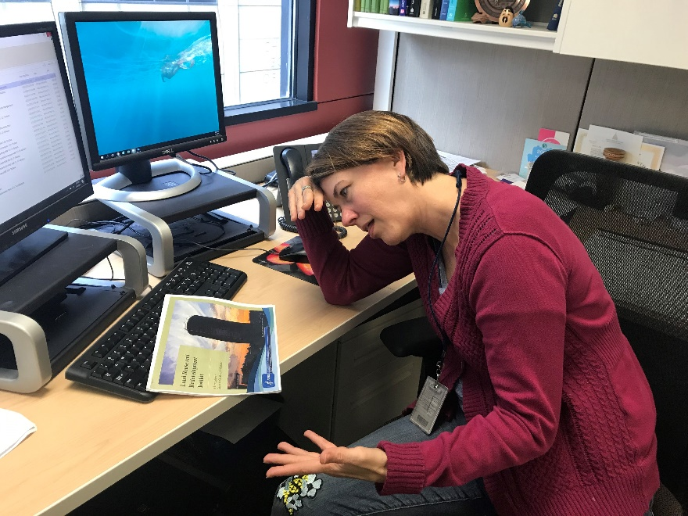
Course Details
Pre-test
Post-test: 70% or higher to receive a certificate
  Create a 4-digit number to put on your pre- and post-tests
  Memorize the number or keep a written copy
  Use the same number on both the pre- and post-test
An ATSDR Regional Representative taking a test. ATSDR, 2019.

Slide 5
Pre-test
Pre-test Module 3
Put your 4-digit number on the top right corner of your pre-test

Slide 6
Risk Communication Definition
A science-based approach for communicating effectively
How we talk to the public about
  Substances or behaviors that can be harmful
  Potential hazards
  The nature and level of risks

Slide 7
Risk Communication
Enhance understanding and knowledge
Build trust and credibility
  Local health departments
  Environmental professionals
Notes:
Trusted information providers: local health departments, environmental professionals.

Slide 8
Understand Your Audience
Demographics
    Education
    Income level
    Age
    Languages spoken and read
    Religious beliefs
Cultural background norms and values

Slide 9
Understand Your Audience continued…
Points to consider about your audience:
  Geographic location
  Knowledge of environmental contamination
  How close do they live to brownfields sites?
    Are they concerned about these sites?
    Ask your audience

Slide 10
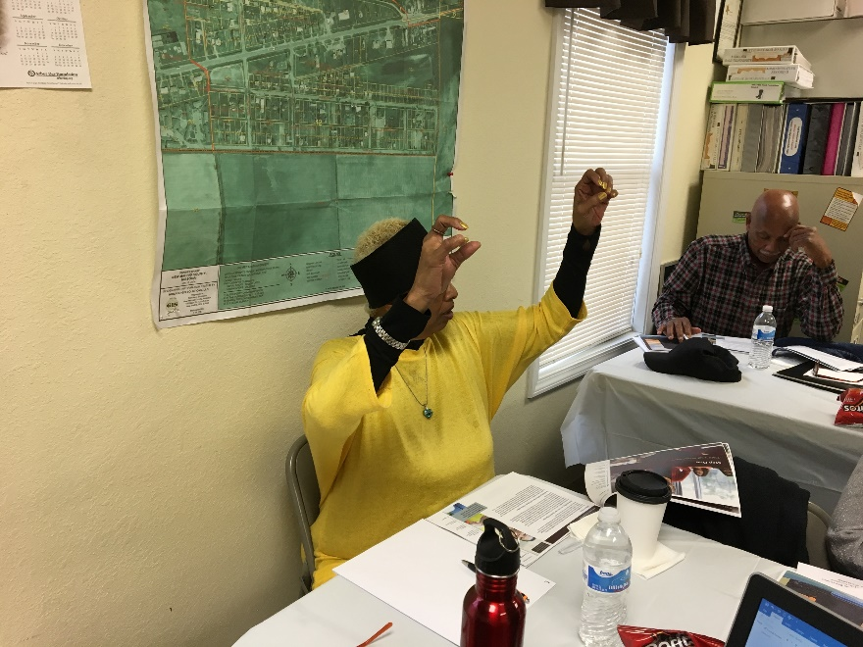
Communicating Environmental and Health Risks
Seven Cardinal Rules of Risk Communication
  Developed by Dr. Vincent T. Covello for US Environmental Protection Agency
  Adapted and updated for current applicability
Image of community member discussing
environmental concerns. ATSDR, 2017.

Slide 11
Rule 1
Accept and involve the public as a legitimate partner.
  Involve the public early.
  Recognize that people hold you accountable.
  Recognize rights of people and communities to participate in decisions that affect their lives, property, and things they value.
Notes:
Walking in someone else’s shoes may be one of your greatest community engagement and risk communication skills. Do they have children? What stresses may they have?

Slide 12
Rule 2
Listen to the audience.
  Don’t assume you know what people know, think, or want.
  Ask people what they are thinking:
    Interviews
    Discussion groups
    Surveys
    Toll-free numbers
Identify with your audience and try to put yourself in their place.

Slide 13
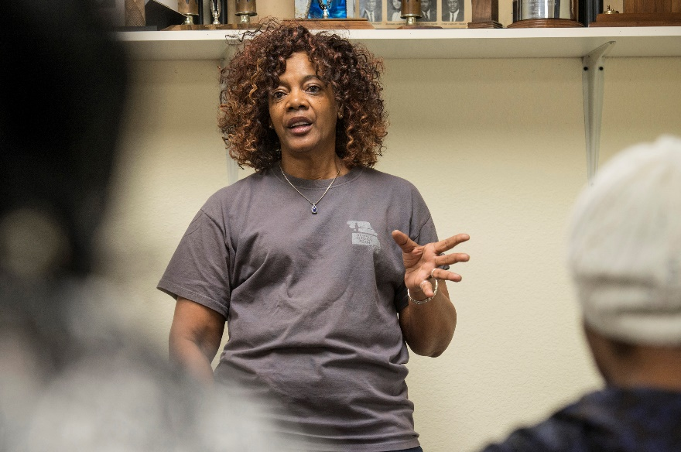
Rule 3
Be honest, frank and open.
State your credentials.
  Don’t ask or expect to be trusted by the public.
If you don’t know the answer to a question, say so.
  Offer to find out.
Share more information, rather than less.
  Ensures people don’t think you are hiding anything.
A community leader discussing contamination and exposure with community members. Lloyd DeGrane, 2018.
Notes:
Remember: it is ok to say “I don’t know” and offer to get an answer.

Slide 14
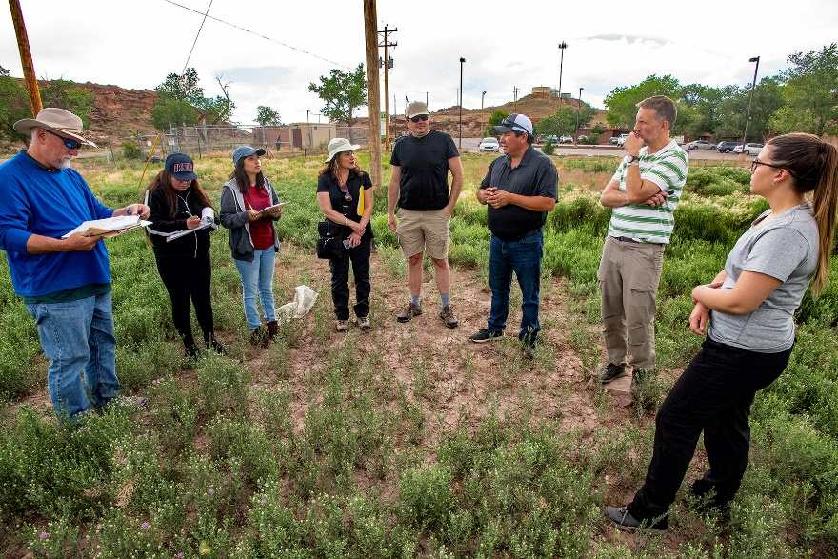
Rule 4
Coordinate and collaborate with other credible sources.
Issue joint communications with trustworthy sources.
  Local universities
  Citizen advisory groups
  Local officials.
Environmental professionals, planners, and Chapter official coordinating to discuss site concerns. ATSDR, 2019.

Slide 15
Rule 5
Meet the needs of the media.
  Be open with and accessible to reporters.
  Respect deadlines.
  Stay on topic.
  Prepare a limited number of factual key messages.
    Repeat these messages
    Say only what you are willing to have repeated.
Remember, everything you say in an interview
is on the record!
Notes:
Sometimes we call the positive key messages “sound bytes.” These are succinct, memorable messages, such as “arsenic levels were not at a harmful level.”

Slide 16
Rule 6
Speak clearly and with compassion.
  Use plain language.
  Be sensitive to local norms, such as speech and dress.
  Use images to clarify messages.
  Personalize risk data through stories, examples, and anecdotes.
  Acknowledge and respond to emotions that people often express
    Anxiety
    Fear
    Anger
    Outrage
    Helplessness
Tell people what you can and cannot do.
Notes:
Your clothing and appearance may have impact. Wear something that a member of the community might wear, such as a business casual outfit. Or, if you are meeting with a lot of officials, you may need to be respectful and wear a suit.

Slide 17
Rule 7
Plan carefully and evaluate performance.
  Have clear objectives
    Providing information
    Providing reassurance
    Involving stakeholders in joint problem solving
  Evaluate your efforts and learn from mistakes
Train staff in communication skills
Pre-test messages
  Different audiences may need different risk communication strategies.

Slide 18
Knowledge Check #1
A basic tenet of risk communication in a democracy is that people and communities have a right to participate in decisions that affect their lives, property, and things they value.
  True
  False
Notes:
KC #1 Answer: a) True

Slide 19
Knowledge Check #2
Which are true? Select all that apply.
Train all staff in communication skills.
Only talk to the subgroup that you feel will listen to the message.
Avoid thinking of your audience as “the public” or using this term. Understand the concept of different “audiences,” each with its own interests, needs, concerns, priorities, preferences, and organizations.
Begin with clear, explicit risk communication objectives – such as providing information to the public, motivating individuals to act, stimulating response to emergencies, or contributing to the resolution of conflict.
Recruit spokespeople who are very technical so they can get all the minute details correct.
Pretest messages whenever possible.
Evaluate efforts carefully and learn from mistakes.
Notes:
KC #2 Answer: All but b) and e) are true. Discuss why these are incorrect.

Slide 20
Knowledge Check #3
Select all that apply:
When listening your audience’s concerns, remember to
  Let all parties with an interest or stake in the issue be heard.
  Let people know that what they say is understood, addressing their concerns as well as yours.
  Recognize the “hidden agendas,” symbolic meanings, and broader economic or political considerations that often underlie and complicate the task of risk communication.
Notes:
KC #3 Answer: All of the above are true

Slide 21
Knowledge Check #4
Select all that apply:
What strategies will help build trust and credibility in the community?
  Be honest if an answer is unknown or uncertain.
  Disclose risk information as soon as possible (emphasizing any reservation about reliability).
  Never disclose data uncertainties.
  Get back to people with answers.
  Emphasize worst-case scenarios, just in case.
  Never admit mistakes.
Notes:
KC #4 Answer: a), b, and d) are correct. Disclose as much information as you can. If data is uncertain, you can say so. Emphasizing worst-case scenarios without looking at a realm of possibilities may alarm people. Admit your mistakes. You are human.

Slide 22
Knowledge Check #5
Conflicts or public disagreements with other credible sources have no effect on risk communication.
True
False
Notes:
KC #5 Answer: b) False. Conflicts or public disagreements can confuse your audience and impact the way you communicate.

Slide 23
Knowledge Check #6
Select the best answer:
Meet the needs of the media by
  Telling them only what they need to know
  Telling them where to find their own background information
  Providing risk information tailored to the needs of each type of media (e.g., graphics and other visual aids for television).
  Ignoring their deadlines and only worrying about the project deliverables
Notes:
KC #6 Answer: c) is correct

Slide 24
Knowledge Check #7
Select all that apply:
When communicating risk to the public, speak clearly and with compassion. Remember to
  Avoid distant, abstract, unfeeling language about deaths, injuries, and illnesses
  Never include a discussion of actions that are under way or can be taken
  Use technical language and jargon
  Be sensitive to local norms, such as speech and dress
  Use risk comparisons to help put risks in perspective, but avoid comparisons that ignore distinctions people consider important
  Use vivid, concrete images that communicate on a personal level
Notes:
KC #7 Answer: a), d), e), and f) are correct. Answer b) is incorrect. You can include an update on what is happening or will happen to keep the community informed and build trust. Avoid technical language and jargon (answer c)) so that your communication is clear and easy to understand.

Slide 25
Summary Risk Communication Pointers
Include your audience early in the process.
Assure them that you are their partner, working in collaboration with them.
Listen and ask questions for clarification.
Use plain, clear language.
Don’t promise more than you can deliver.
Be honest.
  You can say “I don’t know but I will try to find an answer for you”
Follow up promptly to maintain trust.

Slide 26
The Role of an Environmental or Heath Professional in Risk Communication
Engage community members to understand their needs for redevelopment.
  You may be seen as a reliable source of accurate information about contaminants, risks, exposures, and site development techniques.
Conduct environmental cleanup of site.
Conduct community health analysis.
  You can assess exposure pathways and who is exposed.

Slide 27
Messaging
How do we get the message to our community about environmental risks?
Messages can be
  Written
  Spoken
  Visual
Messages are generally simple, one-sentence statements.
  Reduce, reuse, recycle
  Make sure your child has these three tests before age 3 (for blood lead screening)
  Boil water
  Think Green
  Shop local

Slide 28
Message Map Template
Stakeholder question or concern:
Key Message 1 9 words on average | Key Message 2 9 words on average | Key Message 3 9 words on average
Supporting message 1a | Supporting message 2a | Supporting message 3a
Supporting message 1b | Supporting message 2b | Supporting message 3b
Supporting message 1c | Supporting message 2c | Supporting message 3c
Message map source Covello, 2007
Notes:
There is a hard copy of this template at your tables.

Slide 29
Message Map
To determine your 3 key messages, ask yourself these 3 questions:
Key message #1:
  What is most important for people to know?
Key message #2:
  How can this impact people’s health?
Key message #3:
  What conclusions can be drawn related to risk and exposure?

Slide 30
Message Map Exercise
My Daycare, Shiprock, Navajo Nation (mock)
Sinco, Inc. redeveloped into a daycare
  Plastic safety net manufacturer
  Soil contaminated with arsenic and other contaminants
  Most of site cleaned up.
Playground soil never sampled
Chapter officials and Tribal environmental professional worked with owner and daycare operator to test playground soil
  Surface and subsurface soil contaminated with elevated levels of arsenic
  Worked with property owner to develop plan to prevent exposure to contaminated soil
Community concerns: Parents and daycare staff concerned about
  Soil contamination and remediation plans
  Possible exposure for children in the past, and harm to their health
Notes:
The hard copy of this case study is at your table. Let’s review it.

Slide 31
Message Map Exercise
Risk Communication Activities
Chapter officials and Tribal environmental professionals conducted the following risk communication activities:
  Prepared a fact sheet
  Held a public meeting to provide information
  Answered questions
Notes:
During the meeting, daycare staff and parents were reassured and were satisfied with the remediation. The message to parents was that children from the daycare will not have direct contact with the contaminated soil in the playground and thus, will not be exposed to the arsenic in the soil.

Slide 32
Overview of Case Study
Environmental health concern: Arsenic in soil at the daycare center
Risk: Much of the site has been cleaned up but soil was never sampled
Outcome: Chapter officials and Tribal environmental professional helped get the soil tested
  Test revealed soil contaminated with arsenic
  Remediation plan put in place to prevent exposure
Results: Chapter worked with property owner to cover the soil with wood chips to prevent exposure

Slide 33
Message Map Template
Stakeholder question or concern: Are the children going to be sick from exposure to arsenic?
Chapter has worked with operator to ensure arsenic in the soil will be covered with wood chips to prevent exposures | Children attending the daycare will not have direct contact with the residual arsenic contamination in the soil. | Children were not likely exposed, as the daycare center has been open less than a year and children were not using the playground during winter.
Limited soil removal will take place in areas with highest arsenic levels. | A layer of woodchips covers the soil on the playground. | A child would need to play directly in the soil on a daily basis for several years to be harmed by arsenic
Cleanup plan may include additional layers across the entire playground. | Operator will add additional soil covering such as heavy landscaping fabric, crushed limestone, and woodchips.
After additional layers are added, children will not be able to come into contact with the soil.
Notes:
THIS SLIDE IS ALSO A HARD COPY FOR USE IN THE EXERCISE. Please note that there are more than 9 words per message to illustrate the use of the message map.

Slide 34
Case Study: Asbestos Mine
The ABC site in Keweenaw Peninsula (mock)
  Active asbestos mine from early 1900s to 1993
  Chrysotile mined
  Tons of waste rock and mine tailings
Contaminated runoff from the mine tailings
  Surface water, stream, and sediment contamination
  Downstream wetland areas contaminated
    Source of airborne asbestos
    Recreational area for activities such as hiking on tailings piles.
Notes:
CASE STUDY IS AT THE TABLE.

Slide 35
Case Study: Asbestos Exposure
Asbestos exposure results from breathing in asbestos fibers.
  Asbestos fibers released into the air when rocks, soil or products containing asbestos are disturbed
  Fibers breathed into the lungs could remain there for a lifetime
Asbestos exposure is not a problem if asbestos is left alone and not disturbed
Notes:
CASE STUDY IS AT THE TABLE.

Slide 36
Case Study: Exposure Factors
Exposure to asbestos doesn’t mean you will definitely develop health problems
Factors that affect whether your health will be harmed:
  How long and how frequently you were exposed
  How long since your exposure began
  How much you were exposed to
  Whether you are a smoker (Cigarette smoking increases chances of getting lung cancer from asbestos exposure.)
  What type and size of asbestos you were exposed to
  Whether you have pre-existing lung conditions that can exacerbate or accelerate exposure risk
Notes:
CASE STUDY IS AT THE TABLE

Slide 37
Case Study: Recommendations and Messages for Regulatory and Health Agencies
Restrict access to the ABC mine property
  Prohibit and discourage recreational use of site to minimize exposure
Prevent and prohibit the removal and reuse of tailings and all other material beyond the ABC property
Don’t use wetlands located downstream for camping or other recreational activities.

Slide 38
Message Map Template:
List Some Key Messages
Stakeholder question or concern:
Key Message 1 9 words on average | Key Message 2 9 words on average | Key Message 3 9 words on average
Supporting message 1a | Supporting message 2a | Supporting message 3a
Supporting message 1b | Supporting message 2b | Supporting message 3b
Supporting message 1c | Supporting message 2c | Supporting message 3c
Notes:
Use your blank Message Map Template and information from the case study. What key message do you think should be included? Take a few minutes to fill in part of your template, and we will review it together.
Participants will write down some key messages, which instructors will then review (see next slide)

Slide 39
Message Map Template
Stakeholder question or concern: I hiked on the mine tailings and camped there. Will I get sick?
Being exposed to asbestos does not mean you will develop health problems. | People with some existing health conditions are more likely to develop health problems. | Lower your exposure to asbestos.
Several factors affect whether you will develop health effects. | Pre-existing lung conditions can exacerbate or accelerate exposure risk | Stay off mine property.
Factors include how long, how often, and how much you were exposed to. | Cigarette smoking added to asbestos exposure increases your chances of getting lung cancer. | Do not camp or recreate in wetlands within one mile of the facility.
The size and type of asbestos fibers you were exposed to is another factor.
Notes:
Compare to your message map template. Are they similar?

Slide 40
Case Study: Asbestos Mine - Outcome
Education and awareness campaign developed
  Federal, state, environmental and health agencies
Campaign informed residents about asbestos exposures and encouraged residents to minimize exposure by staying off the mine property
Site identified as a hazardous place where recreation can be dangerous to people’s health.

Slide 41
Additional Resources
ATSDR Communication Toolkit
  Community Concern Assessment Tool
CDC/Federal Plain Language Guidelines
Risk communication resources

Slide 42
Community Concern Assessment Tool
Notes:
Gather as much information as possible about the exposure, e.g. accident vs. workplace vs. spill/dumping, who is exposed (children, adults), deaths or illnesses? There are hard copies of this tool at each table. Let’s review together.

Slide 43
Community Concern Assessment Tool
Notes:
Review: high concern, high risk; high concern, low risk; and low concern, high risk. You will see many of Covello’s Risk Communication Rules here. For example, with high concern and high risk: empathy, understanding of community, caring, honesty, openness, expertise. In a situation with high concern but low risk: be patient, listen, use message in a moderate tone to not evoke fear, caring, empathy, listening.

Slide 44
CDC/Federal Plain Language Guidelines
Plain Writing Act of 2010
An act to enhance citizen access to government information and services (as well as for other purposes) by establishing that government documents issued to the public must be written clearly.
Find Guidelines at https://www.plainlanguage.gov/guidelines/
Notes:
So what is Plain Language/Plain Writing? Basically, you are writing or speaking to the level of your audience. For general communications, this is typically an 8th-grade level. The Plain Writing Act of 2010 was passed to enhance citizen access to government information and services by establishing that gov’t documents issued to the public must be written clearly, and for other purposes

Slide 45
Federal Plain Language Guidelines
“Plain Language Action and Information Network (PLAIN) is a community of federal employees dedicated to the idea that citizens deserve clear communications from government.”
https://www.plainlanguage.gov/media/FederalPLGuidelines.pdf
Notes:
In addition, using plain language helps to build trust.

Slide 46
Plain Language Guidelines
Download the manual for free
  https://www.plainlanguage.gov/media/FederalPLGuidelines.pdf

Slide 47
Risk Communication Resources
ATSDR provides links to Risk Communication publications on this website: https://www.atsdr.cdc.gov/publications_risk_comm.html.
A Primer on Health Risk Communication (https://www.atsdr.cdc.gov/risk/riskprimer/index.html) is no longer maintained by ATSDR, but much of the basic information may still be useful for communicating with the public.

Slide 48
Risk Communication Resources

Slide 49
Risk Communication Resources
Risk Communication in Action: The Risk Communication Workbook (EPA/625/R-05/003). August 2007. (Authors: Christine Reckelhoff- Dangel, M.S.,ASPH/EPA Fellow and Dan Petersen, Ph.D., DABT)
Risk Communication in Action: Message Mapping (EPA/625/R-06/012). August 2007. (Authors: Ivy Lin, M.S., ASPH/ EPA Fellow and Dan D. Petersen, Ph.D., DABT, USEPA)

Slide 50
Risk Communication Resources

Slide 51
Post-test
Place your 4-digit number on the top of your test
You can retake the test multiple times
Test is open book
Passing score of 70% is required
Bring your test in tomorrow for grading

Slide 52
Thank you!
Laurel Berman, laberman@cdc.gov
Leann Bing, kbing@cdc.gov
Sue Casteel, scasteel@cdc.gov
Division of Community Health Investigations

