Slide 1
Environmental Health and Land Reuse Certificate Module 4: Redesigning with Health in Mind
Agency for Toxic Substances and Disease Registry, (Created 2020)
Instructors: Laurel Berman, Leann Bing, Sue Casteel
Guest Instructors:
Division of Community Health Investigations

Slide 2
Redesigning with Health in Mind:
Objectives
Develop basic understanding of site cleanup methods
  Describe 3 site cleanup methods.
Understand community needs and vision
  Describe why health is an important part of redevelopment plans.
  Define “healthfields” and give 3 examples
Demonstrate how to use the action model
Notes:
Objectives
Have a basic understanding of typical site cleanup methods
Describe at least three site cleanup methods.
Understand how to determine what the community needs and vision are
Describe why health is important to include in redevelopment plans.
Define Healthfields and describe at least three aspects or examples of health-focused redevelopment.
Explain the role, responsibilities, and scope of practice of a development community team member
Demonstrate ability to use the Action Model to include community input in redevelopment plans.

Slide 3
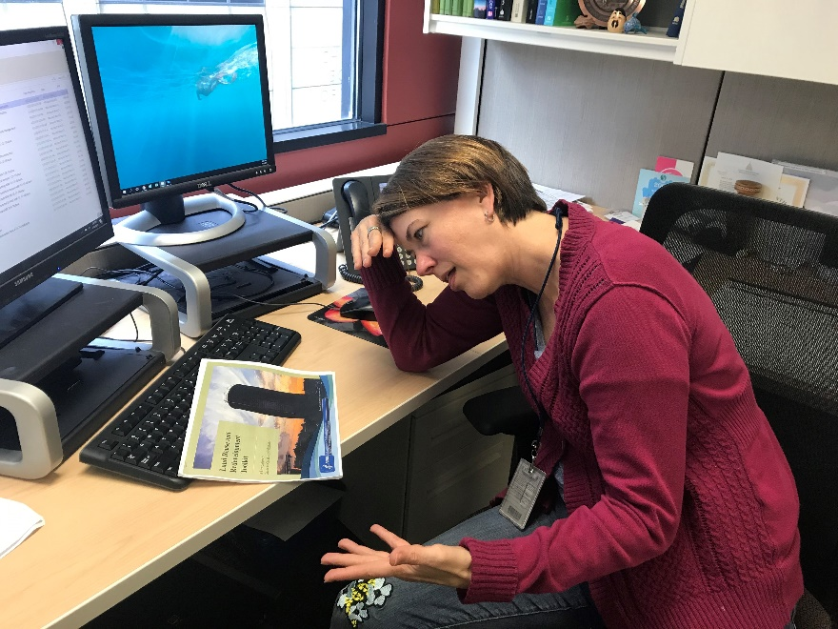
Redesigning with Health in Mind:
Test Details
Pre-test
Post-test: 70% or higher to receive a certificate
  Create a 4-digit number to identify your pre-test and post-test
  Memorize your number or keep a written copy
  Use the same number on both the pre- and post-test
ATSDR Regional Representative taking a test. ATSDR, 2019.
Notes:
Some housekeeping. Everyone write down a 4-digit number that you can remember. You will use this number as your identifier on the pre- and post-test.

Slide 4
Redesigning with Health in Mind:
Pre-test Module 4
Pre-test Module 4
Put your memorized 4-digit number on the top right corner of your pre-test
Notes:
Distribute pre-test. Collect all pre-tests when finished.

Slide 5
Describe 3 site Cleanup Methods
Basic Understanding of Site Cleanup Methods
Objective

Slide 6
Cleanup before Redevelopment
Identify and prioritize
  Contaminants
  Exposure pathways
Understand future use for
  Children
  Adults
  Elderly
Establish protective cleanup goals
Implement the cleanup
Notes:
Now, you have a site in mind. It’s time to plan how to design it with health in mind. Remember from Module 2, your first step to ensure that the site is clean before redevelopment. You have already hired an environmental consultant to conduct an environmental cleanup. During the environmental cleanup, you plan to:
Identify and prioritize the key contaminants and exposure pathways to remediate. (Phase I and II ESA discussed in Module 2).
Understand the future use of the site to ensure remediation does not impede new land use. Know your future users of the site (children, elderly, adults) and adjacent to the site.
Establish cleanup goals that protect both workers, the environment, and future users.
Implement cleanup measures that are consistent with goals and future use.
There are several ways to cleanup contaminants. The type of contaminant(s), site assessment, and exposure pathway(s) all inform the correct method to administer. The following treatment methods are defined by the EPA.

Slide 7
Common Site Cleanup Methods (1 of 2)
Site Cleanup Method | Key Points
Activated carbon treatment | Adds activated carbon to wastewater, to absorb toxic compounds (fuel oil, PCBs, PFAS)
Air stripping | Removes VOCs from water
Bioremediation | Uses microorganisms to transform toxic compounds into nontoxic compounds (petroleum, solvents, pesticides)
Capping | Covers buried waste to prevent migration
Excavation | Removes contaminated materials
Soil vapor extraction (SVE) | Removes vapors from below ground for above-ground treatment
Notes:
Here are some treatment methods used and defined by EPA.
Activated carbon treatment: A wastewater technology, in which powdered activated carbon is added to an anaerobic or aerobic treatment system. The carbon in the biological treatment process absorbs compounds to block toxic effects of organic compounds in the wastewater. Compounds include vapors (radon), groundwater (fuel oil, solvents, polychlorinated biphenyls, dioxins, PFAS, radioactive materials, and low levels of metals).
Air stripping: A process to remove volatile or certain semi-volatile organic compounds from contaminated groundwater or surface water. Part of pump and treat method.
Bioremediation: A process that uses microorganisms to transform harmful substances into nontoxic compounds, a promising technology for treating chemical spills and hazardous waste. Contaminants treated using bioremediation include oil and other petroleum products, solvents, and pesticides. (Time: a few months to multiple years)
Capping: A process to cover buried waste materials in order to prevent migration (movement) of the contaminants. Movement can be caused by rainwater, surface water, or wind moving through the site. Caps do not destroy or remove contaminants. Instead, they isolate them. They prevent people and animals from coming in contact with the contaminants. The caps must be maintained.
Excavation: The removal of contaminated material from a hazardous waste site using heavy construction equipment. Excavation of contaminated soil from a site involves digging it up for “ex situ” (above-ground) treatment or for disposal in a landfill. Excavation also may involve removing old drums of chemicals and other buried debris that might be contaminated.
Soil Vapor Extraction (SVE): Soil vapor extraction removes vapors from below ground for above—ground treatment. The treatment involves using a vacuum to bring the vapors out from underground. SVE is frequently used with petroleum vapors.

Slide 8
Common Site Cleanup Methods (2 of 2)
Site Cleanup Method | Key Points
Immobilization | Treating soil slurries or waste sludge to prevent migration of toxic compounds from soil
Incineration | Burning to destroy organic compounds (e.g., dioxins, PCBs) in waste
Pump and treat | Purifying aquifers/groundwater by removing dissolved contaminants Treating to remove contaminants, Discharging treated water. (Solvents, PCBs, pesticides)
Soil washing | Scrubbing soil ex situ: Dissolving or suspending soil in wash solution Concentrating soil into smaller volume
Thermal desorption | Removing organic compounds from soil and sludge using low temperature heat line separation process
Notes:
Immobilization: A treatment process used to prevent migration of toxic chemicals from soil slurries and waste sludge, in order to keep them from spreading to the surrounding environment.
Incineration: A method to destroy organic compounds in waste, particularly dioxins and polychlorinated biphenyls (PCBs). Incineration is the process of burning hazardous materials in soil, sludge, liquids, or gases at temperatures high enough to destroy contaminants. Used to destroy solvents, PCBS, and pesticides. Will not destroy metals, such as lead or chromium.
Pump and Treat: A method to purify groundwater contaminated with industrial solvents, metals, and fuel oil. Time (Years to decades) Three basic steps:
The contaminated water is recovered from the aquifer or groundwater.
The recovered water is treated to remove contaminants.
The treated water is discharged,
Soil Washing: Soil washing is a water-based process for scrubbing soils ex situ (away from the original site) to remove contaminants. The process removes contaminants from soils in one of two ways:
By dissolving or suspending them in the wash solution (which can be sustained by chemical manipulation of pH for a period of time); or
By concentrating them into a smaller volume of soil through particle size separation, gravity separation, and attrition scrubbing (similar to those techniques used in sand and gravel operations).
Thermal Desorption: A low-temperature heat line separation process designed to remove/evaporate VOCs and some semi-VOCs contaminants from soils and sludges. Thermal desorption removes organic contaminants from soil, sludge or sediment by heating them in a machine called a “thermal desorber” to evaporate the contaminants. Evaporation changes the contaminants into vapors (gases) and separates them from the solid material.

Slide 9
Knowledge Check #1
Select the best answer:
____________ is a process to cover buried waste materials in order to prevent migration (movement) of the contaminants.
Incineration
Immobilization
Capping
Excavation
Notes:
Knowledge Check (KC) #1
Answer c), capping is a process to cover buried waste materials in order to prevent migration (movement) of the contaminants. Movement can be caused by rainwater, surface water, or wind moving through the site.

Slide 10
Knowledge Check #2
Select the best answer:
Bioremediation uses ____________ to transform harmful substances into non-toxic compounds.
Man-made chemicals
Microorganisms
Aeration
Activated carbon
Notes:
KC #2
Answer b): Bioremediation uses microorganisms to transform harmful substances into nontoxic compounds, a promising technology for treating chemical spills and hazardous waste.

Slide 11
Knowledge Check #3 (1of 2)
Soil washing is a surfactant-based process for scrubbing soil ex situ (away from the original site) to remove contaminants.
True
False
Notes:
KC Answer: a) True. Soil washing is a surfactant-based process (liquid/soap) for scrubbing soils ex situ (away from the original site) to remove contaminants.

Slide 12
Knowledge Check #3 (2 of 2)
Two methods of soil washing are
Dissolving or suspending soils in a wash solution (which can be sustained by chemical manipulation of pH for a period of time)
Removing contaminated soils from a hazardous waste site using heavy construction equipment
Incinerating soils to destroy organic compounds
Concentrating contaminants into a smaller volume of soil through particle size separation, gravity separation, and attrition scrubbing (similar to techniques used in sand and gravel operations)
Notes:
The process removes contaminants from soils in one of two ways:
(Choose two). Answer a) and d) are correct:
Dissolving or suspending soils in a wash solution (which can be sustained by chemical manipulation of pH for a period of time).
Removing contaminated soils from a hazardous waste site using heavy construction equipment.
Incinerating soils to destroy organic compounds.
Concentrating contaminants into a smaller volume of soil through particle size separation, gravity separation, and attrition scrubbing (similar to those techniques used in sand and gravel operations).

Slide 13
Community Needs and Visions

Slide 14
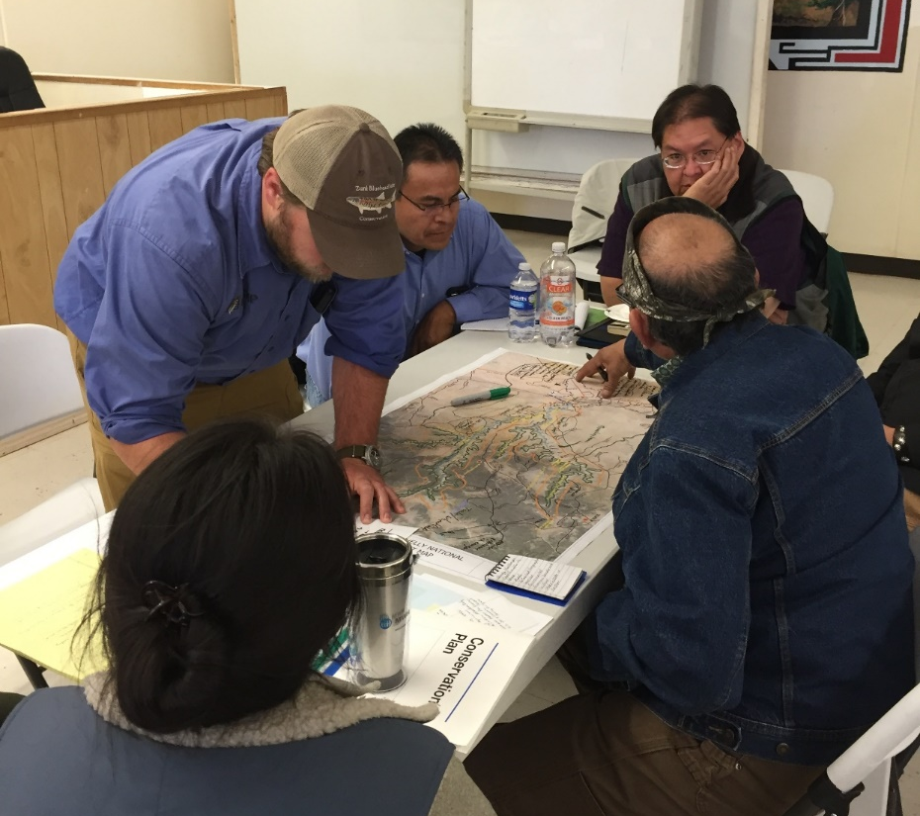
Focusing on Community Vision
Image of a community visioning session (ATSDR, 2016)
Notes:
It is essential to maintain an inclusive and communicative process when working with community stakeholders. It is equally crucial to understand the community vision for the land reuse site and openly communicate with citizens to ensure that the redevelopment meets their unique needs. Translating complex environmental and health concepts into plain language may be the best way to ensure everyone is on the same contextual level. Establishing an open line of communication and displaying a level of understanding with the community builds trust with them and helps guarantee that the work will help address a pressing public health issue.

Slide 15
Emphasizing Health in Redevelopment
Notes:
The land reuse site can be transformed into a site that benefits the health of its citizens. That is why it is important to establish a community vision at the start of the project in Step 1 (Engaging with Your Community). This vision may guide all the decisions for the future site. If the project lacks a vision for a healthier community, it may never happen. When developers and other groups pitch ideas to develop the land, it is crucial to understand the community’s needs and integrate those into the central design of the site.

Slide 16
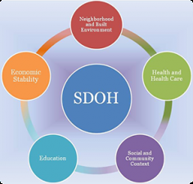
How healthy is your community?
Image of Social Determinants of Health. Healthy People 2020
Notes:
How would you evaluate how healthy your community is? What indicators or determinants of community health could you measure? Above is an image of Social Determinants of Health from Healthy People 2020 (https://www.healthypeople.gov). Determinants include Education, Economic Stability, Neighborhood and Built Environment, Health and Health Care, Social and Community Context
(Source: cleared Land Reuse Toolkit – Environmental Professional (EP)
https://www.atsdr.cdc.gov/sites/brownfields/pdfs/Brownfields_Toolkit_Environmental_Professional-508.pdf
Slide 37)
Use of image (it is cited) will need to be cleared.

Slide 17
Determinants of Community Health
Income and social status
Social support networks
Education
Employment/working conditions
Social environments
Physical environments
Notes:
It is important to understand the basic health profile for your community. Some determinants (indicators) of community health are:
Income and social status
Social support networks
Education
Employment/working conditions
Social environments
Physical environments

Slide 18
Other Determinants of Community Health
Personal health practices
Coping skills
Healthy child development
Sex
Culture
Notes:
Other Determinants of Community Health are:
Personal health practices
Coping skills
Healthy child development
Sex
Culture
It is important to consider all of these factors when evaluating the health of your unique community and communicating with them.

Slide 19
Knowledge Check #4
Including health considerations in redevelopment plans is important, because if a project lacks a vision for a healthier community, it may never happen.
True
False
Notes:
KC #4 Answer: a) True
It is important to include health considerations in redevelopment plans because if a project lacks a vision for a healthier community, it may never happen.

Slide 20
ATSDR Brownfield/Land Reuse action model
Redesigning with Health in Mind:
Notes:
Next, we will learn how to redesign with health in mind. The ATSDR Brownfields /Land Reuse Action Model helps the diverse members of the development community – officials, developers, community supporters, and residents, find ways to make health part of the renewal process. Communities can use the action model to identify common goals to incorporate these goals in strategic planning. First, we’ll need to build our development community.

Slide 21
4 Step Action Model
What are the issues in the community?
How can development address these issues?
What are the corresponding community health benefits?
What data are needed to measure change?
Notes:
It has 4 steps. They’re questions that we’ll ask ourselves today and answer together. You will work with this model throughout this course.

Slide 22
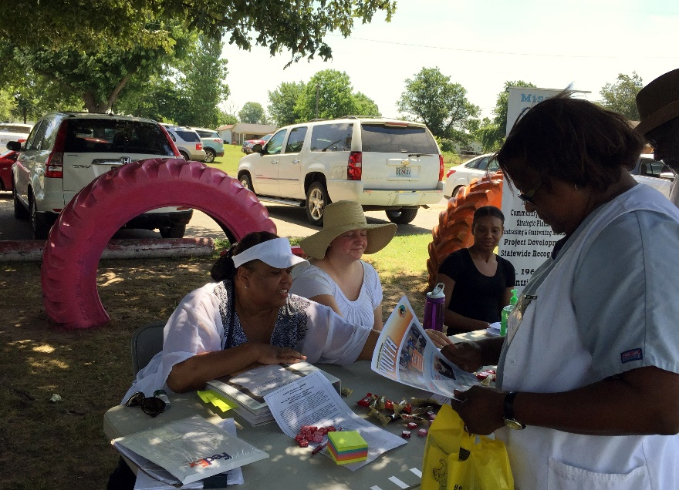
Building a Development Community
Concerned citizens
Business owners
Developers/Planners
Tribal leaders
Government agencies
Health agencies
Nonprofits
Image of a Development Community event. ATSDR, 2016.
Notes:
The first step is to build a development community to get everyone at the table ready to redesign with health in mind.
A development community is a group of people who want to help with and have input on the land reuse site. This community might include:
Concerned citizens
Business owners
Developers
Planners
Tribal leaders
Government agencies
Local, state, tribal health departments, Indian Health Service
Nonprofit groups

Slide 23
Where do you find them?
“I firmly believe that the success of any community action lies with the enthusiasm of its people.” — Participant in the Linnton, Oregon Action Model
Notes:
Some good places to start identifying these people include local resources and organizations like:
Chamber of Commerce
Community centers
Organizations (like the 4-H Club, Boys and Girls Clubs, and Salvation Army)
Local hospitals and health clinics, IHS
City Council, Tribal Council
Where do you think you can find tribal, state, and federal support?

Slide 24
State and Federal Support
ATSDR Land Reuse Team (mailto: atsdr.landreuse@cdc.gov)
EPA Brownfields Program (https://www.epa.gov/brownfields)
EPA Environmental Justice Program (https://www.epa.gov/environmentaljustice)
Health departments (state, local, tribal)
State environmental protection agencies
Notes:
Invite some experts to meet with the development team.
Start by emailing the ATSDR Land Reuse Team to get in contact with a regional ATSDR office.
Other organizations could also be helpful including:
EPA Brownfields Program, which focuses on cleaning up old factories and industrial sites
EPA Environmental Justice Program, which helps make sure all people – regardless of race, color, national origin, and income – live in a healthy environment
Health departments in the local area or state, which focus on keeping communities healthy
State environmental protection agencies, which focus on the environment and its effect on people’s health

Slide 25
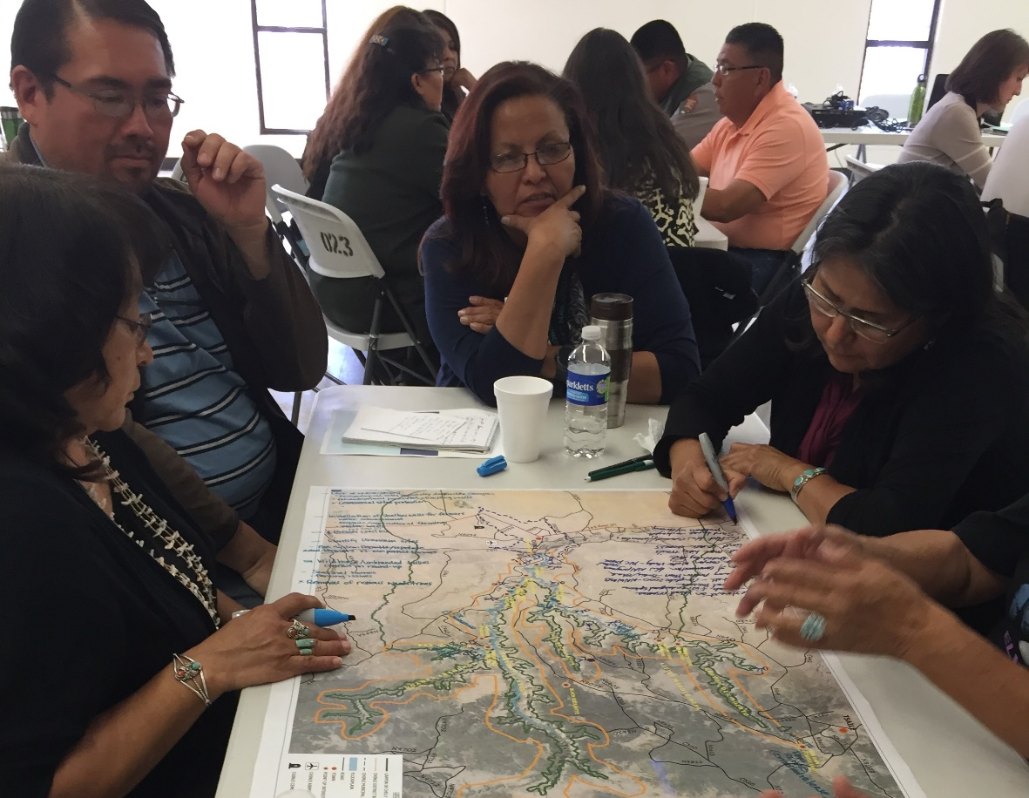
Ask Questions
Development Community meeting. ATSDR, 2017.
Notes:
When you contact possible members of your Development Community, tell them about your ideas and ask a few questions.
What are the problems/situations that you want to improve? These may be the same or different from your own goals.
What would help solve them? See what their ideas are for improvements.
Do you know anyone else who might be interested in our project? This is key. You’ll get more names of people who might want to join the Development Community.

Slide 26
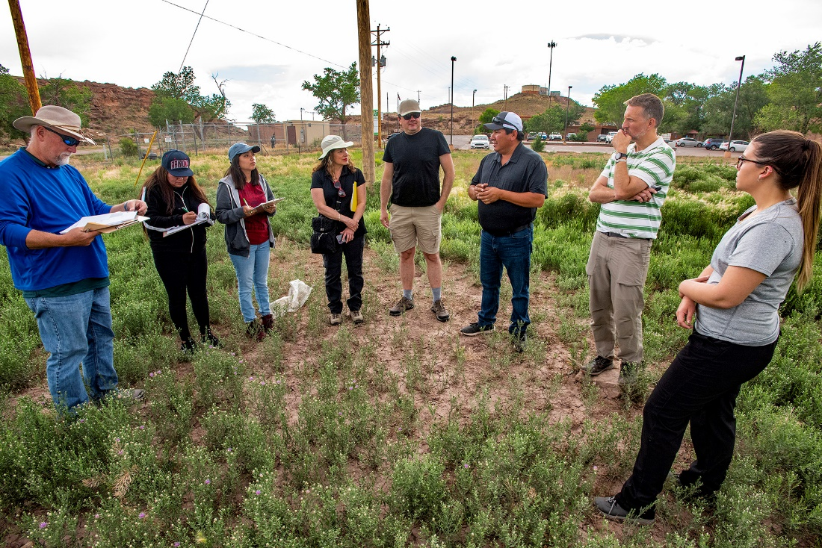
HOW BIG SHOULD THE DEVELOPMENT COMMUNITY BE?
Members of a development community in Navajo Nation. Source: Lloyd DeGrane, 2019.
Notes:
There’s no right number. Development Communities can range from 10 to 30 people.
How do you know you have your complete team? Whenever you talk to a new possible member, ask if they have recommendations for other potential members. When those recommendations tend to be people you’ve already contacted, that’s a sign you have formed your Development Community.
Once some people sign on to work on the project, meet in person. These could be one-on-one meetings, or it could be a meeting of the larger group. Keep in mind that early meetings do not have to be formal. Nothing needs to be decided. The purpose of these meetings is relationship and trust building, providing an opportunity to get to know each other and understand each other’s concerns and perspectives. The environmental or health professional must stay open to new ideas.
These meetings can be at the library, community center, senior center, or at a local health agency.

Slide 27
Action Model
What are the issues in the community?
How can development address these issues?
What are the corresponding community health benefits?
What data are needed to measure change?
Notes:
By setting up the development community, you are ready to start on the first two steps of the action model. By now, you may even have heard about the issues in the community and some ideas of how redevelopment could address them.

Slide 28
Healthfields
Address many health-related issues:
  Contaminant and exposure reduction
  Environmental justice
  Fresh food availability
  Community recreation and green space
  Health care access
  Employment
  Crime
Notes:
As you and your Development Community are starting to plan how redevelopment could address issues in the community, think about how redevelopment could improve the health of the community. How can you transform these brownfields to healthfields?
A Healthfield is a former land reuse site that has been transformed from an underused, potentially contaminated property into a vibrant area that serves a number of community health needs. Healthfields start with a vision to create a healthy community through land reuse and redevelopment. Healthfields is the broader strategy of improving access to health and healthcare through redevelopment. They simultaneously address health-related issues, such as:
Contaminant and exposure reduction
Environmental justice
Fresh food availability
Community recreation and green space
Health care access
Employment
Crime

Slide 29
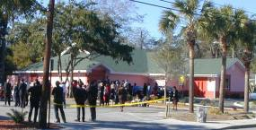
Willa Carson Health and Wellness Center, Clearwater, FL
Clearwater Healthfield redevelopment. Source: Leading Change for Healthy Communities and Successful Land Reuse. Available at: https://www.atsdr.cdc.gov/sites/brownfields/docs/ATSDR_LandReuse.pdf
Notes:
The Healthfields movement owes a tremendous debt to Ms. Willa Carson. In 1998, Carson was a retired nurse in Clearwater, Florida. She ran a health clinic that provided basic medical assistance to friends and neighbors who lacked health insurance and the means to travel to the nearest hospital. When the City of Clearwater designated the Greenwood area of Clearwater as a Brownfields Redevelopment Site, Carson saw an opportunity. She had the pioneering vision to turn Greenwood, an abandoned gas station site, into a stand-alone health care facility.
Today, the Willa Carson Health and Wellness Center provides over 3,500 underserved residents with local access to preventive health and dental care, a pharmacy, and health education programs. Carson’s work serves as the basis for community-driven Highways to Healthcare initiatives that turn abandoned properties with underground storage tanks across Florida into health centers and public service facilities.

Slide 30
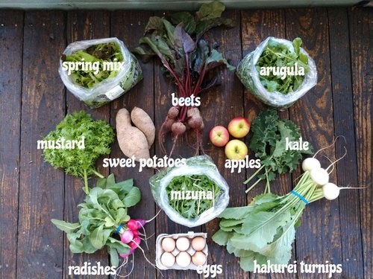
Lynchburg Grows, Lynchburg, VA
Promotional image for Lynchburg Grows community supported agriculture. How to Get What We Grow. Retrieved from: https://www.lynchburggrows.org/veggiebox2019.
Notes:
In Lynchburg, Virginia, organizers turned to the owners of the derelict Schenkel Farm, a six-and-a-half acre rose growing facility with nine historic greenhouses, a farmhouse, a root cellar, and other farm buildings. Inspired by the Lynchburg Grows mission, the family provided attractive terms for the organization to acquire the property, now known at the H.R. Schenkel Urban Farm and Environmental Center. Once transferred, the fledgling Lynchburg Grows appealed to community groups and local schools to clean the space and prepare for growing food. By 2013, more than 5,000 volunteers contributed over 70,000 hours working with Lynchburg Grows staff. They have produced over 100,000 roses and 80,000 pounds of food, donating almost 75% to Lynchburg-area food banks and soup kitchens.

Slide 31
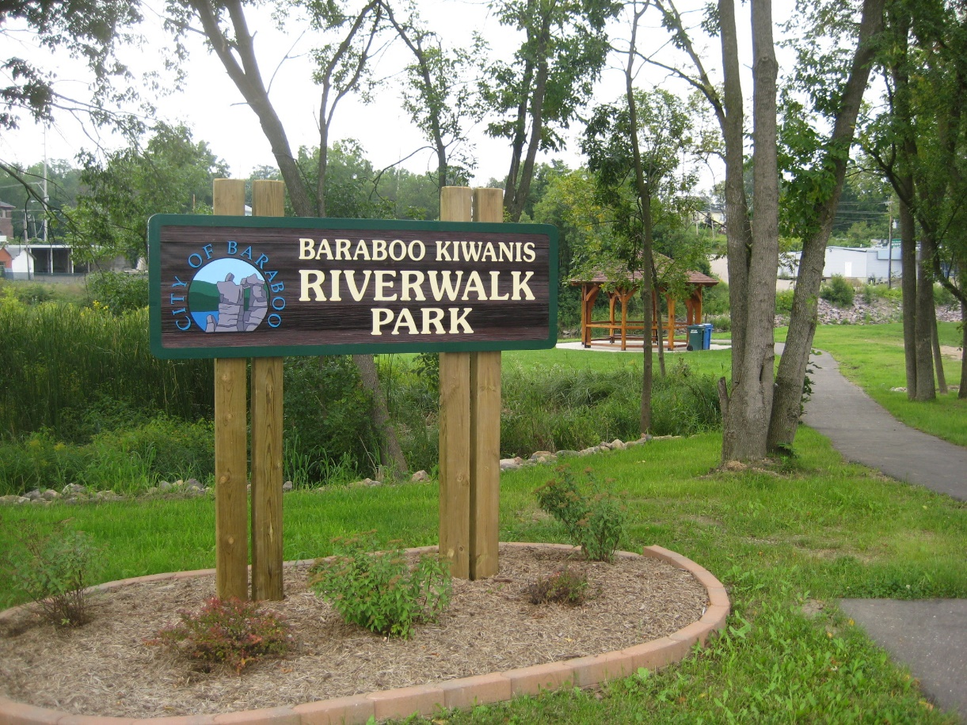
Baraboo, WI, Riverwalk
Notes:
The City of Baraboo is a river community of 12,000 people with the Baraboo River essentially bisecting the town. An active group of volunteers in Baraboo created redevelopment plans that not only improved the environment, but also the health of the community in the redevelopment area (e.). Several community organizations helped support the development of a 2.92-mile recreational trail along the riverfront. As a result, the area has seen increasing numbers of residents and visitors alike — walking, jogging, picnicking, and using several parks linked by the trail.

Slide 32
Knowledge Check #5
Select the best answer:
What is a “healthfield?”
One example of a “healthfield” is working as a nurse.
A location where many healthy people gather together for like-minded activities is a healthfield.
A former land reuse site that has been transformed from an underused, potentially contaminated property into a vibrant area that serves a number of community health needs is a healthfield.
None of the above describes a healthfield.
Notes:
On KC #5 Answer:
What is a “healthfield?” (Answer c)
A former land reuse site that has been transformed from an underused, potentially contaminated property into a vibrant area that serves a number of community health needs is a healthfield.

Slide 33
Knowledge Check #6
Which of these would be considered an example of health-focused redevelopment? (Choose all that apply)
Reusing existing underground storage tanks for a new gas station at the site of an old gas station.
Increasing the availability of fresh food in a community by creating a community garden on an abandoned lot.
Creating a senior center and health clinic inside an abandoned school.
Demolishing an abandoned warehouse and fencing the property to protect the community from the danger of the debris left behind.
Remediating asbestos contamination inside an old mill and redeveloping the building to be a cultural center.
Notes:
KC #6 Answer: (Answers b, c, and e are correct)
What would be considered an example of health-focused redevelopment? (Choose all that apply).
Increasing the availability of fresh food in a community through the creation of a community garden on an abandoned lot.
Creating a senior center and health clinic inside an abandoned school.
Remediating asbestos contamination inside an old mill and redeveloping the building to be a cultural center.

Slide 34
Demonstrate how to use the action model
Action Model
Objective
Notes:
Next, we will continue to use the Action Model. The ATSDR Brownfields /Land Reuse Action Model helps the diverse members of the development community – officials, developers, community supporters, and residents, find ways to make health part of the renewal process. Communities can use the action model to identify common goals to incorporate these goals in strategic planning. First, we’ll need to build our development community to address some community concerns and for engagement in healthfields redevelopment.

Slide 35
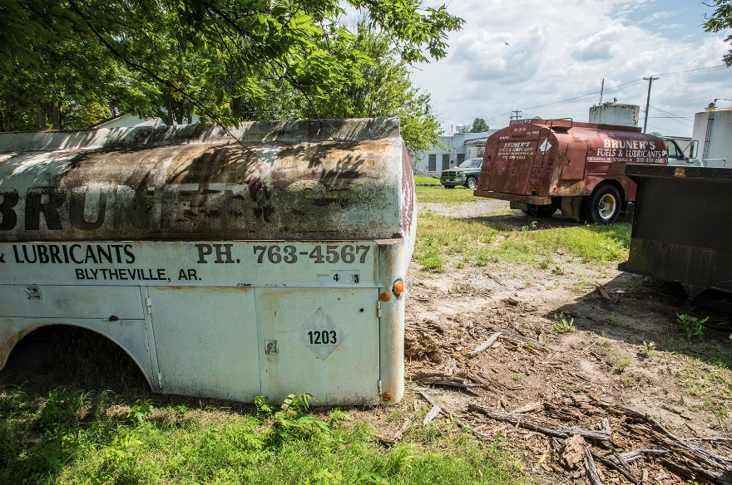
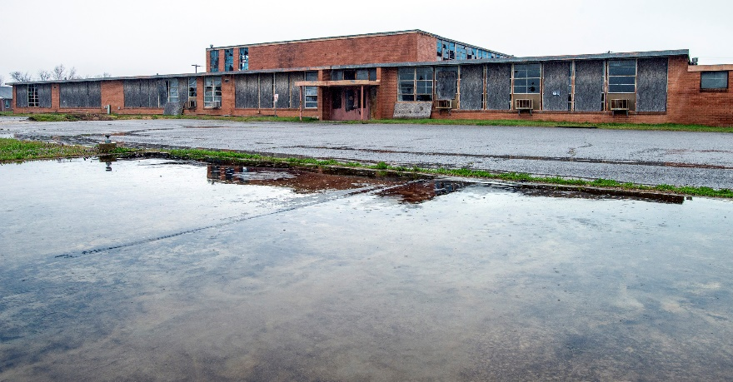
Practice: Redesign with Health in Mind
Old fuel tanks behind a gas station. Lloyd DeGrane, 2019.
Old school that needs cleanup. Lloyd DeGrane, 2018.
Notes:
We will focus on a rural community with a gasoline leak that has migrated to an old school. The school is also contaminated with several chemicals of concern.

Slide 36
Practice
You are working with a rural community like the one shown in the previous slide that has
  High number of land reuse sites
  No grocery stores
  No community gathering spaces that can also serve as storm shelters
  A low median income
  An aging population (median age 48)
  No early childhood education programs
  Primary health care or dental providers located 25 miles away
  Gas station located 5 miles away
  Grocery store located10 miles away
  Residents who don’t drive and can’t get to doctor appointments and grocery stores.
Notes:
You are working with a rural community that has high numbers of land reuse sites, no grocery stores, no community gathering spaces that can also serve as storm shelters, a low median income, no early childhood education, and no primary health care or dental providers. The town is 25 miles from the nearest hospital and healthcare providers, five miles from the nearest gas station, and 10 miles from the nearest grocery store. The population is aging (median age is 48). Some residents can no longer drive and have a hard time getting to doctor appointments and grocery stores.

Slide 37
Practice
The development community recently received a cleanup grant to clean up:
  Former school contaminated with
    Lead
    Mercury
    PCBs (polychlorinated biphenyls)
    Asbestos
  Former gas station where
    Tanks leaked gasoline in soil and groundwater
    Groundwater VOC (volatile organic chemical) plume migrated from the gas station to the former school
Notes:
Practice time. Pick a site in your community to redevelop. Assume that you have plans and funding for cleaning the site. How will you redevelop it? Who is on your development community?
The Development Community recently received a cleanup grant to clean up:
Former school contaminated with
Lead
Mercury
PCBs
Asbestos
Former gas station
Tanks leaked gasoline in soil and groundwater
Groundwater VOC plume migrated from the gas station to the former school

Slide 38
Practice
What would be the steps in the cleanup? What are some potential cleanup methods?
Who are the members of your development community?
Create an action model (steps 1-3):
  What are the issues in the community?
  How can development address these issues?
  What are the corresponding community health benefits?
How can you redesign with health in mind or create healthfields?
Notes:
What are the steps conducted in the cleanup? What are some potential cleanup methods?
Who are the members of your development community? Who is at the table?
Create an action model (steps 1-3):
What are the issues in the community?
How can development address these issues?
What are the corresponding community health benefits?
How can you redesign with health in mind? Create healthfields.

Slide 39
New Healthfields Example
Vendor Village – Crafts village with community amenities in Chinle, AZ
Notes:
This proposed vendor crafts village will provide more visibility for vendors, generate tourism dollars, provide a central location for jeep tour access (of Canyon de Chelly) , provide recreational trails for locals, a community center, an amphitheaters, showers, and basketball court. The natural wash through the area will be incorporate in the design. Ultimately, a formerly vacant parcel of land will be reused to improve overall community health.

Slide 40
Review
Review your slides and knowledge checks
Post-test is next. It is an “open-book” exam.
  Score 70% to pass
  Take it multiple times if needed to reach an 80% score
  Add your 4-digit number in upper right corner.
We will grade these on the break.

Slide 41
Thank you!
Laurel Berman, laberman@cdc.gov
Leann Bing, kbing@cdc.gov
Sue Casteel, aov2@cdc.gov
Division of Community Health Investigations

