Slide 1
The CDC/ATSDR Social Vulnerability Index
A tool for measuring community-level social vulnerability
Prepared by the Geospatial Research, Analysis, & Services Program,
Centers for Disease Control and Prevention/Agency for Toxic Substances and Disease Registry
Notes:
Good morning/afternoon, everyone! This presentation was created by members of the Geospatial Research, Analysis, and Services Program (or GRASP) at CDC/ATSDR. The GRASP group is focused on providing geospatial expertise through research, analysis, and services within the geospatial space. GRASP created the Social Vulnerability Index, which is the topic of today’s discussion.

Slide 2
Today’s Agenda
Overview of the CDC/ATSDR Social Vulnerability Index (SVI)
Examples of SVI in Research
Group Activity
Discussion
Notes:
Today, we will provide information on the Social Vulnerability Index (or SVI) regarding its history, how it was created, and use cases of SVI in research. After discussing a few examples of using the SVI, we will then do a group activity, followed by a discussion session.

Slide 3
The History of the CDC/ATSDR Social Vulnerability Index
  The Pandemic and All-Hazards Preparedness Act of 2006 cited public health preparedness and response capabilities as critical needs for the United States.
  CDC decided to build agency capacity by addressing social vulnerability to disasters.
  GRASP began developing SVI in 2007 and disseminated SVI in 2011.
Notes:
What came to be known as the CDC/ATSDR SVI was created in accordance with the Pandemic and All-Hazards Preparedness Act of 2006. This Act cited that public health preparedness and response capabilities were critical needs for the nation. When this Act was signed into law by President Bush, it was a mandate to which all federal agencies were tasked to comply.
In response, CDC decided to build agency capacity in public health preparedness and response by addressing social vulnerability to disasters and public health emergencies.
From this effort, a group of social scientists and statisticians in GRASP began developing the SVI in 2007 and released the first iteration of the SVI in 2011.

Slide 4
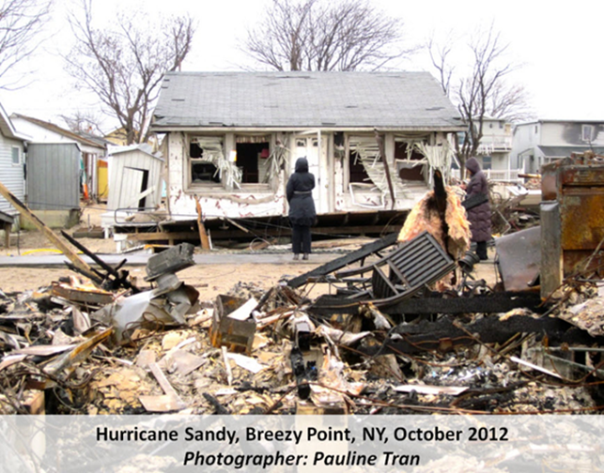
The Purpose of the CDC/ATSDR Social Vulnerability Index
  Social vulnerability refers to the demographic and socioeconomic factors that adversely affect communities that encounter hazards and other community-level stressors.
  SVI was developed as a place-based index, database, and mapping tool to assist public health officials with identifying and quantifying socially vulnerable communities.
Hurricane Sandy, Breezy Point, NY, October 2012
Photographer: Pauline Tran, CDC public health image library
Notes:
Every single community in the United States exhibits varying degrees of vulnerability to public health emergencies; however, a community’s social vulnerability plays an important role in its response to and recovery from hazardous events, such as a disaster or disease outbreak.
Social vulnerability refers to the demographic and socioeconomic factors that contribute to communities being more adversely affected by public health emergencies and other external hazards and stressors that cause disease and injury. For instance, there are social factors, such as poverty, that lead to certain populations being less able to prepare for, respond to, and recover from public health emergencies. Also, it’s important to track and measure social vulnerability to address social disadvantage within communities and decrease human suffering, health disparities, and health inequities.
Thus, the SVI was developed as an index, database, and mapping tool to assist public health practitioners with identifying and quantifying the communities most impacted by social vulnerability in their jurisdictions.
The photo is in the public domain via the CDC Public Health Image Library: https://phil.cdc.gov/Details.aspx?pid=19316.

Slide 5
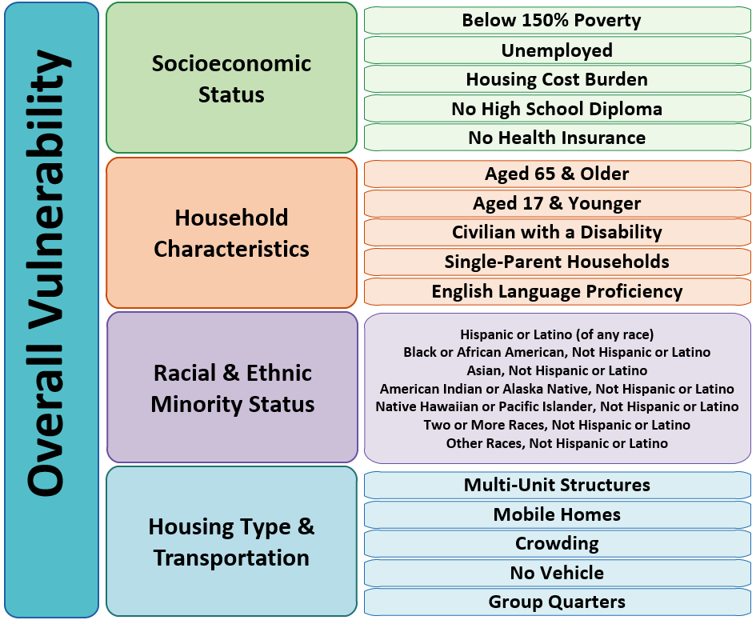
The Methodology of the CDC/ATSDR Social Vulnerability Index
Components of the Social Vulnerability Index
SVI uses Census Bureau data to measure the relative social vulnerability of U.S. communities.
SVI uses percentile ranks to score the social vulnerability of a community from 0 to 1.
SVI has been developed for U.S. census tracts and counties at national and state levels (including Puerto Rico & tribal tracts).
SVI is available for 2000, 2010, 2014, 2016, 2018, and 2020.
Notes:
The SVI is composed of Census Bureau data from the 5-year American Community Survey to measure the relative social vulnerability of U.S. communities. Currently, the SVI includes data on 16 sociodemographic variables, as we can see shown here.
The 16 variables are grouped into 4 themes that cover four major areas of social vulnerability, including vulnerability based on socioeconomic status, household characteristics, racial & ethnic minority status, and housing type & transportation. Each of the 16 variables are weighted equally, as are the 4 themes. Additionally, a measure of overall social vulnerability utilizes all 16 variables combined.
For the SVI, we use percentile ranks to score the social vulnerability of a community on a scale of 0 to 1, with 1 representing most vulnerable or the highest level of vulnerability. This is the main variable, which is RPL_THEMES in the dataset.
SVI databases have been developed and validated for U.S. census tracts and counties at both national and state levels, including databases for Puerto Rico and tribal tracts. The SVI database for Puerto Rico is a stand-alone database that is ranked separately from U.S. states. The CDC/ATSDR SVI databases for tribal census tracts include data for the SVI indicators but do not include rankings.
Since the start of development of the SVI in 2007 and releasing the first database in 2011, six SVI databases have been created (for the years 2000, 2010, 2014, 2016, 2018, and 2020) using the data from the American Community Survey (ACS) conducted by the U.S. Census Bureau. GRASP releases new SVI databases every 2 years.

Slide 6
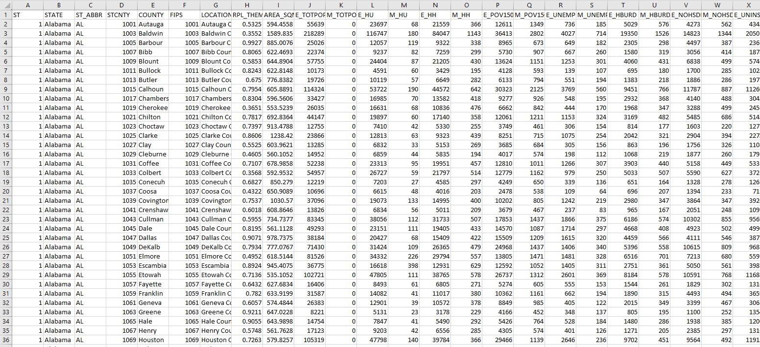
The CDC/ATSDR Social Vulnerability Index is a Complete Toolbox
Centers for Disease Control and Prevention/ Agency for Toxic Substances and Disease Registry/ Geospatial Research, Analysis, and Services Program. CDC/ATSDR Social Vulnerability Index 2020 Database U.S. https://www.atsdr.cdc.gov/placeandhealth/svi/data_documentation_download.html. Accessed on Oct 14, 2023.
Notes:
Here, we have the SVI 2020 map in which you can easily distinguish areas of increased social vulnerability based on the dark blue color.
One aspect that makes SVI different and from other social vulnerability indices is what you see behind the map, which is an example of the database provided. The GRASP team not only computes the index and provides maps of rankings, but they also provide the raw data (meaning the counts and percentages) that generate those rankings for each census tract and county in the United States.
These data are often useful for practitioners needing to know how many people in specific vulnerable groups reside in their communities to focus and allocate limited resources to those most in need.

Slide 7
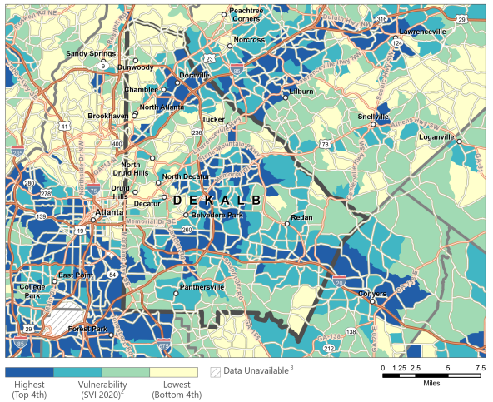
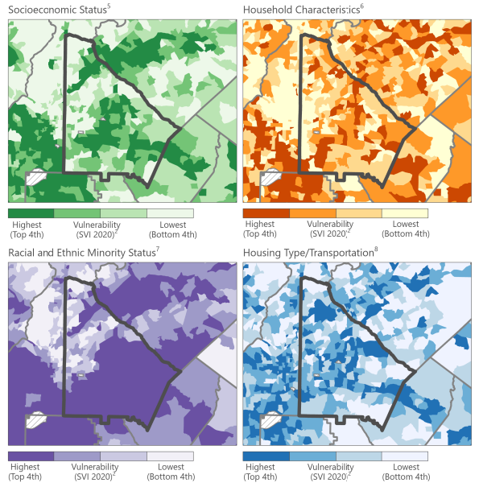
Prepared Social Vulnerability Index (SVI) County Map
2020 Overall SVI for Dekalb County, GA
2020 SVI Themes for Dekalb County, GA
Centers for Disease Control and Prevention/ Agency for Toxic Substances and Disease Registry/ Geospatial Research, Analysis, and Services Program. CDC/ATSDR Social Vulnerability Index 2020 Allegheny County Prepared County Map. https://svi.cdc.gov/Documents/CountyMaps/2020/Pennsylvania/Pennsylvania2020_Allegheny.pdf. Accessed on Oct 14, 2023.
Notes:
The SVI site contains Prepared County Maps for every U.S. county, which display social vulnerability at the census tract level for counties of interest. Users can take a quick glance at these maps and get a good idea of the varying patterns of social vulnerability in their areas.
Here is an example Prepared County Map of Dekalb County, GA where the CDC campus is located. On the left is the overall social vulnerability of Dekalb County, GA, and on the right are the 4 SVI themes we previously discussed.
These maps can be a helpful visual to show variable patterns of social vulnerability within a county.
For example, if we look at the overall map on the left and look at the bottom left corner of the county, we see the light green color that denotes a moderately low overall social vulnerability ranking. However, if we want to dig a little deeper to get more specific information about what might be driving this overall score, we can look at the four maps on the left that show each of the four SVI themes. Looking at that same area in these maps, we can see that although the Socioeconomic Status is in the lowest quartile and the Housing Type and Transportation is moderately low, the Household Characteristics and Racial and Ethnic Minority Status themes are both in the highest quartile. This can help provide more context for an area as to what might be impacting the social vulnerability index ranking of a community. Try downloading these maps on our site and checking the overall and thematic SVI for your neighborhood!

Slide 8
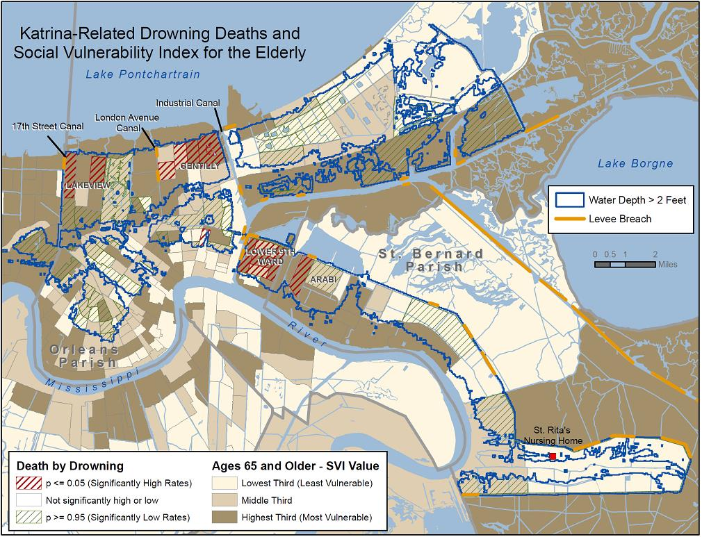
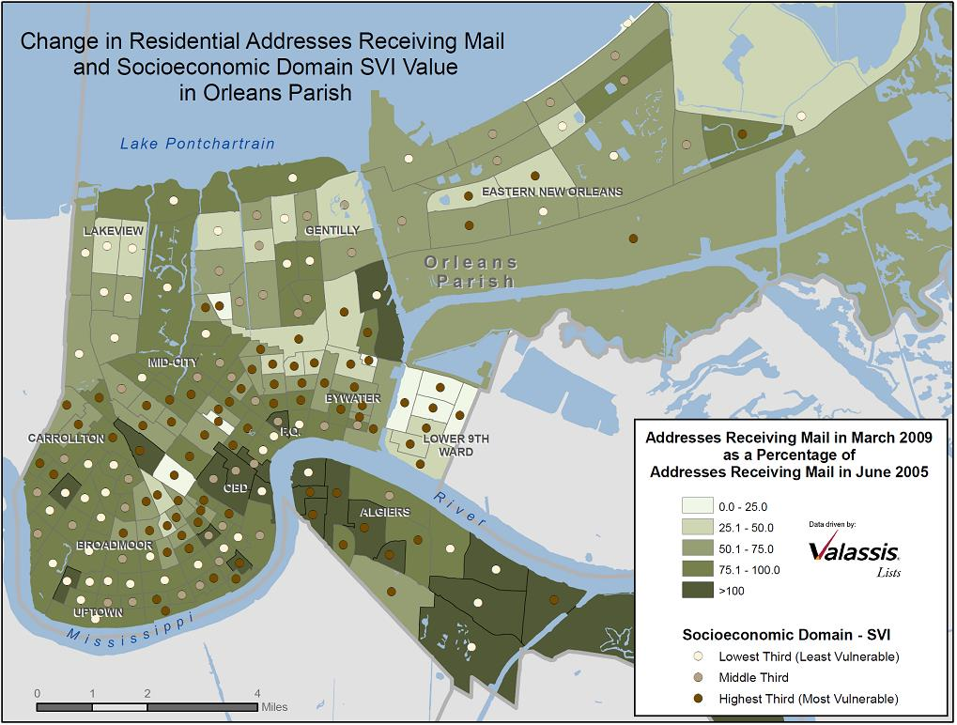
Application of the SVI in Descriptive Epidemiology:
Natural Disasters
What are some ways these data can be used for public health interventions?
Reply in chat!
Flanagan, B., Gregory, E.W., Hallisey, E., Heitgerd, J.L., & Lewis, B. (2011). A Social Vulnerability Index for Disaster Management. Journal of Homeland Security and Emergency Management, 8.
Notes:
Now we’ll explore a few ways SVI is used in research at CDC and externally.
The literature tells us that individuals who reside in socially vulnerable communities are more likely to be negatively affected by disasters and less likely to recover quickly. This slide portrays a map from the first study after the creation of the SVI, that was testing this theory, to informally and empirically validate whether SVI was measuring what was expected.
The map on the left is an early visualization of SVI data and Hurricane Katrina aftermath. The maps were produced in 2010.
Here you’ll find Hurricane Katrina-related drowning deaths, by census tract, mapped and compared to SVI rankings for elderly populations.
Almost half of Katrina fatalities were over age 75.
Given that only six percent of the pre-Katrina residents in the affected area were older than age 75, the elderly were especially vulnerable to this catastrophic event.
The tracts with red hatching show where the number of deaths per tract is significantly higher than expected compared to a regional mortality rate.
Of the fifteen tracts with a statistically significant higher number of deaths than expected, eight are scored as the most vulnerable ranking in terms of the number of residents 65 and older. With the exception of one tract scored as the lowest SVI quartile ranking for number of individuals 65 and older, the remaining tracts are in the middle SVI quartiles.
This is an example of using the SVI, specifically data from the household characteristics theme that includes the proportion of individuals who are over age 65, to examine the communities and individuals who are most at risk during a natural disaster. Moreover, these SVI data were used to address a specific research question using the granular data included in one of the SVI themes.
Subsequently, the SVI was also used to examine the recovery after Hurricane Katrina. On the right is a map of change in residential addresses that receive mail with the SVI value for the socioeconomic theme. Zones where there was the most drastic change in receiving mail (in dark green) are commonly also labeled as areas that experience more vulnerability (brown dot).
Take a moment to examine these maps. What are some ways that these data can be used for public health intervention?
Potential answers: Relief efforts can be focused on areas ranked with a higher social vulnerability score. For example, more instrumental support can be distributed where the elderly resides to improve their chances of survival from the disaster.

Slide 9
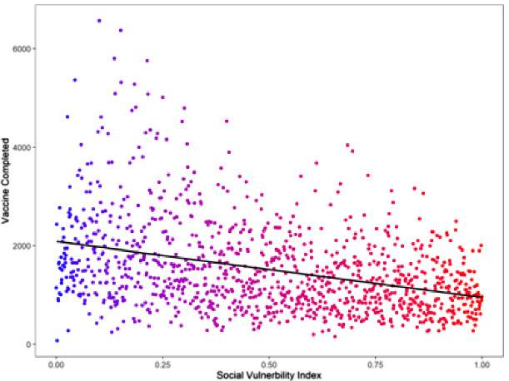
Application of the SVI in Descriptive Epidemiology: COVID-19 Pandemic
Scatterplot of 2018 Overall SVI Percentile Ranking vs Vaccination in Louisiana from December 2020 – October 2021
Bhuiyan MAN, Davis TC, Arnold CL, et al. Using the social vulnerability index to assess COVID-19 vaccine uptake in Louisiana. GeoJournal. 2023;88(3):3239-3248. doi:10.1007/s10708-022-10802-5
Notes:
Here is a more recent example of an application of the SVI in a study that examined the relationship between social vulnerability and vaccine uptake in Louisiana during the COVID-19 pandemic in December 2020 through October 2021. This is an instance where the SVI is used in an aspatial matter rather than using maps. In this scatter plot, the y axis is the number of vaccinations, and the x axis is the SVI where higher SVI values indicate higher vulnerability. This figure shows a statistically significant (p< 0.001) negative association between SVI and vaccine uptake: as the SVI increased, vaccinations decreased.

Slide 10
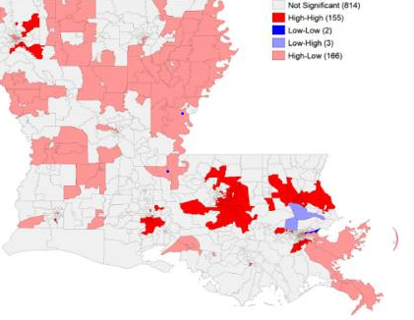
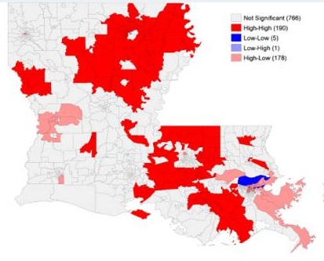
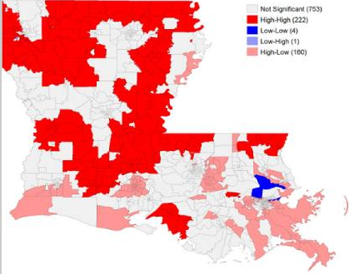
Application of the SVI in Descriptive Epidemiology:
COVID-19 Pandemic
Cluster maps of COVID-related vaccination rates, mortality rates, and SVI ranking in Louisiana
Where would you target for vaccination campaigns?
Reply in chat!
Bhuiyan MAN, Davis TC, Arnold CL, et al. Using the social vulnerability index to assess COVID-19 vaccine uptake in Louisiana. GeoJournal. 2023;88(3):3239-3248. doi:10.1007/s10708-022-10802-5
Notes:
These figures came from the same publication as the previous slide and show different cluster maps for various pairing of SVI dichotomized into high and low and COVID-19 outcomes dichotomized into high and low. Specifically (from left to right), they show vaccination, cases, and mortality. In the key, the first word (high or low) corresponds with SVI, and the second word (high or low) corresponds to the COVID-19 related outcome.
Now, I’ll give you all a moment to examine these maps. Based on these figures, where would you recommend focusing in terms of vaccination campaigns?
Potential answer: vaccination campaigns should focus in areas with low vaccination and high mortality.

Slide 11
Application of the SVI in Descriptive Epidemiology: SVI & Preterm Birth (cont.)
SVI Component Overall Composite | Unadjusted Analyses | Adjusted Analyses
 | OR (95% CI) | Model A aOR (95% CI) | Model B aOR (95% CI)
Preterm birth at <37 0/7 wk | 1.34 (1.17-1.54) | 1.28 (1.10-1.49) | 1.32 (1.14-1.53)
Preterm birth at <34 0/7 wk | 1.39 (1.10-1.75) | 1.47 (1.27-1.71) | 1.60 (1.27-2.01)
Preterm birth at <28 0/7 wk | 2.35 (1.62-3.40) | 1.81 (1.21-2.69) | 2.21 (1.50-3.25)
Composite major neonatal morbidity | 2.30 (1.68-3.14) | 1.88 (1.35-2.62) | 2.30 (1.67-3.17)
Unadjusted odds ratio and adjusted odds ratio for preterm births and composite morbidity conferred by each 0.01 increase in the SVI component/theme⁴.
Model A: All initial “A” models evaluating preterm birth as an outcome included Black race, tobacco smoking during pregnancy, chronic hypertension, any diagnosis of diabetes mellitus, a shortened mid-trimester cervical length, twin gestation, and male fetal sex. All initial “A” models evaluating composite major neonatal morbidity included Black race, tobacco smoking during pregnancy, any diagnosis of diabetes mellitus, twin gestation, small for gestational age.
Model B: All initial “B” models were identical to “A” models, but patient race was excluded from model inclusion.
Givens M, Teal EN, Patel V, Manuck TA. Preterm birth among pregnant women living in areas with high social vulnerability. Am J Obstet Gynecol MFM. 2021;3(5):100414. doi:10.1016/j.ajogmf.2021.100414
Notes:
In this study, the investigators used a continuous SVI as their exposure of interest and preterm birth as the outcome in a multivariate regression analysis. This is great example of a using the SVI to address different, but related, research questions.
For example, is there an association between community-level SVI and preterm birth? Is the association different for across each of the SVI themes? Is the association different across various pregnancy term lengths that are considered as preterm? Is the association between the SVI and preterm birth different than the association between SVI and composite neonatal morbidity? And so on. This slide and the next several slides seek to address these research questions.
Here we see the regression results for preterm birth and the overall SVI.
Individuals classified as experiencing a preterm birth (delivering before term at <37 weeks, < 34 weeks, and <28 weeks’ gestation) were more likely to live in an area with a higher overall SVI ranking. Additionally, the associations between SVI and preterm birth were strongest among the shortest gestational periods.
Note: This study used the 2014, 2016, and 2018 versions of the SVI. There are some differences in variables and themes from these years and 2020.

Slide 12
Application of the SVI in Descriptive Epidemiology: SVI & Preterm Birth
SVI Component Theme 1: socioeconomic status | Unadjusted Analyses | Adjusted Analyses
 | OR (95% CI) | Model A aOR (95% CI) | Model B aOR (95% CI)
Preterm birth at <37 0/7 wk | 1.36 (1.19-1.57) | 1.23 (1.06-1.43) | 1.26 (1.08-1.46)
Preterm birth at <34 0/7 wk | 1.66 (1.06-1.68) | 1.33 (1.06-1.68) | 1.50 (1.20-1.88)
Preterm birth at <28 0/7 wk | 2.47 (1.72-3.54) | 1.97 (1.34-2.90) | 2.35 (1.61-3.42)
Composite major neonatal morbidity | 2.18 (1.61-2.96) | 1.85 (1.34-2.56) | 2.22 (1.62-3.05)
Unadjusted odds ratio and adjusted odds ratio for preterm births and composite morbidity conferred by each 0.01 increase in the SVI component/theme⁴.
Model A: All initial “A” models evaluating preterm birth as an outcome included Black race, tobacco smoking during pregnancy, chronic hypertension, any diagnosis of diabetes mellitus, a shortened mid-trimester cervical length, twin gestation, and male fetal sex. All initial “A” models evaluating composite major neonatal morbidity included Black race, tobacco smoking during pregnancy, any diagnosis of diabetes mellitus, twin gestation, small for gestational age.
Model B: All initial “B” models were identical to “A” models, but patient race was excluded from model inclusion.
Givens M, Teal EN, Patel V, Manuck TA. Preterm birth among pregnant women living in areas with high social vulnerability. Am J Obstet Gynecol MFM. 2021;3(5):100414. doi:10.1016/j.ajogmf.2021.100414
Notes:
In this slide, we have the results for the socioeconomic theme. Similar to the overall SVI, there is association between preterm birth and the socioeconomic SVI theme and stronger associations for shorter gestational periods.

Slide 13
Application of the SVI in Descriptive Epidemiology: SVI & Preterm Birth (cont.)
SVI Component Theme 2: household composition and disability | Unadjusted Analyses | Adjusted Analyses
 | OR (95% CI) | Model A aOR (95% CI) | Model B aOR (95% CI)
Preterm birth at <37 0/7 wk | 1.33 (1.16-1.53) | 1.28 (1.10-1.48) | 1.31 (1.13-1.52)
Preterm birth at <34 0/7 wk | 1.49 (1.20-1.85) | 1.30 (1.03-1.64) | 1.44 (1.15-1.82)
Preterm birth at <28 0/7 wk | 1.92 (1.33-2.39) | 1.61 (1.09-2.39) | 1.89 (1.29-2.78)
Composite major neonatal morbidity | 2.16 (1.58-2.95) | 1.92 (1.38-2.67) | 2.24 (1.62-3.09)
Unadjusted odds ratio and adjusted odds ratio for preterm births and composite morbidity conferred by each 0.01 increase in the SVI component/theme⁴.
Model A: All initial “A” models evaluating preterm birth as an outcome included Black race, tobacco smoking during pregnancy, chronic hypertension, any diagnosis of diabetes mellitus, a shortened mid-trimester cervical length, twin gestation, and male fetal sex. All initial “A” models evaluating composite major neonatal morbidity included Black race, tobacco smoking during pregnancy, any diagnosis of diabetes mellitus, twin gestation, small for gestational age.
Model B: All initial “B” models were identical to “A” models, but patient race was excluded from model inclusion.
Givens M, Teal EN, Patel V, Manuck TA. Preterm birth among pregnant women living in areas with high social vulnerability. Am J Obstet Gynecol MFM. 2021;3(5):100414. doi:10.1016/j.ajogmf.2021.100414
Notes:
Again, the results are similar across themes. This table shows the regression results for theme 2 of the SVI: household composition and disability.

Slide 14
Application of the SVI in Descriptive Epidemiology: SVI & Preterm Birth (cont.)
SVI Component Theme 3: minority status and language | Unadjusted Analyses | Adjusted Analyses
 | OR (95% CI) | Model A aOR (95% CI) | Model B aOR (95% CI)
Preterm birth at <37 0/7 wk | 1.13 (0.96-1.32) | 1.13 (0.95-1.34) | 1.18 (1.00-1.39)
Preterm birth at <34 0/7 wk | 1.41 (1.10-1.81) | 1.23 (0.94-1.60) | 1.46 (1.12-1.89)
Preterm birth at <28 0/7 wk | 1.90 (1.23-2.93) | 1.47 (0.93-1.33) | 1.88 (1.20-2.85)
Composite major neonatal morbidity | 1.80 (1.25-2.59) | 1.44 (0.98-2.13) | 1.86 (1.28-2.71)
Unadjusted odds ratio and adjusted odds ratio for preterm births and composite morbidity conferred by each 0.01 increase in the SVI component/theme⁴.
Model A: All initial “A” models evaluating preterm birth as an outcome included Black race, tobacco smoking during pregnancy, chronic hypertension, any diagnosis of diabetes mellitus, a shortened mid-trimester cervical length, twin gestation, and male fetal sex. All initial “A” models evaluating composite major neonatal morbidity included Black race, tobacco smoking during pregnancy, any diagnosis of diabetes mellitus, twin gestation, small for gestational age.
Model B: All initial “B” models were identical to “A” models, but patient race was excluded from model inclusion.
Givens M, Teal EN, Patel V, Manuck TA. Preterm birth among pregnant women living in areas with high social vulnerability. Am J Obstet Gynecol MFM. 2021;3(5):100414. doi:10.1016/j.ajogmf.2021.100414
Notes:
This table shows the regression results for theme 3 of the SVI: minority status and language.

Slide 15
Application of the SVI in Descriptive Epidemiology: SVI & Preterm Birth (cont.)
SVI Component Theme 4: housing type and transportation | Unadjusted Analyses | Adjusted Analyses
 | OR (95% CI) | Model A aOR (95% CI) | Model B aOR (95% CI)
Preterm birth at <37 0/7 wk | 1.25 (1.09-1.45) | 1.22 (1.04-1.42) | 1.25 (1.07-1.45)
Preterm birth at <34 0/7 wk | 1.50 (1.19-1.87) | 1.28 (1.01-1.63) | 1.44 (1.14-1.82)
Preterm birth at <28 0/7 wk | 1.82 (1.24-2.68) | 1.40 (0.93-2.10) | 1.62 (1.11-2.44)
Composite major neonatal morbidity | 1.87 (1.35-2.59) | 1.47 (1.05-2.07) | 1.74 (1.25-2.43)
Unadjusted odds ratio and adjusted odds ratio for preterm births and composite morbidity conferred by each 0.01 increase in the SVI component/theme⁴.
Model A: All initial “A” models evaluating preterm birth as an outcome included Black race, tobacco smoking during pregnancy, chronic hypertension, any diagnosis of diabetes mellitus, a shortened mid-trimester cervical length, twin gestation, and male fetal sex. All initial “A” models evaluating composite major neonatal morbidity included Black race, tobacco smoking during pregnancy, any diagnosis of diabetes mellitus, twin gestation, small for gestational age.
Model B: All initial “B” models were identical to “A” models, but patient race was excluded from model inclusion.
Givens M, Teal EN, Patel V, Manuck TA. Preterm birth among pregnant women living in areas with high social vulnerability. Am J Obstet Gynecol MFM. 2021;3(5):100414. doi:10.1016/j.ajogmf.2021.100414
Notes:
Lastly, here are the results for the housing type and transportation theme. Now that you’ve seen the associations across each of the themes, what do you believe may explain the similarities in trends across each of the themes? What public health action can be taken to mitigate preterm birth and neonatal morbidity?
Potential answers: Areas with higher levels of deprivation or poverty (lower socioeconomic status) often have higher numbers of minoritized individuals due to historical redlining and housing discrimination practices.
Proposed Action answers: The CDC/ATSDR SVI is a valuable tool that the authors suggest using to further identify communities who have a higher risk for experiencing preterm birth and to encourage providers to utilize information about local and home environment of their patients to further refine preterm birth risk assessment. Additionally, mobile prenatal care clinic campaigns or health centers may target operating in areas with high CDC/ATSDR SVI rankings.

Slide 16
What are some other ways these SVI data can be used for public health?
Notes:
Thus far, we have seen the SVI used as a categorical variable and a continuous variable. We have seen the data used both spatially with mapping and in an aspatial manner. We have also seen uses of the overall SVI and the SVI stratified into 4 themes. Are there any other ways that you all think the SVI can be used for public health?

Slide 17
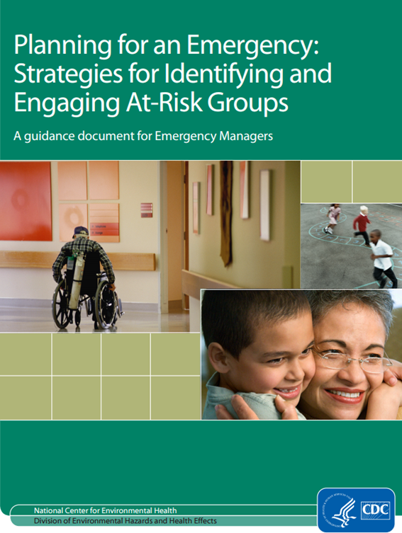
What are some ways these data can be used for public health?
Surveillance
  Identify areas with socially vulnerable populations
  Target interventions
  Evaluate progress
Descriptive Data
  Characterize health outcomes in the context of community level social determinants and vulnerability
Etiologic Data
  Assess mediating and moderating mechanisms in more complex analyses (e.g., multivariable regression models of risk ratios vs risk differences)
Facilitate Decision-Making
  Help with emergency preparedness, response, recovery, and mitigation (see guidance to the left)
  Combine the SVI with other data resources (hazard, hospital or nursing home locations) and analyze data to prioritize funding and actions
Notes:
Here are some additional ideas to consider as well. Firstly, the SVI can be used as a surveillance tool to focus interventions and identify areas that may experience more social vulnerability.
Secondly, descriptive data such as the Hurricane Katrina study can characterize health and mortality outcomes in the context of communities.
In terms of etiology, SVI can be used to assess mediating and moderating mechanisms in more complex analyses.
Lastly, the SVI can facilitate decision-making with respect to emergency preparedness and policy making in combination with other data and evidence to ultimately prioritize funding and action.
Each of these bullets and many of the responses that you all proposed as a group are included in the CDC’s Health Studies Branch’s publication “Planning for an Emergency: Strategies for Identifying and Engaging At-Risk Groups, A guidance document for Emergency Managers,” which includes a substantial section on how to use the SVI.
The guide functions as an aid to emergency managers as it describes the intersection of the population-based SVI with the local knowledge of individuals and communities provided by local public health workers.
GRASP provided SVI maps and data for various emergency responses, including hurricanes Sandy, Harvey, Irma, and Maria. A set of SVI maps are also provided in the GRASP IntroMap series used at ATSDR.
Recently, the SVI has been used in non-emergency management, including obesity in youth and for public health allocation budgets.

Slide 18
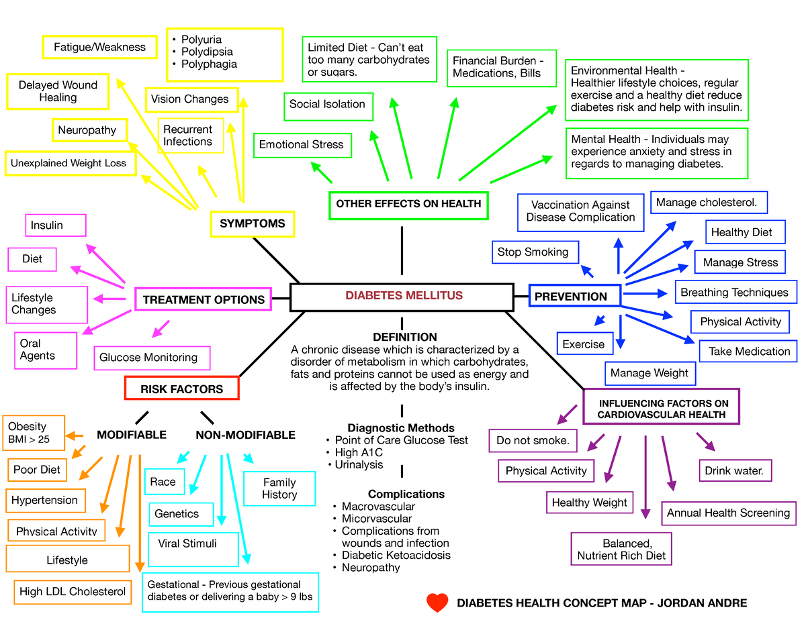
Activity: Create your own Concept Map using the SVI
Goals of Concept Mapping:
To create a graphical representation of relationships between concepts
To develop a tool for brainstorming the connections between variables, deep dive into a research questions, and to tease out complex structures
To Connect research topic to the SVI
Google Drive Link
Notes:
https://docs.google.com/presentation/d/1Uuq_IgbnrK5Q7iro3qyD9qLO8WLDg-jcsf1bF-ltflY/edit?usp=sharing
For our group activity today, we will spend the next 20 minutes creating concept maps. Concept maps, also referred to as “mind maps,” are graphical representations of concepts and the relationships between those concepts using nodes (e.g., bubbles or squares) that contain a concept or idea and edges (e.g., labeled arrows) that indicate the relationship between the nodes.
Concept maps are often compared to directed acyclic graphs, visually, but they have no rules! Thus, this is a great exercise to tease apart your variables and relationships between those variables when getting started with a deep dive into a research topic or question.
We will practice using concept maps by connecting the SVI with crude depression (or a health outcome of your group or instructor’s choice) in the United States. You all will breakout into small groups. After 20 minutes, we will come back together as a larger group and show-and-tell each of our concept maps. Please use the link provided to access your maps. You can edit this presentation to create your maps by moving boxes around and making connections with arrows. There are blank boxes that are available to you as well. Try to use at least one of the themes or the overall SVI (you can also use all of them!). Have fun!

Slide 19
References
Flanagan BE, Hallisey EJ, Adams E, Lavery A. Measuring Community Vulnerability to Natural and Anthropogenic Hazards: The Centers for Disease Control and Prevention’s Social Vulnerability Index. J Environ Health. 2018;80(10):34-36.
Agency for Toxic Substances and Disease Registry. (2018). The social vulnerability index. Retrieved from http://svi.cdc.gov
Bhuiyan MAN, Davis TC, Arnold CL, et al. Using the social vulnerability index to assess COVID-19 vaccine uptake in Louisiana. GeoJournal. 2023;88(3):3239-3248. doi:10.1007/s10708-022-10802-5
Givens M, Teal EN, Patel V, Manuck TA. Preterm birth among pregnant women living in areas with high social vulnerability. Am J Obstet Gynecol MFM. 2021;3(5):100414. doi:10.1016/j.ajogmf.2021.100414
Notes:
Here are the references for the publications that we discussed today.

Slide 20
Questions?
SVI Website: https://www.atsdr.cdc.gov/placeandhealth/svi/index.html
SVI Coordinator Email: svi_coordinator@cdc.gov
The findings and conclusions in this presentation have not been formally disseminated by the Centers for Disease Control and Prevention/Agency for Toxic Substances and Disease Registry and should not be construed to represent any agency determination or policy.
Notes:
If you would like to learn more information about the SVI or if you have any specific questions, please visit the SVI website or reach out to the team via email at svi_coordinator@cdc.gov. Thank you!

