Slide 1
Action Model
Toolkit

Slide 2
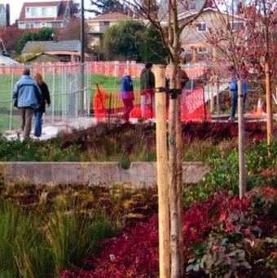
What is the Action Model?
The Agency for Toxic Substances and Disease Registry (ATSDR) created the ATSDR Brownfields/Land Revitalization Action Model as a tool to help people make changes where we live — like fixing up old buildings or cleaning up empty lots.
By teaming up with other people in
our Development Community — like neighbors, officials, developers, and community supporters — we can work together to make lasting improvements in our community.

Slide 3
What are the problems in our community?
What’s having a negative impact on the health, safety, or happiness of people in our neighborhood, town, or city? In other communities, people say things like:
  “We don’t have a park, so there’s no
  place for kids to play.”
  “The sidewalks are all broken up, so
  older people can’t walk anywhere.”
  “We have 3 abandoned buildings on my
  block, and I don’t feel safe anymore.”

Slide 4
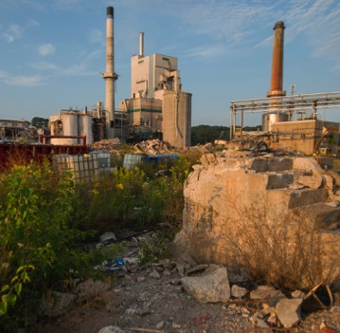
Make a difference.
Since you’re here, you probably want to do something about problems like these. You want to make real, lasting change.
The Action Model is a grassroots tool for people like us. We can use it to form a plan to improve health and quality of life, reduce risks, and boost pride in our community.

Slide 5
Improve your community.
  “We turned an abandoned lot into a
  community center and a park.”
  “We were in a food desert, so we started
  our first community garden.”
  “We rebuilt some crumbling buildings and
  brought in new businesses and jobs.”

Slide 6
The Action Model is simple.
It has 4 steps. They’re questions that we’ll ask ourselves today and answer together.
What are the issues in the community?
How can development address these issues?
What are the corresponding community health benefits?
What data are needed to measure change?

Slide 7
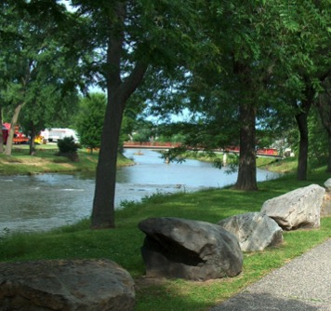
How will the Action Model help?
Health
Improving physical health (like forming walking clubs or building trails to boost physical activity) and mental health (like offering services to lower stress).
Environment
Getting rid of harmful substances
and cleaning up the air, water, and land around us.

Slide 8
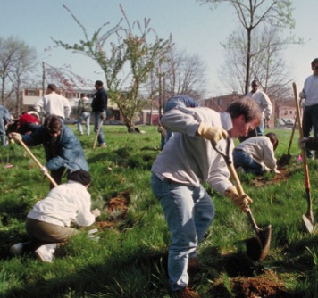
How will the Action Model help?
Education and economy
Bringing in new businesses and
building schools.
Safety and security
Preventing accidents, raising confidence, and lowering crime.
A completed Action Model can also be a powerful tool to get funding for our project. We can show groups that offer grants exactly what we want to accomplish and how.

Slide 9
Take control of redevelopment.
Sometimes, redevelopment (which can mean tearing down old buildings and putting up new ones) can have a bad effect on a neighborhood if the people who live there don’t get a say in the process.
Using the Action Model will give our community a voice in redevelopment. We can make sure any changes will really
benefit our community.

Slide 10
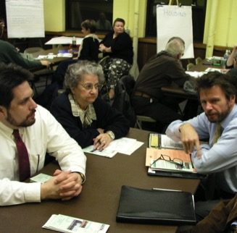
Work as a team.
Everyone in this room already knows some of the problems affecting our community. We can work together as a team — the Development Community — to create an Action Model plan that will help solve them.
Redevelopment with the Action Model is transforming neighborhoods, towns, and cities across the country. And it always starts with a few passionate, dedicated people like you.

Slide 11
Let’s take action!
Now, let’s get started.
What are the biggest problems
in our community — and how
do we want to fix them?

